Slide 2
Key takeaways from day 1
Bash Razak, Ghana EITI
Need to engage all relevant stakeholders
Strong need for political commitment
‘Reasonable’ level of details – e.g. personal address
Review legal framework: difference between legal/corporate ownership and corporate ownership
Global BO register vs. national

Slide 3
Key takeaways from day 1 (cont.)
Bash Razak, Ghana EITI
Mainstreaming – harmonisation of OGP, EITI, FATF
Validation – moving away from compliant/not compliant to discussing progress, impact and reform
Satisfactory progress = compliant, meaningful is not
Form CSO working groups
Coordination between key agencies

Slide 4
Key takeaways from day 1 (cont.)
Align roadmaps with workplan and donors
Establish workgroups with others outside the MSGs
The benefits of Bo disclosures outweigh the costs of not disclosing
Communications strategy needed to inform these different

Slide 5
Please share one of each from your writing-sessions
One thing in your roadmap you have changed
One thing in your roadmap you are proud of/would recommend others to include in their roadmaps
One action point to follow-up when you return home

Slide 6
Ghana BO Roadmap
1. One thing in the roadmap you have changed.
No change made but we consider to add other donors for Technical/Financial assistance.
2. One thing in the roadmap Ghana is proud of/would recommend others to include in their roadmaps.
Ghana established 2 parallel working groups: One at the Office of the President and the other (CSOs working group) at the NRGI which were working on the same issue but shared a lot of information. The NRGI working group included MPs who offered advice/strategies to get the necessary BO legislation passed.
3. One action point to follow-up when we return home
Ghana made significant progress in our BO roadmap but will follow-up with the implementation issues
Questions
Two working groups, why?
One was with President’s Office. To create political buy in.
Difference between working group, and advisory group
Company inclusion?
On advisory group

Slide 7
Ethiopia
Changed
Identifying the relevant agencies to engage with on SDG 17
Recommend
Engage with the anti-corruption commission; through access to information on PEPs.
One action point to follow up
Organize broad consultation with stakeholders. On 1) BO definition 2) level of detail, and 3) collection of data.
Questions
What definition? Perhaps to include other participants’ definitions

Slide 8
Malawi
One thing in your roadmap you have changed
Structural and content - from Workplan to a full Roadmap
One thing in your roadmap you are proud of/would recommend others to include in their roadmaps
Approach to the consensus building and Buy-in of the Roadmap development and implementation by stakeholders including Government Miniseries Departments and Agencies, CSOs and Corporate Entities and the Media
One action point to follow-up when you return home
Workplan development aligning with the Roadmap and finalize second draft

Slide 9
Liberia BO Roadmap
Amendments we have made to the BO Roadmap
Draw up a BO disclosure regulation in consultation with other stakeholders, which will serve as the basis for BO disclosure in Liberia.
Set up a stakeholders working group comprising LEITI and other relevant stakeholders including civil society to support the development and implementation of the road map.
Include more details of LEITI previous BO efforts and decisions into the roadmap to expand on the background.
One thing we have changed
Nothing we saw we needed to change to our current draft.
2. One thing we are proud of/would recommend to others
Civil society’s involvement and consultation at every stage of the way especially in setting the parameter for Institutional legal framework.
Follow up action point
Broader stakeholders consultation to include the LACC, relevant security agencies, etc. to complete the roadmap.

Slide 10
Mozambique BO Roadmap
Added a clear definition of the outcomes.
Use medias and SCO to promote national debate on BO.
Arrange a meeting with the Board of directores of MIREME to present the BO roadmap (draft) and its objectives. This will be with the assistance of the international secretariat or other implementing country.

Slide 11
Zambia
One thing in your roadmap you have changed
The major changes were on the Who, when and cost for the implementation of the BO.
One thing in your roadmap you are proud of/would recommend others to include in their roadmaps
We recommend that countries should consider having plans; interim and long term in areas such as data collection plans, timeliness and accessibility such as accessing data through EITI reports while setting up the mainstreaming process (interim vs. long term plan)
One action point to follow-up when you return home
BO activities to be included in the communication strategy

Slide 12
São Tomé e Príncipe
One thing in your roadmap you have changed
Disclose in short term BO information on the 2016 EITI Report and and throught public registry in long term;
One thing in your roadmap you are proud of/would recommend others to include in their roadmaps
A platform linking all the information from the related entities on the companies data and information including BO;
One action point to follow-up when you return home
To contact the relevant entities involved

Slide 13
Nigeria’s Three Main Take-aways
What has changed: some level of data only available to competent authority
What we are proud of: the value of broad stakeholder consultation, including early involvement of the media
Next action: power-interest mapping and communication strategy

Slide 14
SLEITI BO roadmap
What have we changed? More civil society participation from the beginning of the process
What are we proud of? Narrative explaining the roadmap (activities lead from it, see next slide)
What are next steps? Scoping and consultations (next week!)
(still missing: element of monitoring and evaluation)

Slide 15
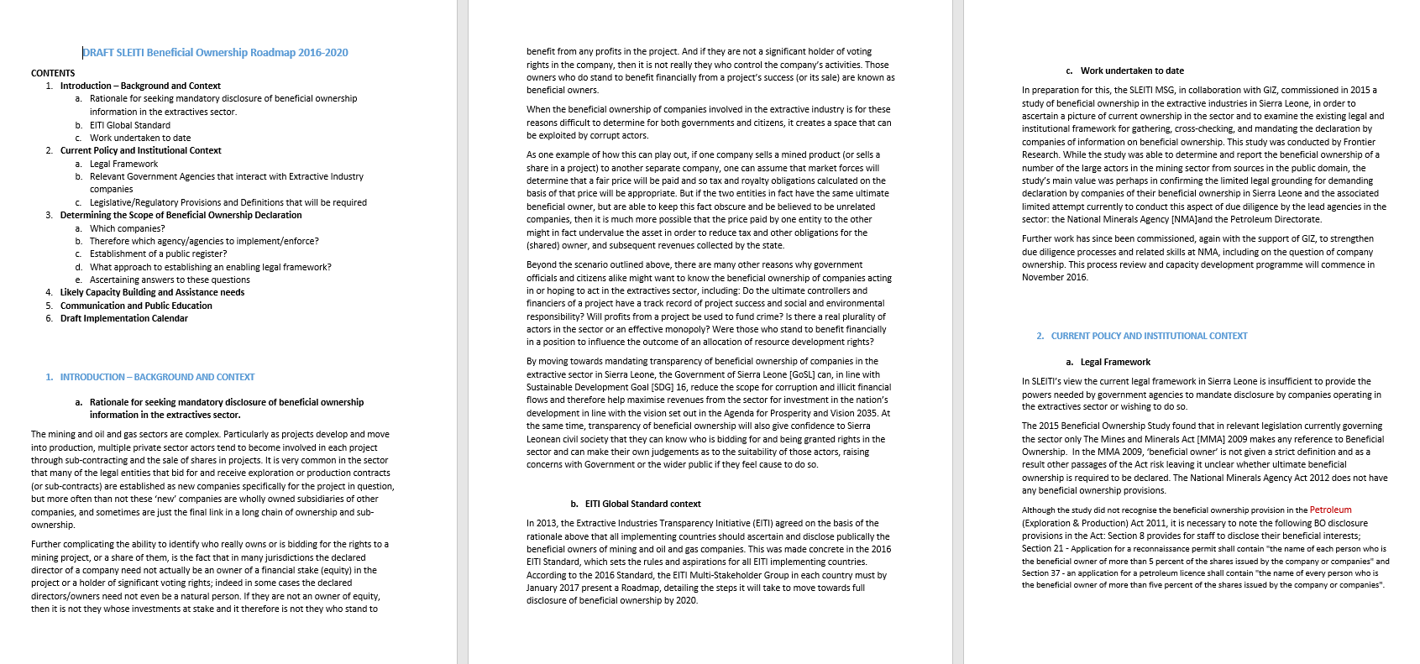
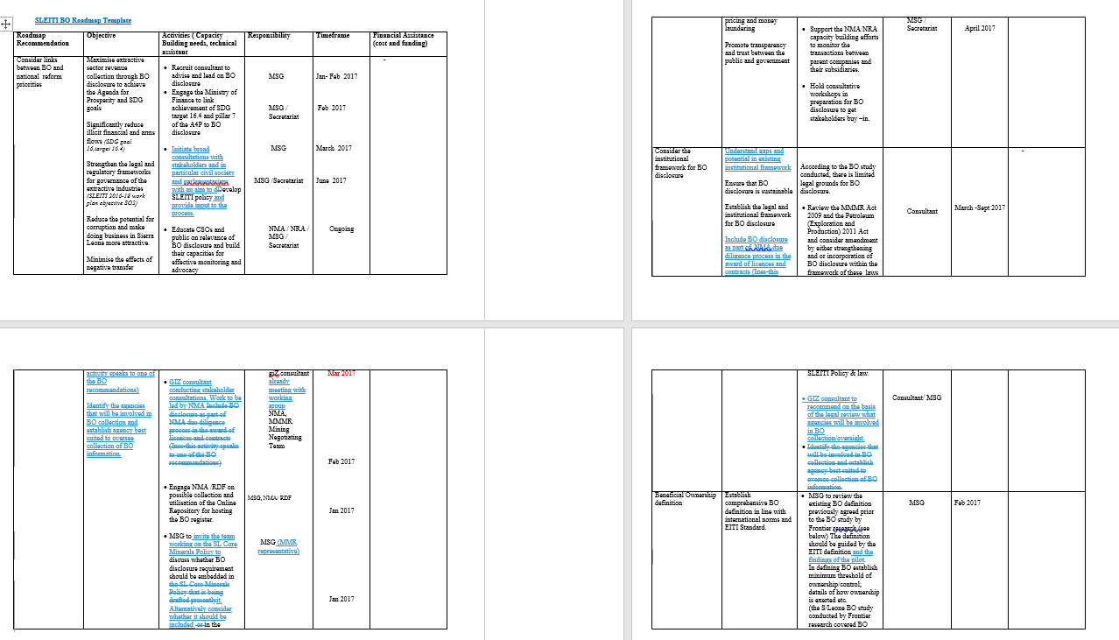
SLEITI BO roadmap

Slide 16
Conclusions / final points
After submission to EITI Int. Sec., is it available for amendments?
National Secretariats have ownerships of their own roadmaps (and other documents). So yes!

