Slide 1
EITI Anglophone and Lusophone Africa Beneficial Ownership Workshop
Exercise 2 – Peer review of draft BO roadmaps:
Data Collection and quality

Slide 2
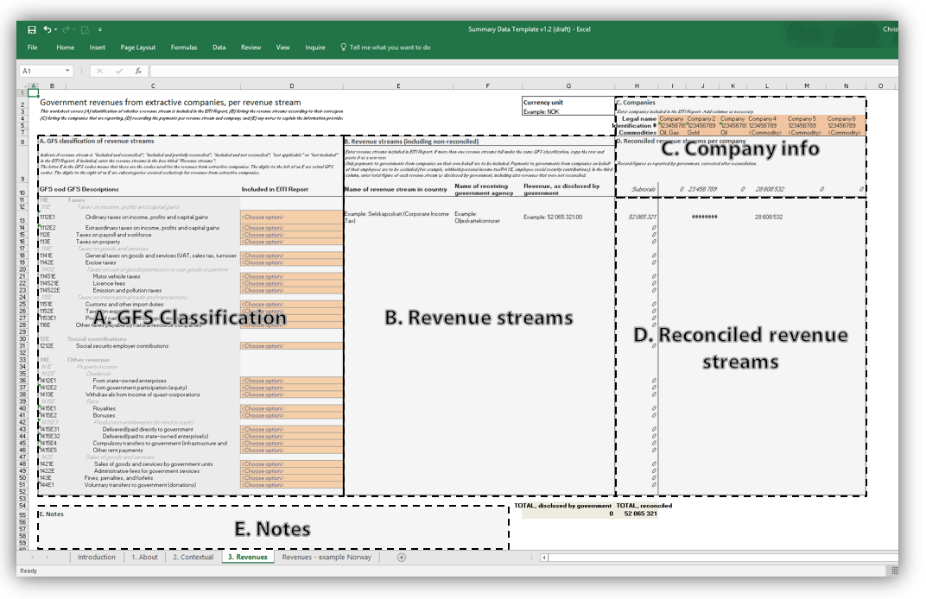
Contents
1. What is open data?
2. New 2016 EITI Standard – what’s new?
Requirement 7.1 Public debate
Open data policy
New website with data-driven content
3. Summary data template
Contents
GFS classification

Slide 3
What is open data?
Basics
Open data is data that anyone can access, use and share.
Policy
Must have a licence/statement that says it is open data. No licence, no reuse
Should be linked, for ease of access
Data standard
Is available in a standard, structured format
Guaranteed availability and consistency over time
Traceable, right back to source, allows assessment of trust

Slide 4
Why open data
Understanding
Accountability
Quality assurance
Trust

Slide 5
2016 EITI Standard – what’s new? Requirements
2013 Standard - Requirement 5.3.b
“Summary data […] should be submitted electronically to the International Secretariat […].”

Slide 6
2016 EITI Standard – what’s new? Requirements
2016 Standard - Requirement 7.1 Public debate
The multi-stakeholder group is required to:
b) Agree a clear policy on the access, release and re-use of EITI data. […]
c) Make the EITI Report available in an open data format (xlsx or csv) online and publicise its availability.
Standard TOR for Independent Administrators - section 5.4
Requires the delivery of “summary data […] electronically to the International Secretariat according to the standardised reporting format available from the International Secretariat”.

Slide 7
2016 EITI Standard – what’s new? Requirements
2016 Standard - Requirement 7.1 Public debate
The multi-stakeholder group is required to:
b) Agree a clear policy on the access, release and re-use of EITI data. […]
c) Make the EITI Report available in an open data format (xlsx or csv) online and publicise its availability.
Standard TOR for Independent Administrators - section 5.4
Requires the delivery of “summary data […] electronically to the International Secretariat according to the standardised reporting format available from the International Secretariat”.
DEADLINE 1 JANUARY 2016

Slide 8
2016 EITI Standard – what’s new? Open data policy
Recommendations on open data in implementation. Lessons from national implementation and international best practice.
Feeds into Req. 7.1 Public debate and EITI Principle 4:
“a public understanding of government revenues and expenditure over time [can] help public debate and inform choice of appropriate and realistic options for sustainable development”
“Free access to, and subsequent re-use of, open data are of significant value to society and the economy.”

Slide 9
2016 EITI Standard – what’s new? Open data policy
How do we fulfil this?

Slide 10
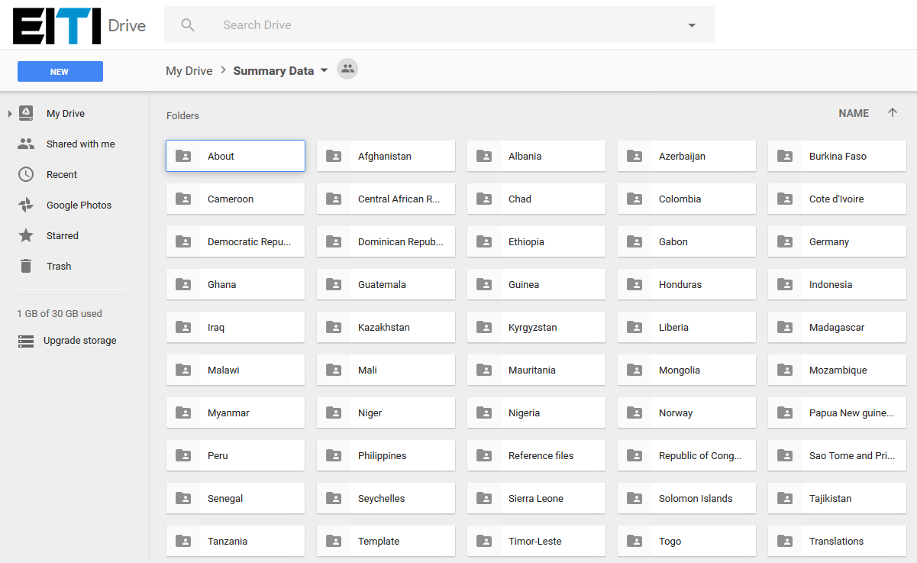
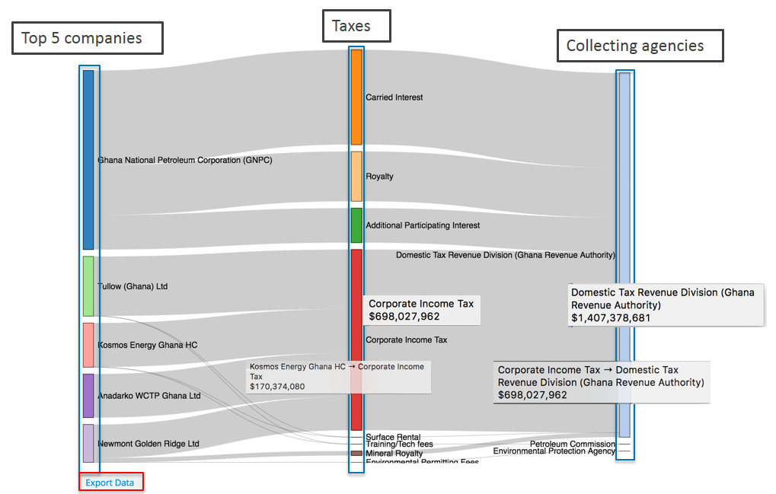
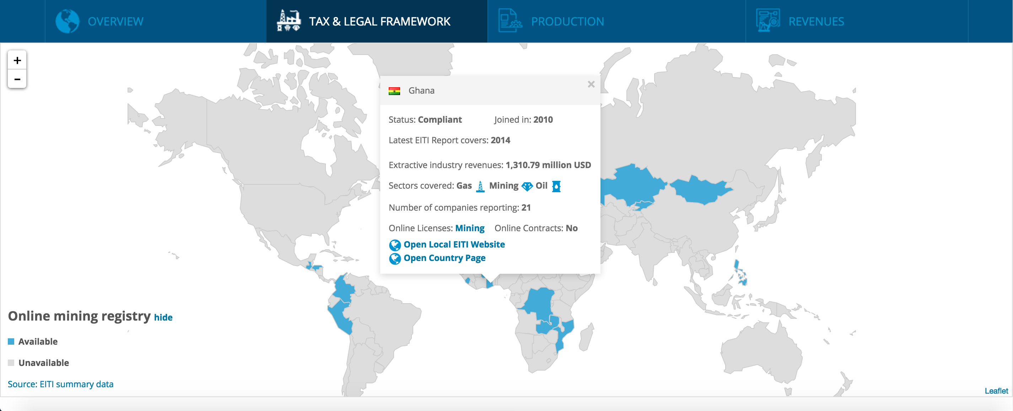
2016 EITI Standard – what’s new? Open data policy
How do we fulfil this?

Slide 11
Summary data templates
The summary data-files/reports (not templates after being filled out), feeds all visualisations on new webpages, especially country-pages
Revenues are comparable across countries and time
Intertemporal comparability (across reports) are often not real, due to inconsistency in revenues stream names
Even national nomenclature refers to different taxes in same countries – calculations / base are sometimes different

Slide 12
Summary data templates Contents
About: Information about the report
Contextual: Information about the sector in the country
+ production, exports, links, sources and aggregate numbers
Revenues: A. GFS classification
B. National nomenclature, recipients and total revenues
C. Company information
D. All reconciled receipts / payments by both company, and revenue stream

Slide 13
Summary data templates 3. Revenues

Slide 14
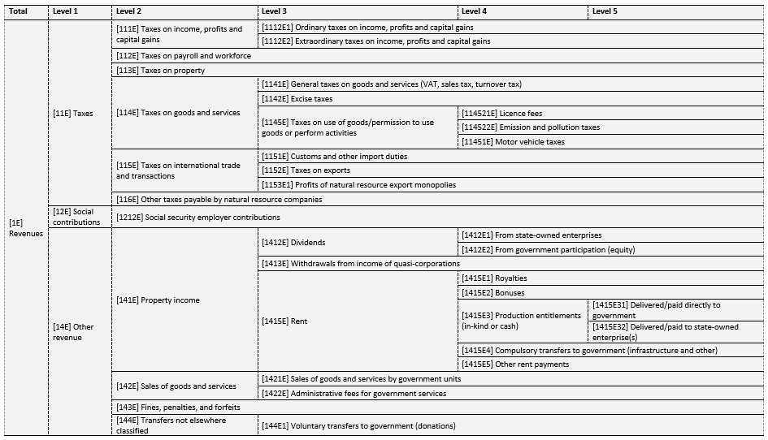
Summary data templates GFS Classification
Notes:
Point out how these are aggregated:
National revenues classified as ‘1415E31’ or ‘1415E32’
Aggregated to form 1415E3
Which, together with Royalties, bonuses and other form the aggregate of ‘Rent’
Rent, together with Dividends and Withdrawals from income of quasi-fiscal entities form Property income
Property income et al. is part of Other revenue, forming lastly total Revenues

Slide 15
Summary data templates GFS Classification
Notes:
Point out how these are aggregated:
National revenues classified as ‘1415E31’ or ‘1415E32’
Aggregated to form 1415E3
Which, together with Royalties, bonuses and other form the aggregate of ‘Rent’
Rent, together with Dividends and Withdrawals from income of quasi-fiscal entities form Property income
Property income et al. is part of Other revenue, forming lastly total Revenues

Slide 16
Main GFS categories
Revenues (1E)
Taxes (11E)
Social contributions (12E)
Other revenues (14E)
Notes:
These are most relevant as they cover the bulk of revenues, with the exception of social security employer contributions

Slide 17
Parent categories
Taxes (11E)
Taxes on income, profits and capital gains (111E)
Taxes on payroll and workforce (112E)
Taxes on goods and services (114E)
Taxes on property (113E)
Taxes on international trade and transactions (115E)
Other taxes (116E)
Taxes (11E) (broad interpretation):
Government income from its redistributive functions, through mandatory transfers of other units’ profitable activities.

Slide 18
Parent categories
Other revenues (14E)
Property income (141E)
Sales of goods and services (142E)
Transfers not elsewhere classified (144E)
Fines, penalties, and forfeits (143E)
Other revenues (14E) :
Government income from ownership, through quasi-corporate functions, or through services. This means governments participates in actual value-creation and earning revenues through such activities.

Slide 19
Revenues by classification Norway, 2009-2013
Notes:
Licensees gain ownership fields, but in most cases the government retains a share of ownership and partakes in investments and costs.
Taxes
Corporate taxes and sector-specific combined
Area fees, NOx and CO₂ taxes
Other revenues
Dividends from majority share in Statoil
Petoro transfers from State’s Direct Financial Interest (SDFI) to SWF
Taxation of oil companies equal to approximately USD 218.75 billion, compared to USD 136.78 billion from quasi corporations. This means that Norway does indeed rely a lot on the private sector in terms of operations and exploration, but also acquires an income-base unrelated to private companies’ costs through its shares in ownership. This model also ensures a lower risk for companies in Norwegian petroleum fields and a lower burden on the Norwegian government in performing state-driven exploration and other investments.

Slide 20
Revenues by classification Nigeria, 2009-2013
Notes:
Several JVs and PSCs, managed by NNPC natural resource sector, and sector-specific taxes. Reported on 26 revenue streams (2013)
Main taxes
Petroleum Profit Tax Act:
> 5 years: 67.5% tax on profits
5+ years: 85% tax on profits
Main other revenues
JVs – previously with major IOCs, now more indigenous companies
Production sharing contracts
The taxes accumulate to USD 69.20 billion for the time-period, and account for 26.4% of Nigeria’s total revenues from oil and gas activities (see figure 5).
Most of the income under Other revenue (14E) come from rents (1415E). Rents account for approximately USD 172.63 billion, or 65.9% of total revenues for the period and is part of Property income (141E).

Slide 21
Revenues by classification Nigeria, 2009-2013
Notes:
Several JVs and PSCs, managed by NNPC natural resource sector, and sector-specific taxes. Reported on 26 revenue streams (2013)
Main taxes
Petroleum Profit Tax Act:
> 5 years: 67.5% tax on profits
5+ years: 85% tax on profits
Main other revenues
JVs – previously with major IOCs, now more indigenous companies
Production sharing contracts
The taxes accumulate to USD 69.20 billion for the time-period, and account for 26.4% of Nigeria’s total revenues from oil and gas activities (see figure 5).
Most of the income under Other revenue (14E) come from rents (1415E). Rents account for approximately USD 172.63 billion, or 65.9% of total revenues for the period and is part of Property income (141E).

Slide 22
Open data definitions and policies
EITI International: https://eiti.org/standard/open-data-policy
Open Government Partnership’s declaration: http://www.opengovpartnership.org/about/open-government-declaration
G8 Open data charter: https://www.gov.uk/government/publications/open-data-charter/g8-open-data-charter-and-technical-annex
The Open Data Charter: http://opendatacharter.net/
Open data definition: http://opendefinition.org/
Notes:
Point out how these are aggregated:
National revenues classified as ‘1415E31’ or ‘1415E32’
Aggregated to form 1415E3
Which, together with Royalties, bonuses and other form the aggregate of ‘Rent’
Rent, together with Dividends and Withdrawals from income of quasi-fiscal entities form Property income
Property income et al. is part of Other revenue, forming lastly total Revenues

Slide 23
Examples of open data …
World Bank report on open data standards
https://eiti.org/node/7340
In countries
Azerbaijan: http://azeitireport.org/
DRC: https://www.mapx.online/app/w3/
Ghana (NRGI): http://data.gheiti.gov.gh/#home
Norway: http://www.norskpetroleum.no/en/
US: https://useiti.doi.gov/explore/
Notes:
Point out how these are aggregated:
National revenues classified as ‘1415E31’ or ‘1415E32’
Aggregated to form 1415E3
Which, together with Royalties, bonuses and other form the aggregate of ‘Rent’
Rent, together with Dividends and Withdrawals from income of quasi-fiscal entities form Property income
Property income et al. is part of Other revenue, forming lastly total Revenues

Slide 24
Thank you!
www.eiti.org
@EITIorg
Email: secretariat@eiti.org - Telephone: +47 22 20 08 00
Address: EITI International Secretariat, Ruseløkkveien 26, 0251 Oslo, Norway

