Slide 1
Creating open data policies
1 December 2016
Open data policy webinar
EITI International Secretariat

Slide 2
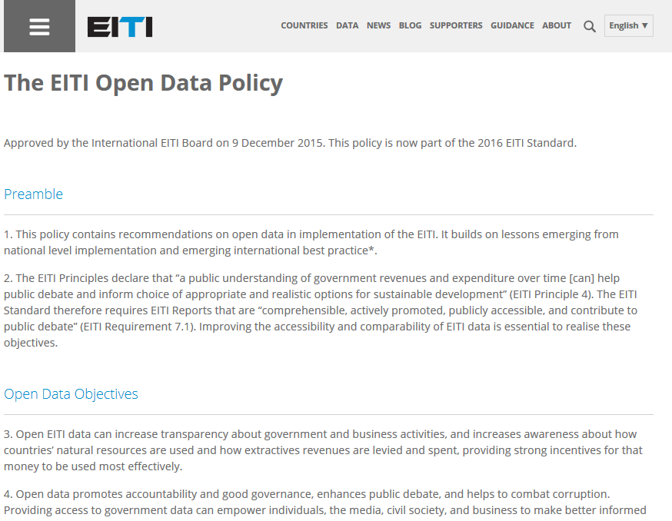
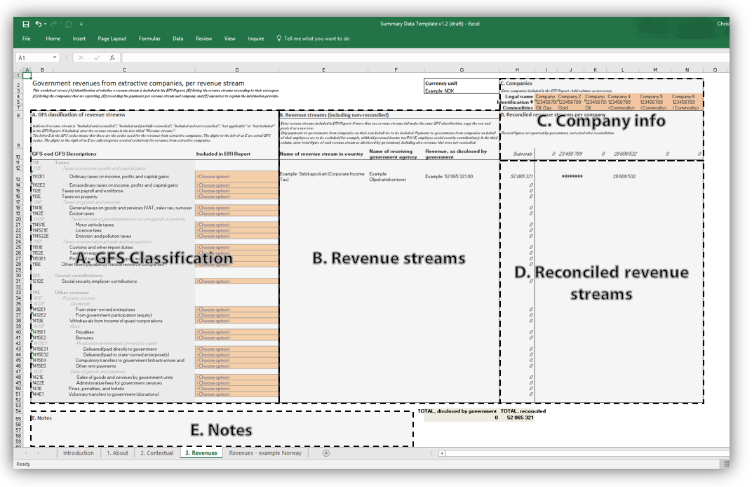
Contents
Developing an open data policy
Requirement 7.1
Access, release and re-use
Five useful steps
Examples
Policies
Open data solutions
QA and next steps

Slide 3
2016 EITI Standard – what’s new? Requirements
2013 Standard - Requirement 5.3.b
“Summary data […] should be submitted electronically to the International Secretariat […].”

Slide 4
2016 EITI Standard – what’s new? Requirements
2016 Standard - Requirement 7.1 Public debate
The multi-stakeholder group is required to:
b) Agree a clear policy on the access, release and re-use of EITI data. […]
c) Make the EITI Report available in an open data format (excel or csv) online and publicise its availability.
https://eiti.org/node/4922#r7-1
Standard TOR for Independent Administrators - section 5.4
Requires the delivery of “summary data […] electronically to the International Secretariat according to the standardised reporting format available from the International Secretariat”.

Slide 5
2016 EITI Standard – what’s new? Requirements
2016 Standard - Requirement 7.1 Public debate
The multi-stakeholder group is required to:
b) Agree a clear policy on the access, release and re-use of EITI data. […]
c) Make the EITI Report available in an open data format (excel or csv) online and publicise its availability.
https://eiti.org/node/4922#r7-1
Standard TOR for Independent Administrators - section 5.4
Requires the delivery of “summary data […] electronically to the International Secretariat according to the standardised reporting format available from the International Secretariat”.
DEADLINE 1 JANUARY 2017

Slide 6
What is open data?
Definition
“[…] digital data that is made available with the technical and legal characteristics necessary for it to be freely used, reused, and redistributed by anyone, anytime, anywhere.”
- http://opendatacharter.net/principles/

Slide 7
Access Key points for access
Decide on effective way of enabling access to data based on profile, resources and technology available to potential users.
Identify the potential users of open data
with user stories:
Who (user role)
What (goal/desire)
Why (benefit)
gives clarity as to why a product is useful
can influence how a product should function
can give you ideas for other useful features that support the user's goals
Notes:
Step 1 – Review the accessibility of EITI data (with reference to requirement 7.2). Essentially, take stock of the current situation regarding the access, release and re-use of EITI data. These would have two aspects: (1) assessing whether the data from EITI Reports is accessible, (2) taking stock of wider efforts to promote routine automated online disclosure (a mini mainstreaming feasibility study).
Step 2 – Review national policies and international best practice on open data. This helps to ensure that the MSG’s work is aligned with other national efforts (e.g., OGP and similar efforts), and emerging best practice. This should address the question of data standards.
Step 3 – Consider options for the policy on access, release and re-use of EITI data. Here, we should highlight international best practice. (Perhaps a box on the US-EITI efforts to consider the data needs of different user groups).
Step 4 – Document the MSG’s policy on access, release and re-use of EITI data, and agree any actions to be included in the workplan to address these issues. Suggest we provide a list of possible actions, including:
Addressing open data issues in the Independent Administrator’s Terms of Reference.
Tasking the Independent Administrator to produce excel files, and with compiling the Summary Data Templates
Clarifying the policy on open data in forthcoming EITI Reports.
Publishing excel files on the EITI website.
Efforts to increase open data literacy
Commission feasibility studies and/or recommend reforms to promote routine automated online disclosure by companies and government agencies.
Step 5 – Evaluation. Provide an update on theses effort in annual activity reports.

Slide 8
Access Key points for access
Decide on effective way of enabling access to data based on profile, resources and technology available to potential users.
Identify the potential users of open data
with user stories:
Who (user role)
What (goal/desire)
Why (benefit)
gives clarity as to why a product is useful
can influence how a product should function
can give you ideas for other useful features that support the user's goals
Notes:
Step 1 – Review the accessibility of EITI data (with reference to requirement 7.2). Essentially, take stock of the current situation regarding the access, release and re-use of EITI data. These would have two aspects: (1) assessing whether the data from EITI Reports is accessible, (2) taking stock of wider efforts to promote routine automated online disclosure (a mini mainstreaming feasibility study).
Step 2 – Review national policies and international best practice on open data. This helps to ensure that the MSG’s work is aligned with other national efforts (e.g., OGP and similar efforts), and emerging best practice. This should address the question of data standards.
Step 3 – Consider options for the policy on access, release and re-use of EITI data. Here, we should highlight international best practice. (Perhaps a box on the US-EITI efforts to consider the data needs of different user groups).
Step 4 – Document the MSG’s policy on access, release and re-use of EITI data, and agree any actions to be included in the workplan to address these issues. Suggest we provide a list of possible actions, including:
Addressing open data issues in the Independent Administrator’s Terms of Reference.
Tasking the Independent Administrator to produce excel files, and with compiling the Summary Data Templates
Clarifying the policy on open data in forthcoming EITI Reports.
Publishing excel files on the EITI website.
Efforts to increase open data literacy
Commission feasibility studies and/or recommend reforms to promote routine automated online disclosure by companies and government agencies.
Step 5 – Evaluation. Provide an update on theses effort in annual activity reports.

Slide 9
Access Key points for access
Decide on effective way of enabling access to data based on profile, resources and technology available to potential users.
Identify the potential users of open data
with user stories:
Who (user role)
What (goal/desire)
Why (benefit)
gives clarity as to why a product is useful
can influence how a product should function
can give you ideas for other useful features that support the user's goals
As a civil servant in the ministry of mines,
I am interested in revenue data from mining activities,
To present options for a license agreement to my minister.
Notes:
Step 1 – Review the accessibility of EITI data (with reference to requirement 7.2). Essentially, take stock of the current situation regarding the access, release and re-use of EITI data. These would have two aspects: (1) assessing whether the data from EITI Reports is accessible, (2) taking stock of wider efforts to promote routine automated online disclosure (a mini mainstreaming feasibility study).
Step 2 – Review national policies and international best practice on open data. This helps to ensure that the MSG’s work is aligned with other national efforts (e.g., OGP and similar efforts), and emerging best practice. This should address the question of data standards.
Step 3 – Consider options for the policy on access, release and re-use of EITI data. Here, we should highlight international best practice. (Perhaps a box on the US-EITI efforts to consider the data needs of different user groups).
Step 4 – Document the MSG’s policy on access, release and re-use of EITI data, and agree any actions to be included in the workplan to address these issues. Suggest we provide a list of possible actions, including:
Addressing open data issues in the Independent Administrator’s Terms of Reference.
Tasking the Independent Administrator to produce excel files, and with compiling the Summary Data Templates
Clarifying the policy on open data in forthcoming EITI Reports.
Publishing excel files on the EITI website.
Efforts to increase open data literacy
Commission feasibility studies and/or recommend reforms to promote routine automated online disclosure by companies and government agencies.
Step 5 – Evaluation. Provide an update on theses effort in annual activity reports.

Slide 10
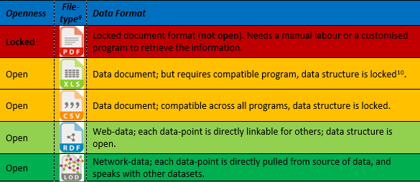
Release Three key points for Release
Appropriate procedures for the release of data:
regularity of release
timeliness
methods of release – platforms and formats (which website, link/reference to source, format)
Notes:
Step 1 – Review the accessibility of EITI data (with reference to requirement 7.2). Essentially, take stock of the current situation regarding the access, release and re-use of EITI data. These would have two aspects: (1) assessing whether the data from EITI Reports is accessible, (2) taking stock of wider efforts to promote routine automated online disclosure (a mini mainstreaming feasibility study).
Step 2 – Review national policies and international best practice on open data. This helps to ensure that the MSG’s work is aligned with other national efforts (e.g., OGP and similar efforts), and emerging best practice. This should address the question of data standards.
Step 3 – Consider options for the policy on access, release and re-use of EITI data. Here, we should highlight international best practice. (Perhaps a box on the US-EITI efforts to consider the data needs of different user groups).
Step 4 – Document the MSG’s policy on access, release and re-use of EITI data, and agree any actions to be included in the workplan to address these issues. Suggest we provide a list of possible actions, including:
Addressing open data issues in the Independent Administrator’s Terms of Reference.
Tasking the Independent Administrator to produce excel files, and with compiling the Summary Data Templates
Clarifying the policy on open data in forthcoming EITI Reports.
Publishing excel files on the EITI website.
Efforts to increase open data literacy
Commission feasibility studies and/or recommend reforms to promote routine automated online disclosure by companies and government agencies.
Step 5 – Evaluation. Provide an update on theses effort in annual activity reports.

Slide 11
Release Three key points for Release
Appropriate procedures for the release of data:
regularity of release
timeliness
methods of release – platforms and formats (which website, link/reference to source, format)
Notes:
Step 1 – Review the accessibility of EITI data (with reference to requirement 7.2). Essentially, take stock of the current situation regarding the access, release and re-use of EITI data. These would have two aspects: (1) assessing whether the data from EITI Reports is accessible, (2) taking stock of wider efforts to promote routine automated online disclosure (a mini mainstreaming feasibility study).
Step 2 – Review national policies and international best practice on open data. This helps to ensure that the MSG’s work is aligned with other national efforts (e.g., OGP and similar efforts), and emerging best practice. This should address the question of data standards.
Step 3 – Consider options for the policy on access, release and re-use of EITI data. Here, we should highlight international best practice. (Perhaps a box on the US-EITI efforts to consider the data needs of different user groups).
Step 4 – Document the MSG’s policy on access, release and re-use of EITI data, and agree any actions to be included in the workplan to address these issues. Suggest we provide a list of possible actions, including:
Addressing open data issues in the Independent Administrator’s Terms of Reference.
Tasking the Independent Administrator to produce excel files, and with compiling the Summary Data Templates
Clarifying the policy on open data in forthcoming EITI Reports.
Publishing excel files on the EITI website.
Efforts to increase open data literacy
Commission feasibility studies and/or recommend reforms to promote routine automated online disclosure by companies and government agencies.
Step 5 – Evaluation. Provide an update on theses effort in annual activity reports.

Slide 12
Re-use Three key point for re-use
Include declarations on the free use and re-use of data without legal or administrative restrictions. The examples below allow users to:
Copy and distribute
Produce new works using the data
Modify, adapt, and build upon the data
Table 2: Open licenses
Sharing-level of Licence | Creative Commons License | Open Data Commons License
Public Domain | CC0 | PDDL
Attribution | CC-by | ODC-by
Attribution & Share-Alike | CC-by-sa | ODbL
Notes:
Step 1 – Review the accessibility of EITI data (with reference to requirement 7.2). Essentially, take stock of the current situation regarding the access, release and re-use of EITI data. These would have two aspects: (1) assessing whether the data from EITI Reports is accessible, (2) taking stock of wider efforts to promote routine automated online disclosure (a mini mainstreaming feasibility study).
Step 2 – Review national policies and international best practice on open data. This helps to ensure that the MSG’s work is aligned with other national efforts (e.g., OGP and similar efforts), and emerging best practice. This should address the question of data standards.
Step 3 – Consider options for the policy on access, release and re-use of EITI data. Here, we should highlight international best practice. (Perhaps a box on the US-EITI efforts to consider the data needs of different user groups).
Step 4 – Document the MSG’s policy on access, release and re-use of EITI data, and agree any actions to be included in the workplan to address these issues. Suggest we provide a list of possible actions, including:
Addressing open data issues in the Independent Administrator’s Terms of Reference.
Tasking the Independent Administrator to produce excel files, and with compiling the Summary Data Templates
Clarifying the policy on open data in forthcoming EITI Reports.
Publishing excel files on the EITI website.
Efforts to increase open data literacy
Commission feasibility studies and/or recommend reforms to promote routine automated online disclosure by companies and government agencies.
Step 5 – Evaluation. Provide an update on theses effort in annual activity reports.

Slide 13
Re-use Three key point for re-use
Include declarations on the free use and re-use of data without legal or administrative restrictions. The examples below allow users to:
Copy and distribute
Produce new works using the data
Modify, adapt, and build upon the data
Table 2: Open licenses
Sharing-level of Licence | Creative Commons License | Open Data Commons License
Public Domain | CC0 | PDDL
Attribution | CC-by | ODC-by
Attribution & Share-Alike | CC-by-sa | ODbL
Notes:
Step 1 – Review the accessibility of EITI data (with reference to requirement 7.2). Essentially, take stock of the current situation regarding the access, release and re-use of EITI data. These would have two aspects: (1) assessing whether the data from EITI Reports is accessible, (2) taking stock of wider efforts to promote routine automated online disclosure (a mini mainstreaming feasibility study).
Step 2 – Review national policies and international best practice on open data. This helps to ensure that the MSG’s work is aligned with other national efforts (e.g., OGP and similar efforts), and emerging best practice. This should address the question of data standards.
Step 3 – Consider options for the policy on access, release and re-use of EITI data. Here, we should highlight international best practice. (Perhaps a box on the US-EITI efforts to consider the data needs of different user groups).
Step 4 – Document the MSG’s policy on access, release and re-use of EITI data, and agree any actions to be included in the workplan to address these issues. Suggest we provide a list of possible actions, including:
Addressing open data issues in the Independent Administrator’s Terms of Reference.
Tasking the Independent Administrator to produce excel files, and with compiling the Summary Data Templates
Clarifying the policy on open data in forthcoming EITI Reports.
Publishing excel files on the EITI website.
Efforts to increase open data literacy
Commission feasibility studies and/or recommend reforms to promote routine automated online disclosure by companies and government agencies.
Step 5 – Evaluation. Provide an update on theses effort in annual activity reports.

Slide 14
Re-use Three key point for re-use
Include declarations on the free use and re-use of data without legal or administrative restrictions. The examples below allow users to:
Copy and distribute
Produce new works using the data
Modify, adapt, and build upon the data
+ attribution (naming source)
Table 2: Open licenses
Sharing-level of Licence | Creative Commons License | Open Data Commons License
Public Domain | CC0 | PDDL
Attribution | CC-by | ODC-by
Attribution & Share-Alike | CC-by-sa | ODbL
Notes:
Step 1 – Review the accessibility of EITI data (with reference to requirement 7.2). Essentially, take stock of the current situation regarding the access, release and re-use of EITI data. These would have two aspects: (1) assessing whether the data from EITI Reports is accessible, (2) taking stock of wider efforts to promote routine automated online disclosure (a mini mainstreaming feasibility study).
Step 2 – Review national policies and international best practice on open data. This helps to ensure that the MSG’s work is aligned with other national efforts (e.g., OGP and similar efforts), and emerging best practice. This should address the question of data standards.
Step 3 – Consider options for the policy on access, release and re-use of EITI data. Here, we should highlight international best practice. (Perhaps a box on the US-EITI efforts to consider the data needs of different user groups).
Step 4 – Document the MSG’s policy on access, release and re-use of EITI data, and agree any actions to be included in the workplan to address these issues. Suggest we provide a list of possible actions, including:
Addressing open data issues in the Independent Administrator’s Terms of Reference.
Tasking the Independent Administrator to produce excel files, and with compiling the Summary Data Templates
Clarifying the policy on open data in forthcoming EITI Reports.
Publishing excel files on the EITI website.
Efforts to increase open data literacy
Commission feasibility studies and/or recommend reforms to promote routine automated online disclosure by companies and government agencies.
Step 5 – Evaluation. Provide an update on theses effort in annual activity reports.

Slide 15
Re-use Three key point for re-use
Include declarations on the free use and re-use of data without legal or administrative restrictions. The examples below allow users to:
Copy and distribute
Produce new works using the data
Modify, adapt, and build upon the data
+ attribution (naming source)
Table 2: Open licenses
Sharing-level of Licence | Creative Commons License | Open Data Commons License
Public Domain | CC0 | PDDL
Attribution | CC-by | ODC-by
Attribution & Share-Alike | CC-by-sa | ODbL
+ re-publication must use same license!
Notes:
Step 1 – Review the accessibility of EITI data (with reference to requirement 7.2). Essentially, take stock of the current situation regarding the access, release and re-use of EITI data. These would have two aspects: (1) assessing whether the data from EITI Reports is accessible, (2) taking stock of wider efforts to promote routine automated online disclosure (a mini mainstreaming feasibility study).
Step 2 – Review national policies and international best practice on open data. This helps to ensure that the MSG’s work is aligned with other national efforts (e.g., OGP and similar efforts), and emerging best practice. This should address the question of data standards.
Step 3 – Consider options for the policy on access, release and re-use of EITI data. Here, we should highlight international best practice. (Perhaps a box on the US-EITI efforts to consider the data needs of different user groups).
Step 4 – Document the MSG’s policy on access, release and re-use of EITI data, and agree any actions to be included in the workplan to address these issues. Suggest we provide a list of possible actions, including:
Addressing open data issues in the Independent Administrator’s Terms of Reference.
Tasking the Independent Administrator to produce excel files, and with compiling the Summary Data Templates
Clarifying the policy on open data in forthcoming EITI Reports.
Publishing excel files on the EITI website.
Efforts to increase open data literacy
Commission feasibility studies and/or recommend reforms to promote routine automated online disclosure by companies and government agencies.
Step 5 – Evaluation. Provide an update on theses effort in annual activity reports.

Slide 16
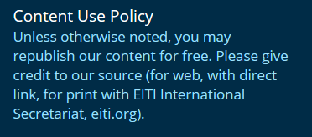
Re-use Three key point for re-use
EITI’s Content Use Policy – custom license
Notes:
Step 1 – Review the accessibility of EITI data (with reference to requirement 7.2). Essentially, take stock of the current situation regarding the access, release and re-use of EITI data. These would have two aspects: (1) assessing whether the data from EITI Reports is accessible, (2) taking stock of wider efforts to promote routine automated online disclosure (a mini mainstreaming feasibility study).
Step 2 – Review national policies and international best practice on open data. This helps to ensure that the MSG’s work is aligned with other national efforts (e.g., OGP and similar efforts), and emerging best practice. This should address the question of data standards.
Step 3 – Consider options for the policy on access, release and re-use of EITI data. Here, we should highlight international best practice. (Perhaps a box on the US-EITI efforts to consider the data needs of different user groups).
Step 4 – Document the MSG’s policy on access, release and re-use of EITI data, and agree any actions to be included in the workplan to address these issues. Suggest we provide a list of possible actions, including:
Addressing open data issues in the Independent Administrator’s Terms of Reference.
Tasking the Independent Administrator to produce excel files, and with compiling the Summary Data Templates
Clarifying the policy on open data in forthcoming EITI Reports.
Publishing excel files on the EITI website.
Efforts to increase open data literacy
Commission feasibility studies and/or recommend reforms to promote routine automated online disclosure by companies and government agencies.
Step 5 – Evaluation. Provide an update on theses effort in annual activity reports.

Slide 17
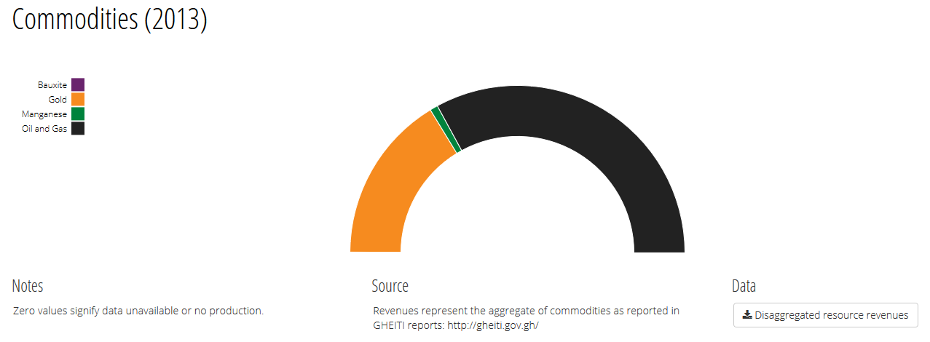
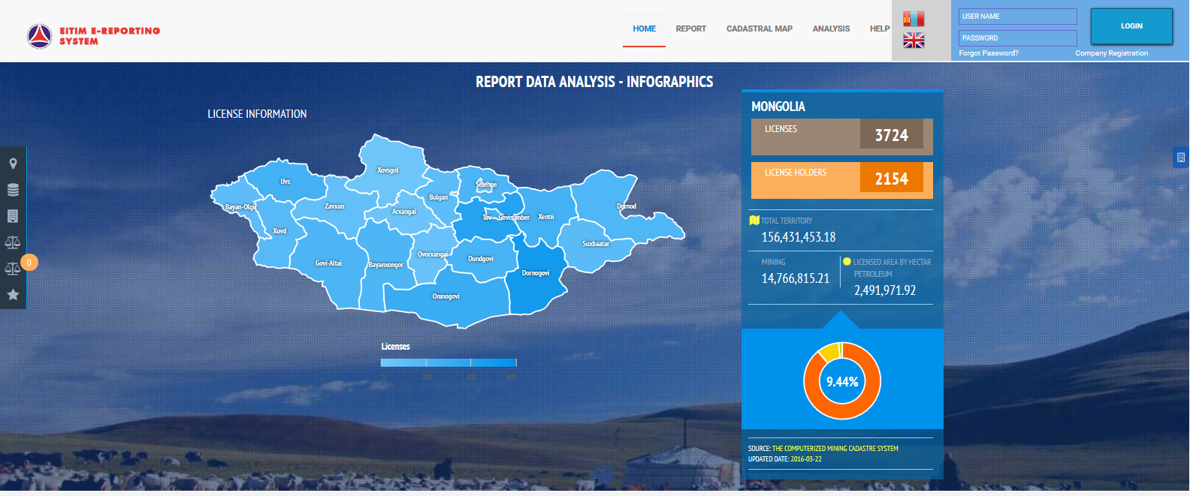
Five useful steps
Step 1: Review the accessibility of EITI data (req 7.2)
Is data from EITI Reports accessible? I.e. online in an open data format?
Taking stock of wider efforts of automated online disclosure
http://data.gheiti.gov.gh/#home
http://e-reporting.eitimongolia.mn/
Notes:
Step 1 – Review the accessibility of EITI data (with reference to requirement 7.2). Essentially, take stock of the current situation regarding the access, release and re-use of EITI data. These would have two aspects: (1) assessing whether the data from EITI Reports is accessible, (2) taking stock of wider efforts to promote routine automated online disclosure (a mini mainstreaming feasibility study).
Step 2 – Review national policies and international best practice on open data. This helps to ensure that the MSG’s work is aligned with other national efforts (e.g., OGP and similar efforts), and emerging best practice. This should address the question of data standards.
Step 3 – Consider options for the policy on access, release and re-use of EITI data. Here, we should highlight international best practice. (Perhaps a box on the US-EITI efforts to consider the data needs of different user groups).
Step 4 – Document the MSG’s policy on access, release and re-use of EITI data, and agree any actions to be included in the workplan to address these issues. Suggest we provide a list of possible actions, including:
Addressing open data issues in the Independent Administrator’s Terms of Reference.
Tasking the Independent Administrator to produce excel files, and with compiling the Summary Data Templates
Clarifying the policy on open data in forthcoming EITI Reports.
Publishing excel files on the EITI website.
Efforts to increase open data literacy
Commission feasibility studies and/or recommend reforms to promote routine automated online disclosure by companies and government agencies.
Step 5 – Evaluation. Provide an update on theses effort in annual activity reports.

Slide 18
Five useful steps
Step 2: Review national policies and int. best practices
Ensure alignment with other national efforts (e.g. OGP etc.), and emerging best practice. This should address the question of data standards
Notes:
Step 1 – Review the accessibility of EITI data (with reference to requirement 7.2). Essentially, take stock of the current situation regarding the access, release and re-use of EITI data. These would have two aspects: (1) assessing whether the data from EITI Reports is accessible, (2) taking stock of wider efforts to promote routine automated online disclosure (a mini mainstreaming feasibility study).
Step 2 – Review national policies and international best practice on open data. This helps to ensure that the MSG’s work is aligned with other national efforts (e.g., OGP and similar efforts), and emerging best practice. This should address the question of data standards.
Step 3 – Consider options for the policy on access, release and re-use of EITI data. Here, we should highlight international best practice. (Perhaps a box on the US-EITI efforts to consider the data needs of different user groups).
Step 4 – Document the MSG’s policy on access, release and re-use of EITI data, and agree any actions to be included in the workplan to address these issues. Suggest we provide a list of possible actions, including:
Addressing open data issues in the Independent Administrator’s Terms of Reference.
Tasking the Independent Administrator to produce excel files, and with compiling the Summary Data Templates
Clarifying the policy on open data in forthcoming EITI Reports.
Publishing excel files on the EITI website.
Efforts to increase open data literacy
Commission feasibility studies and/or recommend reforms to promote routine automated online disclosure by companies and government agencies.
Step 5 – Evaluation. Provide an update on theses effort in annual activity reports.

Slide 19
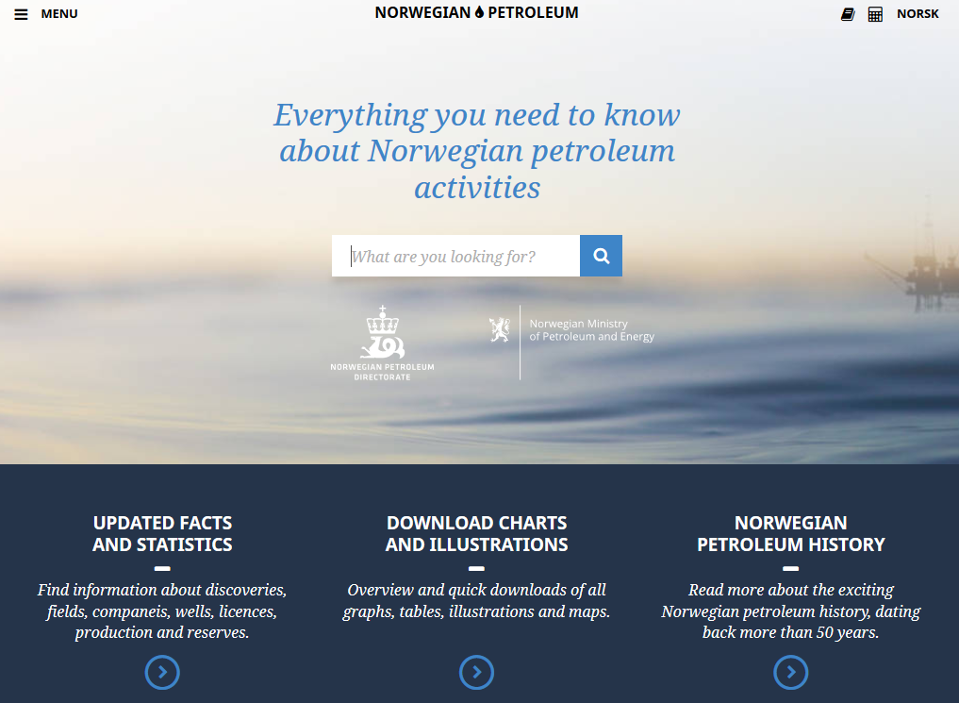
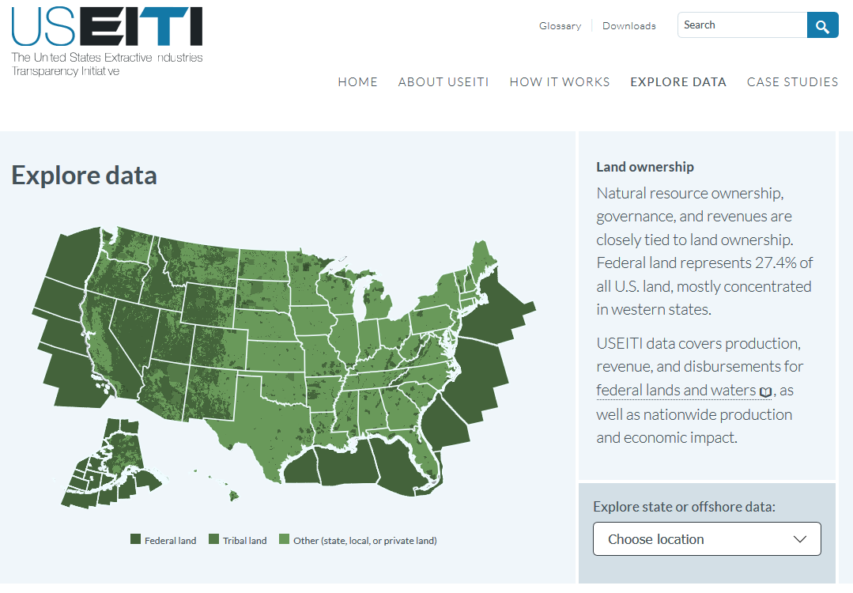
Five useful steps
Step 3: Consider options for access, release and re-use of data
Open data: Ghana, Norway, United States
Notes:
Step 1 – Review the accessibility of EITI data (with reference to requirement 7.2). Essentially, take stock of the current situation regarding the access, release and re-use of EITI data. These would have two aspects: (1) assessing whether the data from EITI Reports is accessible, (2) taking stock of wider efforts to promote routine automated online disclosure (a mini mainstreaming feasibility study).
Step 2 – Review national policies and international best practice on open data. This helps to ensure that the MSG’s work is aligned with other national efforts (e.g., OGP and similar efforts), and emerging best practice. This should address the question of data standards.
Step 3 – Consider options for the policy on access, release and re-use of EITI data. Here, we should highlight international best practice. (Perhaps a box on the US-EITI efforts to consider the data needs of different user groups).
Step 4 – Document the MSG’s policy on access, release and re-use of EITI data, and agree any actions to be included in the workplan to address these issues. Suggest we provide a list of possible actions, including:
Addressing open data issues in the Independent Administrator’s Terms of Reference.
Tasking the Independent Administrator to produce excel files, and with compiling the Summary Data Templates
Clarifying the policy on open data in forthcoming EITI Reports.
Publishing excel files on the EITI website.
Efforts to increase open data literacy
Commission feasibility studies and/or recommend reforms to promote routine automated online disclosure by companies and government agencies.
Step 5 – Evaluation. Provide an update on theses effort in annual activity reports.

Slide 20
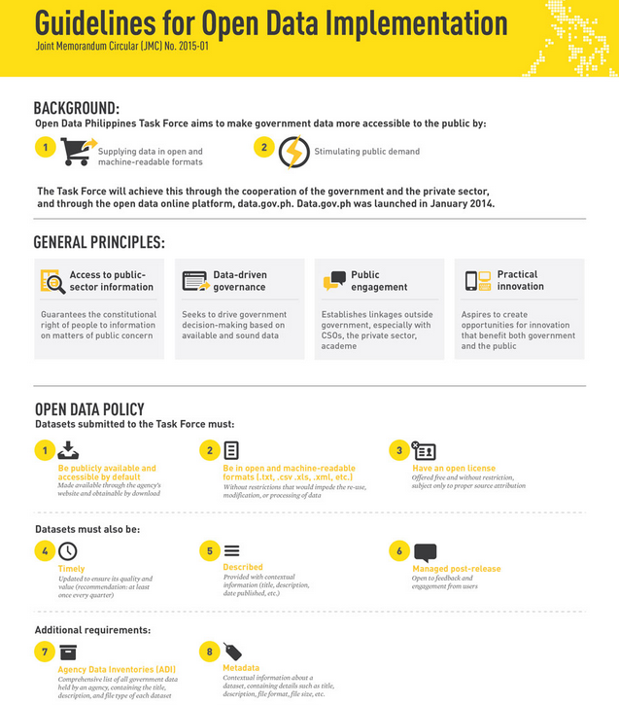
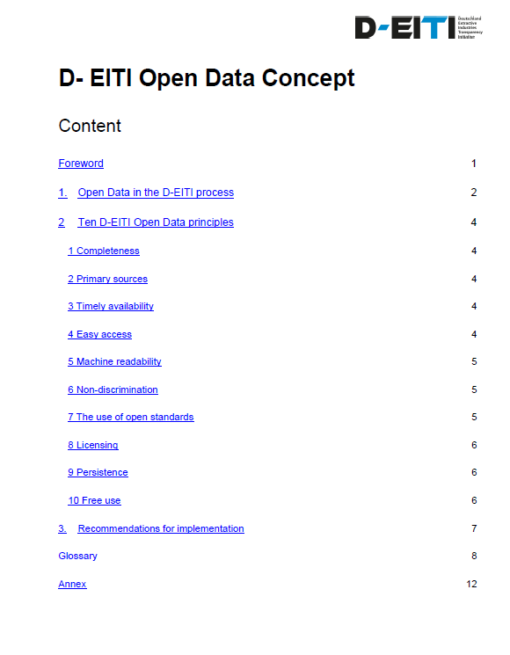
Five useful steps
Step 3: Consider options for access, release and re-use of data
Policies: International Secretariat, Philippines and D-EITI.
EITI International Secretariat will share new policies as they are approved and become public.
Notes:
Step 1 – Review the accessibility of EITI data (with reference to requirement 7.2). Essentially, take stock of the current situation regarding the access, release and re-use of EITI data. These would have two aspects: (1) assessing whether the data from EITI Reports is accessible, (2) taking stock of wider efforts to promote routine automated online disclosure (a mini mainstreaming feasibility study).
Step 2 – Review national policies and international best practice on open data. This helps to ensure that the MSG’s work is aligned with other national efforts (e.g., OGP and similar efforts), and emerging best practice. This should address the question of data standards.
Step 3 – Consider options for the policy on access, release and re-use of EITI data. Here, we should highlight international best practice. (Perhaps a box on the US-EITI efforts to consider the data needs of different user groups).
Step 4 – Document the MSG’s policy on access, release and re-use of EITI data, and agree any actions to be included in the workplan to address these issues. Suggest we provide a list of possible actions, including:
Addressing open data issues in the Independent Administrator’s Terms of Reference.
Tasking the Independent Administrator to produce excel files, and with compiling the Summary Data Templates
Clarifying the policy on open data in forthcoming EITI Reports.
Publishing excel files on the EITI website.
Efforts to increase open data literacy
Commission feasibility studies and/or recommend reforms to promote routine automated online disclosure by companies and government agencies.
Step 5 – Evaluation. Provide an update on theses effort in annual activity reports.

Slide 21
Five useful steps
Step 4: Document policy on access, release and re-use
Publishing
Open data for future/previous data
Include in workplan
ToR for IA
Capacity building
Promote open data towards source of information (linked to mainstreaming)
Step 5 – Evaluation – update in annual activity reports
Policy
ToR for IA
Workplan / APR
Website
Etc …
Notes:
Step 1 – Review the accessibility of EITI data (with reference to requirement 7.2). Essentially, take stock of the current situation regarding the access, release and re-use of EITI data. These would have two aspects: (1) assessing whether the data from EITI Reports is accessible, (2) taking stock of wider efforts to promote routine automated online disclosure (a mini mainstreaming feasibility study).
Step 2 – Review national policies and international best practice on open data. This helps to ensure that the MSG’s work is aligned with other national efforts (e.g., OGP and similar efforts), and emerging best practice. This should address the question of data standards.
Step 3 – Consider options for the policy on access, release and re-use of EITI data. Here, we should highlight international best practice. (Perhaps a box on the US-EITI efforts to consider the data needs of different user groups).
Step 4 – Document the MSG’s policy on access, release and re-use of EITI data, and agree any actions to be included in the workplan to address these issues. Suggest we provide a list of possible actions, including:
Addressing open data issues in the Independent Administrator’s Terms of Reference.
Tasking the Independent Administrator to produce excel files, and with compiling the Summary Data Templates
Clarifying the policy on open data in forthcoming EITI Reports.
Publishing excel files on the EITI website.
Efforts to increase open data literacy
Commission feasibility studies and/or recommend reforms to promote routine automated online disclosure by companies and government agencies.
Step 5 – Evaluation. Provide an update on theses effort in annual activity reports.

Slide 22
Five useful steps - overview
Step 1: Review the accessibility of EITI data (req 7.2)
Is data from EITI Reports accessible?
Taking stock of wider efforts of automated online disclosure
Step 2: Review national policies and int. best practices
Ensure alignment with other national efforts (e.g. OGP etc.), and emerging best practice. This should address the question of data standards.
Step 3: Consider options for access, release and re-use of data
Open data: Ghana, Norway, United States; Policies: Philippines, Germany
Step 4: Document policy on access, release and re-use
ToR for IA, publishing, open data for future/previous data, capacity building, promote open data towards source of information (linked to mainstreaming)
Step 5 – Evaluation – update in annual activity reports
Notes:
Step 1 – Review the accessibility of EITI data (with reference to requirement 7.2). Essentially, take stock of the current situation regarding the access, release and re-use of EITI data. These would have two aspects: (1) assessing whether the data from EITI Reports is accessible, (2) taking stock of wider efforts to promote routine automated online disclosure (a mini mainstreaming feasibility study).
Step 2 – Review national policies and international best practice on open data. This helps to ensure that the MSG’s work is aligned with other national efforts (e.g., OGP and similar efforts), and emerging best practice. This should address the question of data standards.
Step 3 – Consider options for the policy on access, release and re-use of EITI data. Here, we should highlight international best practice. (Perhaps a box on the US-EITI efforts to consider the data needs of different user groups).
Step 4 – Document the MSG’s policy on access, release and re-use of EITI data, and agree any actions to be included in the workplan to address these issues. Suggest we provide a list of possible actions, including:
Addressing open data issues in the Independent Administrator’s Terms of Reference.
Tasking the Independent Administrator to produce excel files, and with compiling the Summary Data Templates
Clarifying the policy on open data in forthcoming EITI Reports.
Publishing excel files on the EITI website.
Efforts to increase open data literacy
Commission feasibility studies and/or recommend reforms to promote routine automated online disclosure by companies and government agencies.
Step 5 – Evaluation. Provide an update on theses effort in annual activity reports.

Slide 23
Open data definitions and policies
EITI International: https://eiti.org/standard/open-data-policy
Open Government Partnership’s declaration: http://www.opengovpartnership.org/about/open-government-declaration
G8 Open data charter: https://www.gov.uk/government/publications/open-data-charter/g8-open-data-charter-and-technical-annex
The Open Data Charter: http://opendatacharter.net/
Open data definition: http://opendefinition.org/
World Bank report on open data standards: https://eiti.org/node/7340

Slide 24
Examples of open data …
In countries
DRC: https://www.mapx.online/app/w3/
Ghana (NRGI): http://data.gheiti.gov.gh/#home
Mongolia: http://e-reporting.eitimongolia.mn/
Norway: http://www.norskpetroleum.no/en/
US: https://useiti.doi.gov/explore/

Slide 25
In case of any questions:
Christoffer Claussen
Data Officer
cclaussen@eiti.org
www.eiti.org
@EITIorg
Thank you!
Email: secretariat@eiti.org - Telephone: +47 22 20 08 00
Address: EITI International Secretariat, Ruseløkkveien 26, 0251 Oslo, Norway

