Slide 1
OXFAM CONTRACT DISCLOSURE SURVEY 2018
Berlin EITI Board Meeting
JUNE 28, 2018
#NoSecretDeals
Notes:
I’m Isabel Munilla, Policy Lead for Transparency in EI at Oxfam America – my job is to document the leading edge and best in class practice on transparency to inform Oxfam’s work at the global and country level – We like to ask for the best, and my job is to identify it – I’m very happy today to be in a room with stakeholders that are practicing the best in class
I’m going to talk about new research today that I hope will be useful to you – I won’t have time to go into the research in great detail, but I want to provide highlights of what the report contains and our findings from a survey of 40 oil, gas and mining companies
But to be clear – why do we support contract disclosure

Slide 2
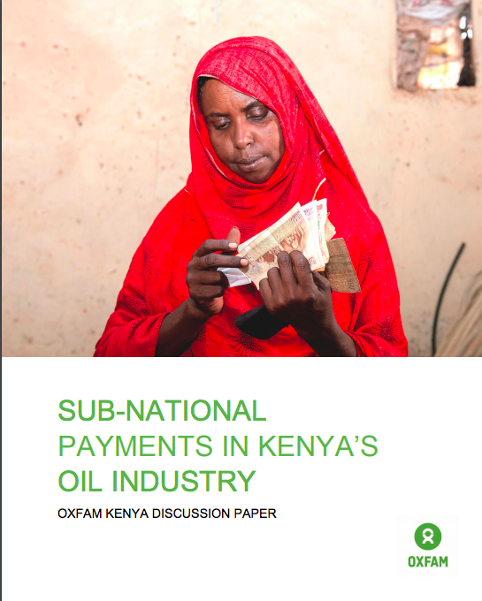
Notes:
Why do we care? It’s about money – contracts define the volume and timing of government revenues at the national and level

Slide 3
Notes:
What happens when we get it wrong – people hit the streets - Conflict is expensive – and it can derail democracy, empower corrupt elites and destabilize whole regions – Contract secrecy can drive conflict

Slide 4
Notes:
Conflict is expensive – and it can derail democracy, empower corrupt elites and destabilize whole regions – Contract secrecy can drive conflict

Slide 5
Notes:
It’s about future generations - oil, gas and mining projects can last decades, many times they outlast most governments – and the agreements that govern them can impact generations of citizens.

Slide 6
Oxfam’s Position on Contract Disclosure: Oxfam believes that citizens have a right to know the full terms under which oil, gas and mineral resources are developed and sold.
Notes:
We support full text disclosure of contracts in line with the EITI recommendation.

Slide 7
CONTRACT DISCLOSURE IS AN EMERGING GLOBAL NORM

Slide 8
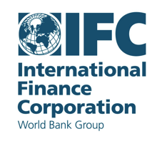
An emerging global norm
2005 – IMF Guide for Resource Revenue Transparency
2007 – IMF Code of Good Practices on Fiscal Transparency
2009 – International Conference on EI Contracts – Oxfam et al
2010 – UN Principles for Responsible Contracts
2011 – International Bar Association Model Mining Agreement
2012 – World Bank IFC requirement
2013 – EITI Standard update
-- European Bank for Reconstruction & Development
2018 – B Team Responsible Tax Principles
Notes:
Contract disclosure is not a radical concept - it’s been endorsed by the IMF for more than a decade
Again, please check out Section 3 of the report for much more detail on this, but I’d like to highlight a few

Slide 9
“Contract transparency should be simply treated as a normal aspect of doing business.”

Slide 10
THE POSITION OF OIL, GAS AND MINING COMPANIES
Notes:
Check out the methodology in the report:
40 companies – 95% operate in EITI countries

Slide 11
Corporate support for contract disclosure is advancing, but work remains
Notes:
Nearly half of companies support in some form
This is significant, since preliminary research conducted in 2016 found few companies with public statements of support
Relatively few companies – 18 – but include a range of globally significant oil and mining multinationals:
including four partially state-owned companies
EITI Board Members
EITI Supporting Companies.
The calibre and the breadth of operations of this group of companies suggest that their leadership on this issue can set important precedents for the behaviour of peer companies.

Slide 12
Includes
16 EITI Supporting
Companies
(88%)
Notes:
Of the 40 companies studied, 22 had either no policy statements on contract disclosure or statements against contract disclosure.
The majority of these companies (13) are EITI Supporting Companies, however, their support for transparency via EITI does not appear to extend to the topic of contract disclosure.
This is despite the fact that most of the companies already have contracts in the public domain, operate in at least one country that legally requires contract disclosure

Slide 13
7/9 EITI Board Members
Includes
16 EITI Supporting
Companies
(88%)
Notes:
Of the 40 companies studied, 22 had either no policy statements on contract disclosure or statements against contract disclosure.
The majority of these companies (13) are EITI Supporting Companies, however, their support for transparency via EITI does not appear to extend to the topic of contract disclosure.

Slide 14
LEADERS | RUNNERS UP | NOTABLE | WEAK | NO SUPPORTIVE STATEMENTS
Kosmos Tullow | PanAust Rio Tinto n Total n | Angkor Gold A.P. Møller - Maersk BP n Freeport McMoran n BHP Billiton n Goldcorp Newmont Petrobras Repsol Royal Dutch Shell n Statoil n | Barrick Vale | Anadarko AngloAmerican AngloGold Ashanti Chevron n China Shenhua Energy CNOOC ConocoPhillips Eni ExxonMobil n First Quantum Minerals Glencore Gold Fields IAMGOLD KrisEnergy MMG Newcrest Occidental OceanaGold Orano Group/Areva PetroChina Pluspetrol Teck

Slide 15
COMPANY STATEMENT HIGHLIGHTS
Notes:
A handy chart on P. 44 that summarizes and categorizes company statements but I would like to highlight a few

Slide 16
Supportive companies:
Most support is rhetorical, next step is policy and implementation
Most focused on supporting government action, rather than their own disclosure
Several included concept of government advocacy
Several included efforts to ensure transparency clauses are proactively included in contracts
Inclusion of commitment to dialogue
Careful language to address confidentiality & commercially sensitive info

Slide 17
Company statement highlights
“Where it is legally possible and acceptable to our host governments, we also prefer to make the material terms of our Petroleum Agreements and Production Sharing (PCs) publicly available.”
“Tullow supports disclosure of production sharing agreements, but will only do so with the express support and agreement of our Government partners.”
“Rio Tinto supports countries publicly disclosing contracts and licences for the exploitation of oil, gas and minerals, as outlined in the EITI standard. Many of Rio Tinto’s major contracts for resource development are publicly available.’
“When it comes to contracts, we are happy to operate in an environment, in a country, that has full contract disclosure. We actually come from a country where we have full disclosure of the contract conditions and we have a concession agreement where all details are public.”

Slide 18
Company statement highlights
“Total supports government efforts towards advancing transparency in accordance with the EITI framework, and advocates for the public disclosure by countries of their Petroleum contracts and licenses. To do this, Total strives to:
Foster dialogue between the relevant Group officials and representatives of States, civil society and the EITI;
Participate in the efforts of the EITI Board;
Promote the EITI and its principles among the States in which it operates and, more generally, whenever it has the opportunity;
Share resources and recommendations based on our experience”

Slide 19
Company statement highlights
“BP supports contract transparency and recognizes that it can help to promote accountability and transparency. BP has proactively disclosed contracts for its Caspian operations on its website, and is considering preparing a formal policy on contract disclosure.
We see contract disclosure as being led by the host government, however, we are supportive, and to the extent we can, we will support the mechanics of contract disclosure. We recognize that EITI Standard implementation has moved beyond ‘encouragement’ of contract disclosure.”

Slide 20
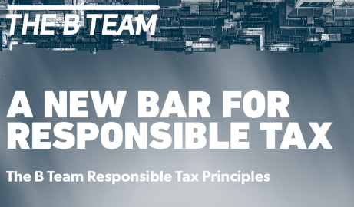
Highlights of progress
“Ideally, tax exemptions and reliefs should be specified by law and generally available to all market participants.
Where there are exceptions, we will work with relevant authorities to encourage publication of those incentives and contracts.”
Feb 2018

Slide 21
Company statement highlights
“When legally permitted and consented to by host governments, PanAust supports making the material terms of its contracts publically available (in line with EITI requirements).”
“Petrobras is committed to good corporate governance practices, which are based on greater transparency and accountability. In this context, we proactively publish in our Transparency Portal information on the contracts where Petrobras acts as contractor, in compliance with the Law on Access to Information…”
“Vale would support conditional contract transparency and would be willing to take part in discussion groups and initiatives to develop the concept of contract transparency…”

Slide 22
RECOMMENDATIONS

Slide 23
RECOMMENDATIONS FOR EITI
Require contract disclosure.
Require companies to make public their policies and actively support contract disclosure.
Highlight and promote leadership.

Slide 24
THANK YOU
Isabel Munilla
Isabel.munilla@Oxfam.org
Twitter: @IsabelMunilla

Slide 25
Company statement highlights
“We understand the connection between this tax and royalty disclosure (which enables citizens to see what a company has paid) and contract transparency (enabling citizens to compare actual payments against what is contractually required to be paid).
Accordingly, BHP would support a host government’s initiative to disclose the content of its licences or contracts for the exploitation of oil, gas or minerals that forms the basis for an extraction company’s payment liabilities.”

Slide 26
Highlights of progress
“Although it’s not a condition of ICMM membership, the majority of our members are willing to make public the general terms of their contract in any specific country, assuming that proper protection for competitively-sensitive information is in place. This is a good practice that we support.”
“ICMM company members commit to engage constructively in appropriate forums to improve the transparency of mineral revenues – including their management, distribution or spending – or of contractual provisions on a level playing-field basis, either individually or collectively through ICMM.”
Notes:
More than half of ICMM members support – Luke will get into more details

Slide 27
BENEFITS FOR COMPANIES
Strengthens a company’s social license to operate by dispelling suspicion & fostering trust
Increases stability and help protect companies from the risk of future scandals
Complements community consultation and consent policies
Serves as an insurance policy to insulate companies from those that would force them to be complicit in corruption

Slide 28
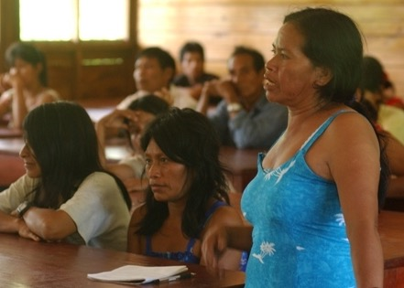
BENEFITS FOR COMMUNITIES
Empowers citizens to play their oversight role
Informs communities of potential risks to property rights & livelihood
Necessary for gender justice around EI projects
Provides critical information for communities engaging in FPIC
Necessary for communities to protect rights to a just climate
Notes:
Contract disclosure allows communities to diagnose whether they were able to effectively participate and influence projects that were licensed, allowing them to identify potential risks and opportunities to engage in future decision-making.
The impact of extractives projects are not gender neutral. Those working to protect women’s rights must understand the contrat terms that fefine project plans, benefits and liability and compensation for impacgs, as well as the volume and timing of revenues and other economic benefits.

Slide 29
ROLE OF CORPORATE PUBLIC POLICIES
External:
Demonstrates real commitment to public accountability
Sets standards against which stakeholders can hold company accountable
Helps shift norms across the industry and in host countries
Internal:
Creates consistency in internal policy regardless of staff turnover
Improves understanding at senior and board levels
Shift operating culture

