Slide 1
Mining Extractives Data
May 23, 2013
EITI Global Conference
Michael Jarvis
Program Leader, Governance for Extractive Industries & Open Contracting
World Bank Institute

Slide 2
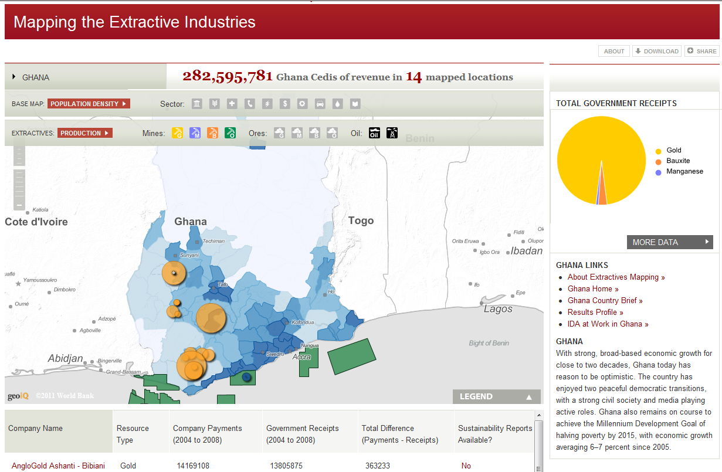
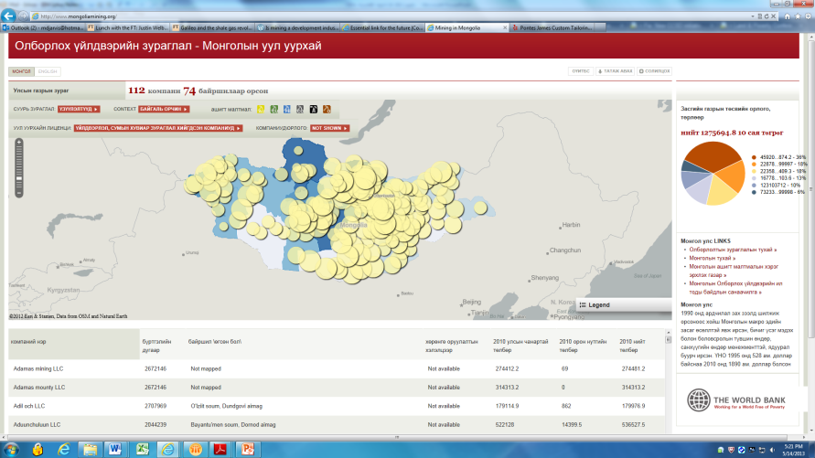
Mapping Data
http://contractroadmap.org
Notes:
Pilot maps completed for Ghana and Mongolia compiling all publicly available extractives data in a common portal. Exploring potential to develop software package to allow easy replication in multiple countries.

Slide 3
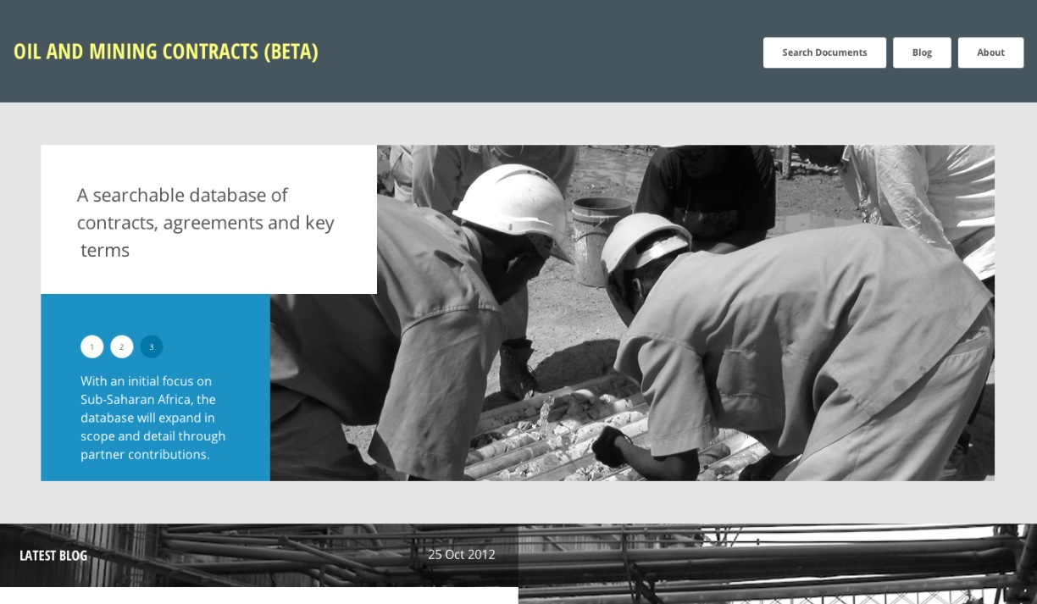
ResourceContracts.org
Notes:
One new tool that goes live this week for this event and the EITI conference is a new database of publicly available oil, gas and mining agreements developed by the World Bank Institute, Revenue Watch Institute and the Vale Columbia Center on Sustainable International Investment. The database is designed to help fill gaps in knowledge and access and is designed for easy use where there are slower Internet connections. You can view full deals, search by country, resource, type of agreement, and clause as well as find summaries of key provisions. It should be useful for all. Such tools, though not a panacea, are intended to be useful to all and hopefully will inform better mining deals in the future with stronger development outcomes.

Slide 4
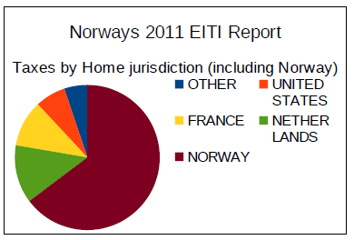
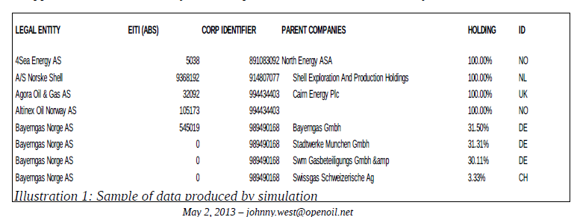
Beneficial Ownership

Slide 5
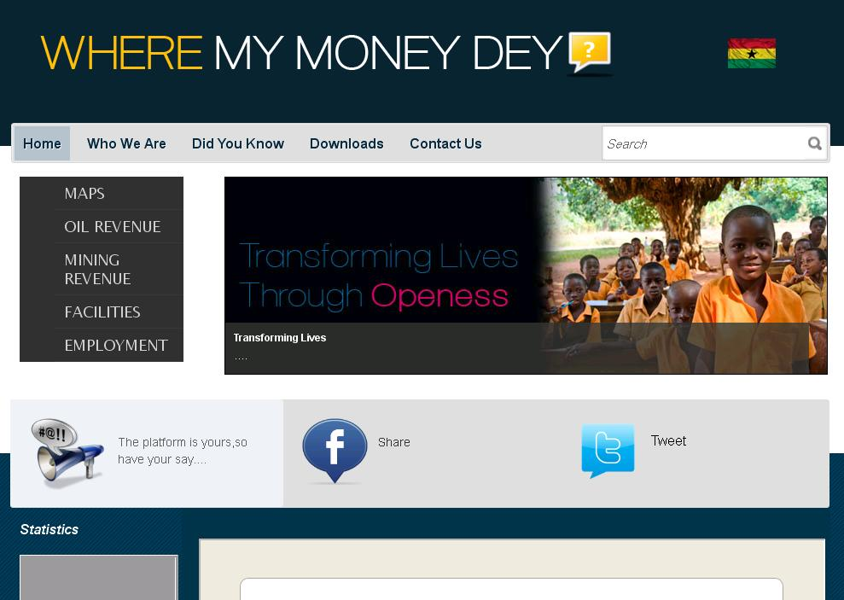
Apps Development

Slide 6
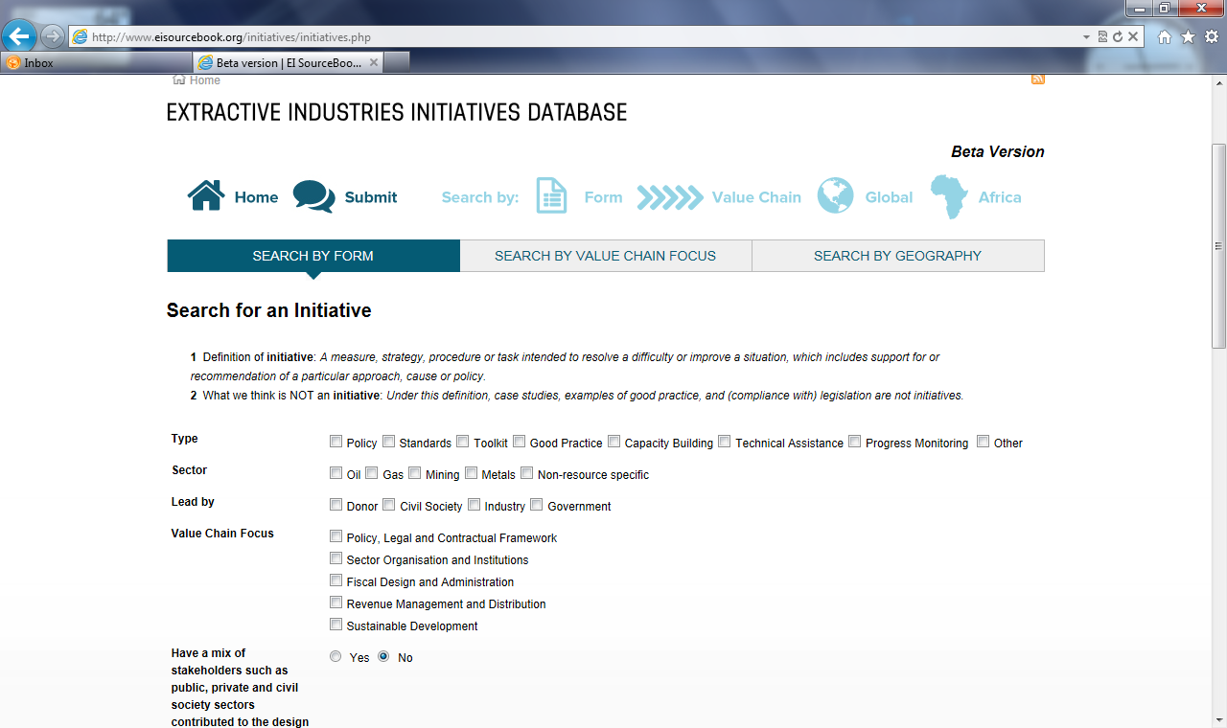

Slide 7
