Slide 1
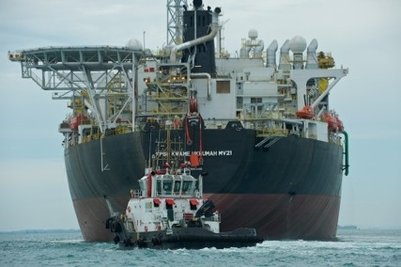
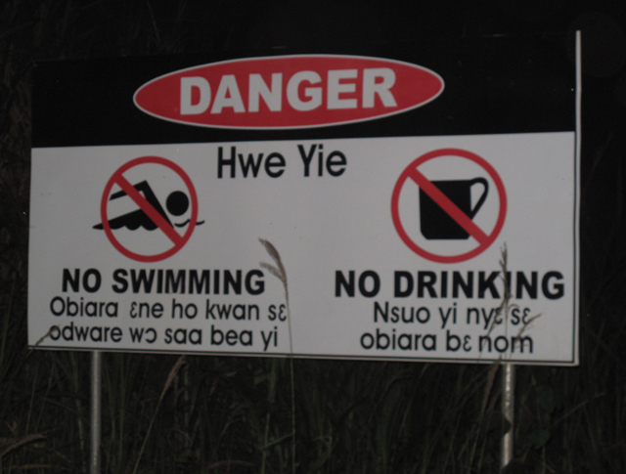
EXPLORING THE OPPORTUNITIES TO MAKE BETTER USE OF EITI REPORTS – ACCESSIBILITY, INFLUENCE AND RELEVANCE OF REPORTS
BY HANNAH OWUSU-KORANTENG
ASSOCIATE EXECUTIVE DIRECTOR, WACAM, GHANA

Slide 2
Outline of Presentation
Introduction
Objective of the reports
How do we report to make them relevant?
How is the information packaged and disseminated?
Using the EITI reports to influence transparency in natural resource governance

Slide 3
Introduction
The EITI reports reveal that 3.5 billion people live in countries rich in oil, gas and minerals who stand to benefit from disclosure and transparency.
The EITI has won the support of over 80 global investment institutions that collectively manage over US $19 trillion.
37 countries (and counting) are already well underway in implementing the EITI.
As of 2013, the total wealth of revenue disclosed in the report amounted to US$ 1 trillion compared to $200 billion in 2009.

Slide 4
Objective of the reports
Natural Resource endowed countries are confronted with resource curse.
Transparency and accountability are important elements for promoting good governance, democracy and reducing corruption in resource rich countries.
EITI reports are meant to contribute to
deepening the rule of law,
promoting active citizenship,
reducing conflicts around natural resources extraction,
promoting transparency and accountability in natural resource management and
Sustained economic development.

Slide 5
Objective of the reports
Reports should be structures to serve the following purposes:
Governments/State institutions/Regulatory agencies- To compute revenues from companies and for regulation
CSOs for advocacy that would influence policy for disclosure and accountability
Affected Communities for advocacy on protection of rights, accountability and local level development
Researchers and media –for academic work and educating the public

Slide 6
How do we report to make them relevant?
Information in any form is good and provides citizens with tools to work with. However, the reports must be packaged in forms that could benefit all stakeholders. Reports must be
Accessible
Package for effective use and
To influence policy.
The relevance of the reports is pivoted on the agreed principles of EITI which among others include;
Principle Two: Affirmation of management of natural resource wealth for the benefit of a country’s citizens which lies in the domain of sovereign governments to be exercised in the interests of their national development.
Principle Six: Recognises that achievement of greater transparency must be set in the context of respect for contracts and laws.

Slide 7
How do we report to make them relevant?
At best the report provide information on benefits based on per capita.

Slide 8
How do we report to make them relevant?
The report should help implementing countries to analyse how they are faring in poverty reduction determined by the HDI.
Information is to enhance good governance which would lead to proper management of resources for poverty reduction to eliminate resource curse.
Principle One: A belief that the prudent use of natural resource wealth should be an important engine for sustainable economic growth that contributes to sustainable development and poverty reduction, but if not managed properly, can create negative economic and social impacts

Slide 9
How do we report to make them relevant?
Reports are presented without reference to existing contracts and in some cases the law
The reports in its form are not very clear on whether mineral endowments of developing countries have contributed to poverty reduction or exacerbated it.
Information is a right especially if it is around common resource such as natural wealth / capital of the state; thus reports on EITI should be accessible to all.
Are the reports too technical to be useful to the marginalised in society?

Slide 10
How do we report to make them relevant?
Are the reports aggregated or disaggregated to assess the performance of the companies and government receipts?
Does the report cover the social, economic and environmental cost of the financial receipts?
Are the reports based on project by project and how host communities should assess information on how much benefits they derive and cost that is externalised to them?
What are the ways in which the information are disseminated could be improved for use by stakeholders?

Slide 11
Using the EITI reports to influence transparency in natural resource governance
Principle Five: Underlines the importance of transparency by governments and companies in the extractive industries and the need to enhance public financial management and accountability.
Using appropriate tools for dissemination of information based on the country’s reality is important to achieve the following;
Citizens’ participation in EITI process to ensure transparency and improving accountability to bring about sustainable development;
Achieving transparency and accountability through extensive disclosure of information, finer disaggregation of reporting and auditing of the entire value chain;

Slide 12
Using the EITI reports to influence transparency in natural resource governance
States building capacities of different stakeholders to monitor funds flows for more effective engagement and interaction.
States reviewing the reports, making recommendations and advocating for policy changes that would promote sustainable development that would benefit citizens?.
Transparency goes beyond financial reporting and ten years of EITI requires that we develop progressive strategies for move to full disclosure along the value chain and expand the scope of the reports to reflect that.

Slide 16
Thank you

