Slide 1
Mainstreaming – entrenching EITI reporting into government systems
Regional EITI Workshop in Abuja, Nigeria
03 November 2016

Slide 2
Why mainstreaming? Timor Leste case study
Source: Timor-Leste Institute for Development Monitoring and Analysis, http://www.laohamutuk.org/

Slide 3
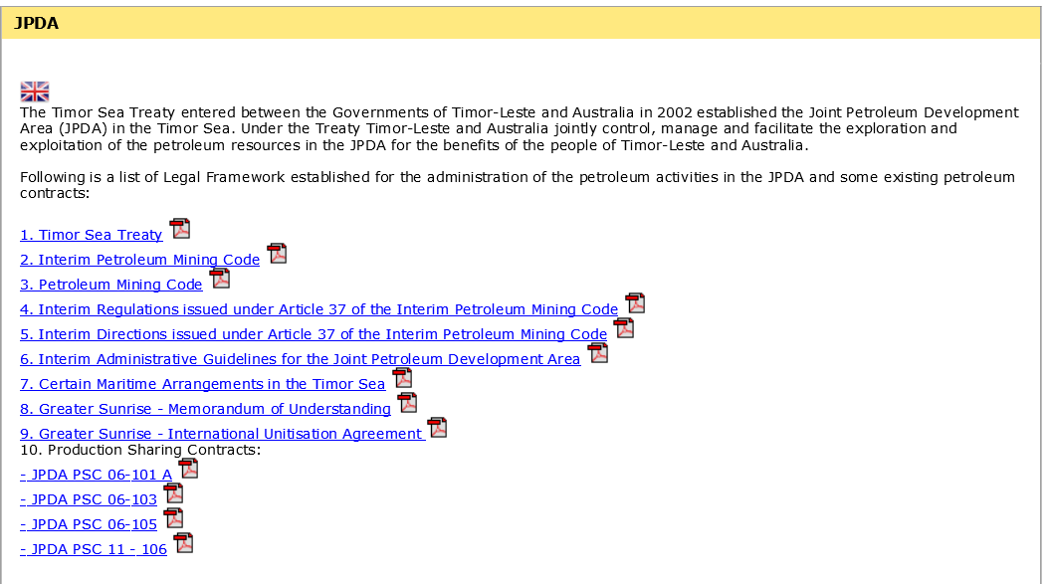
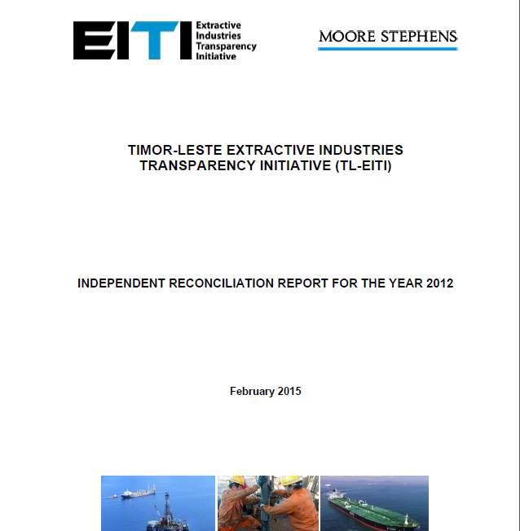
Mainstreaming transparency
National Petroleum Authority, http://www.anp-tl.org/webs/anptlweb.nsf/vwAll/JPDA

Slide 4
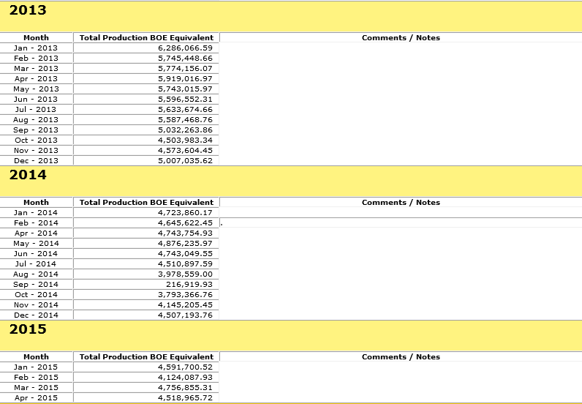
Mainstreaming transparency
National Petroleum Authority, http://www.anp-tl.org/webs/anptlweb.nsf/pgLafaekDataGasListHTML

Slide 5
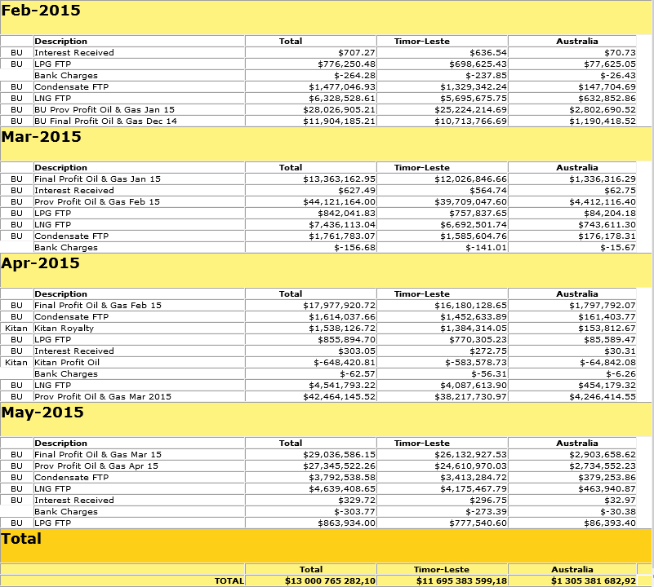
Mainstreaming transparency
National Petroleum Authority, http://www.anp-tl.org/webs/anptlweb.nsf/pgLafaekFTPListl

Slide 6
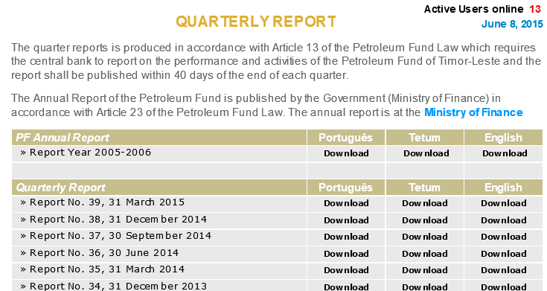
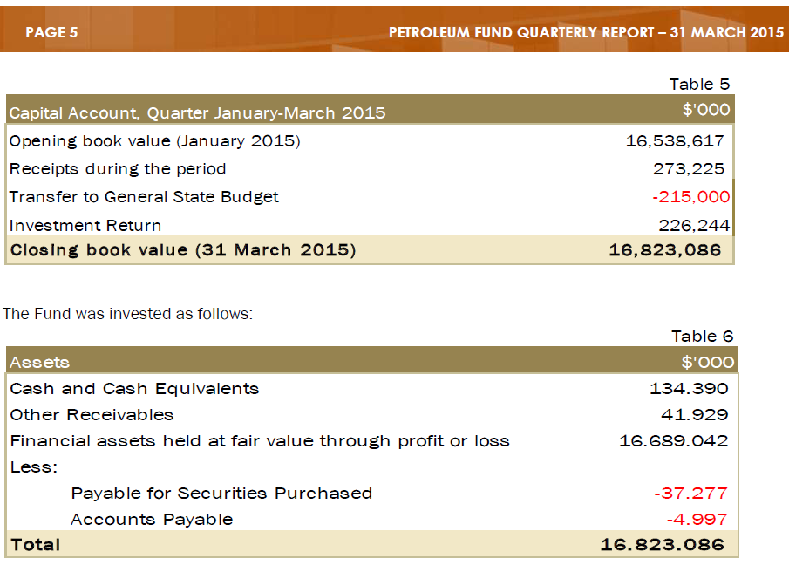
Mainstreaming transparency
Central Bank, http://www.bancocentral.tl/Download/Publications/Quarter-Report39_en.pdf

Slide 7
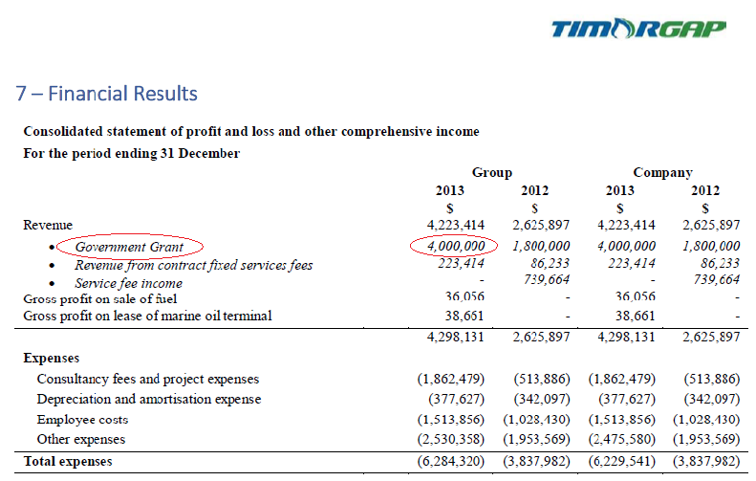
Mainstreaming transparency
Timor GAP, http://www.timorgap.com/databases/website.nsf/vwAll/Annual%20Reports

Slide 8
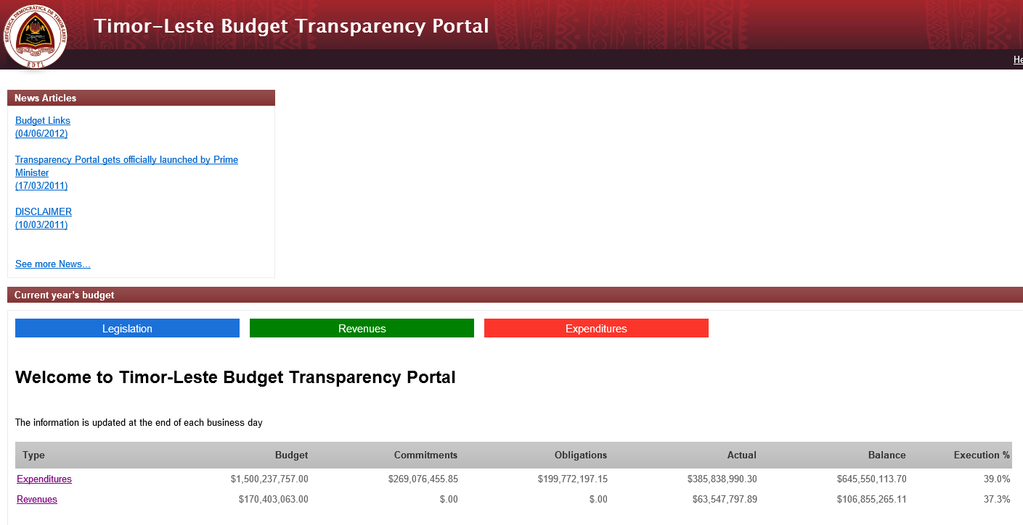
Mainstreaming transparency
http://www.budgettransparency.gov.tl/public/index?&lang=en

Slide 9
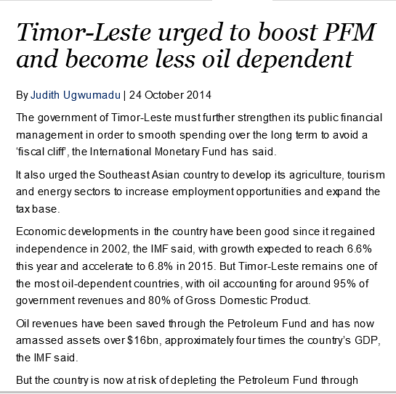
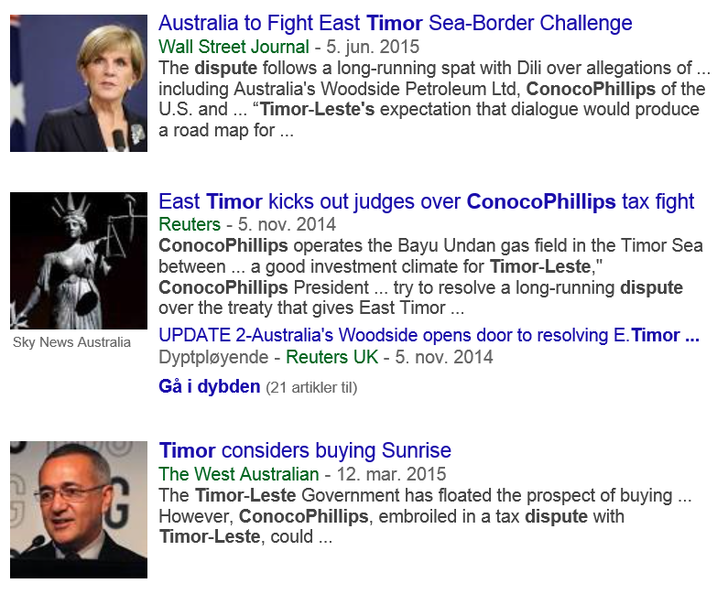
EITI – still important platform for dialogue

Slide 10
Why mainstreaming ?
Transparency should be an integral part of how governments manage their sector. EITI reports are not the only tool for bringing about transparency.
Some benefits:
Flexibility in approach to disclosure method of EITI data
Cheaper – avr. cost EITI Report $130k
More up-to date information
Avoids duplication
No change to disclosure requirements.
No compromise on reliability and comprehensiveness of data.

Slide 11
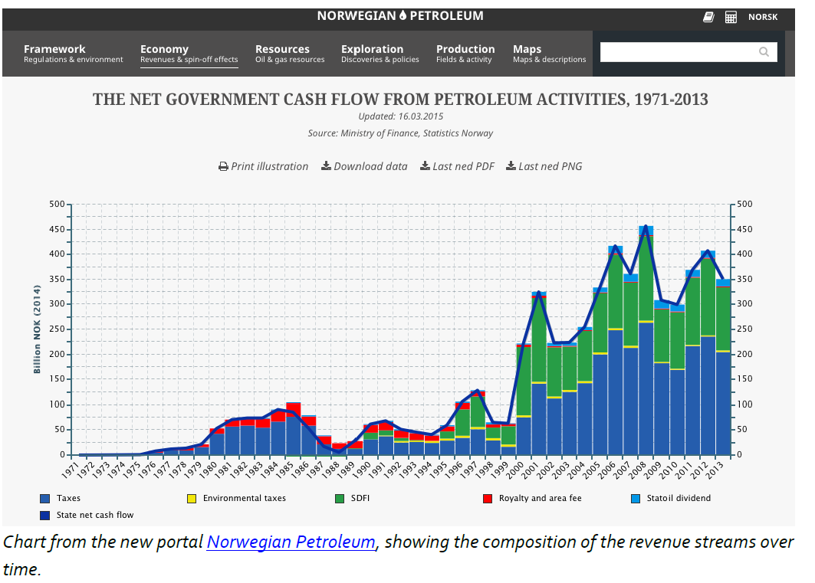
Further examples

Slide 12
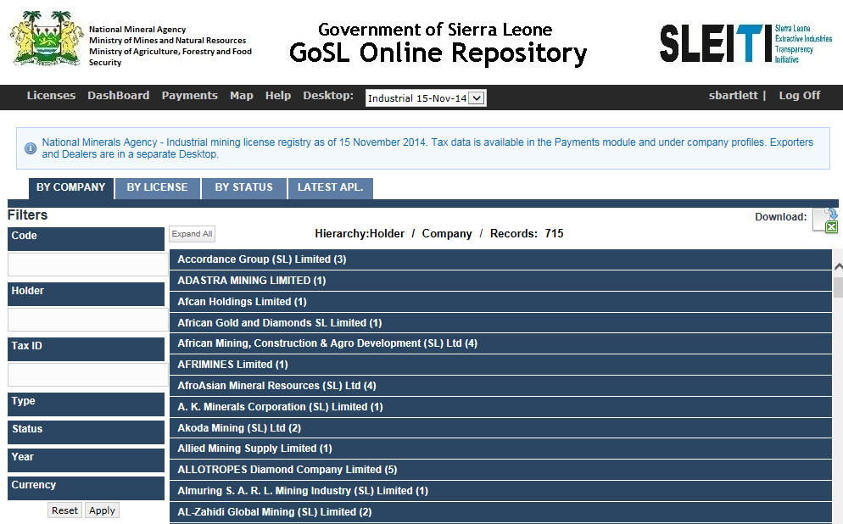
Further examples
http://sierraleone.revenuesystems.org/login/auth

Slide 13
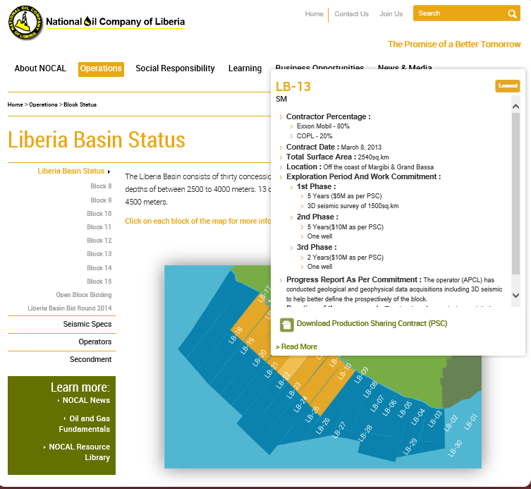
Further examples
http://www.nocal.com.lr/operations/block-status

Slide 14
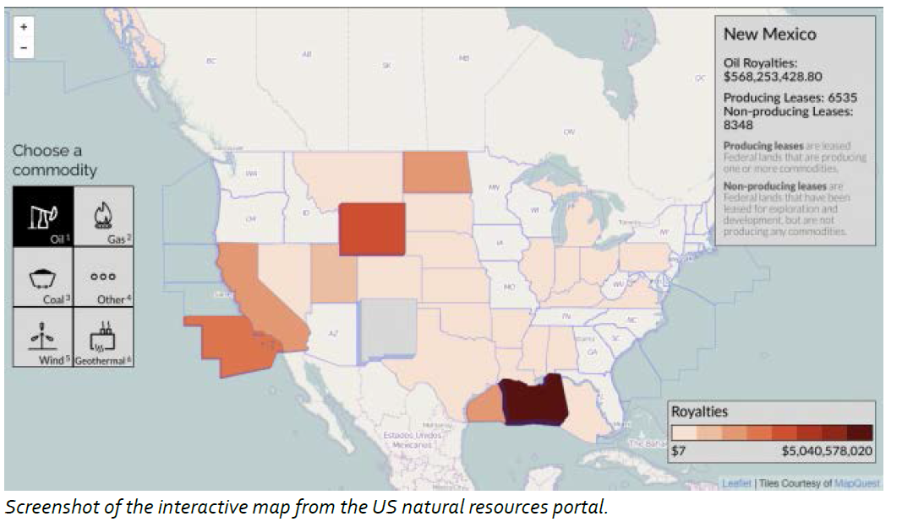
Further examples

Slide 15
EITI Standard & mainstreaming
Under EITI Requirement 4.9c, the multi-stakeholder group can avoid reconciliation by an independent administrator if…
there is routine disclosure of the data … and
the financial data is subject to credible, independent audit, applying international standards
then…
The MSG may seek Board approval to mainstream EITI implementation.

Slide 16
Discussion
What are the advantages of mainstreaming for your country?
What would be the challenges with mainstreaming transparency?

