Slide 1
EITI QUALITY ASSURANCE
Best practices preparing for Validation
Regional training session 6: Validation procedures
Manila, the Philippines
26 October 2017

Slide 2

Goals of Validation under the EITI Standard
Building the most complete dossier possible reflecting work in implementing the EITI Standard;
Ensuring all EITI countries are assessed to the same requirements;
Identifying opportunities to reinforce EITI’s impact and drive meaningful reforms.

Slide 3

OUTLINE
Validation methodology
Steps in preparing for Validation
Preparing stakeholder consultations

Slide 4

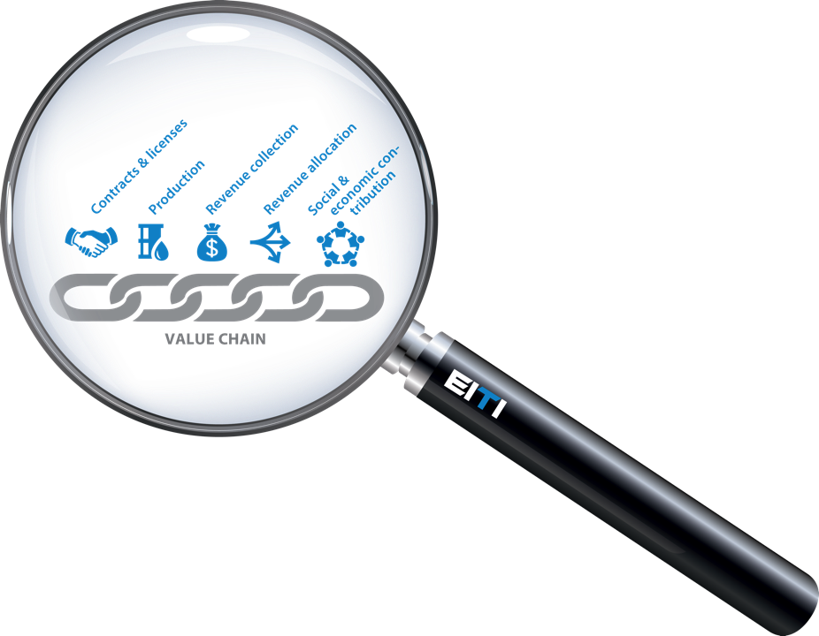

Scope of Validation: three parts to the EITI Standard
Governance
EITI reporting
Outcomes & impacts
Notes:
La Norme ITIE pourrait se diviser en trois – la supervision du groupe multipartite, les divulgations ITIE et resultats et impact

Slide 5
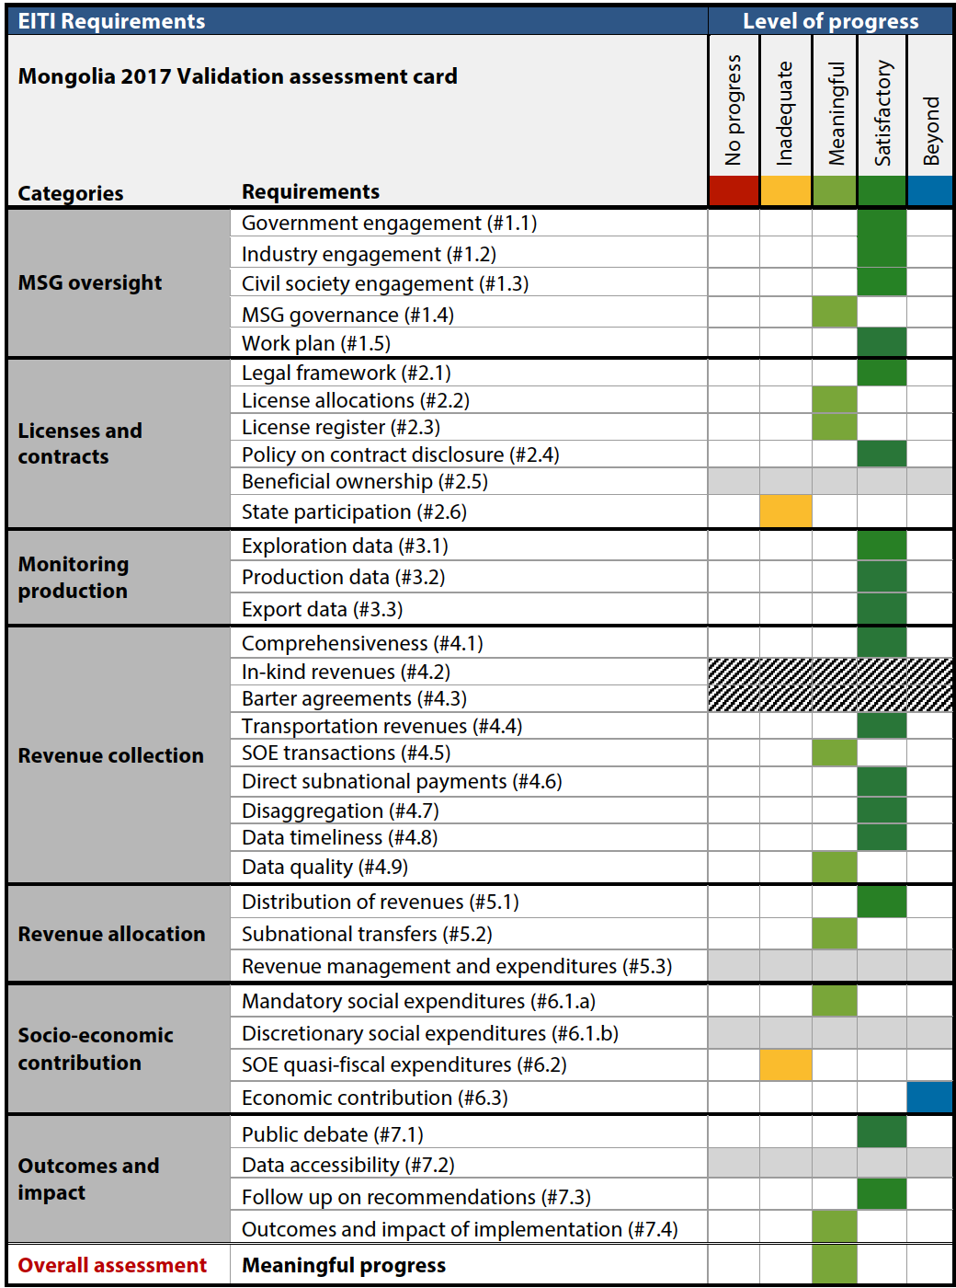
1
Progress with each Requirement
2
Overall assessment
Progress in implementing the EITI Standard

Slide 6
VALIDATION PROCEDURES

Slide 7
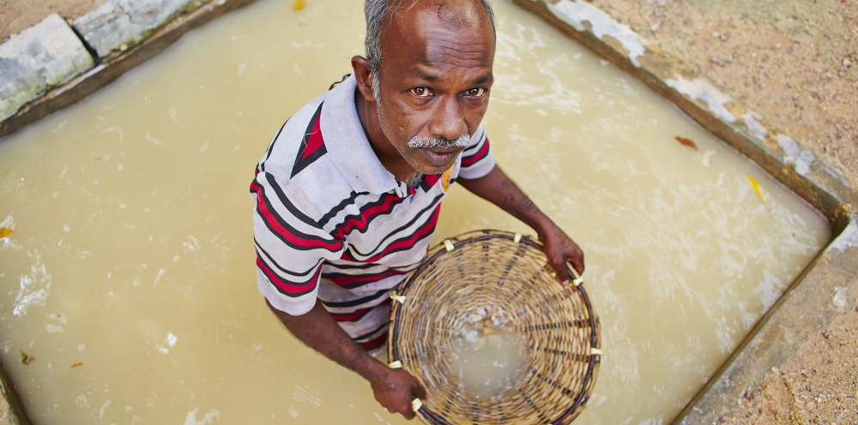
HOW DO COUNTRIES GET READY FOR VALIDATION?

Slide 8
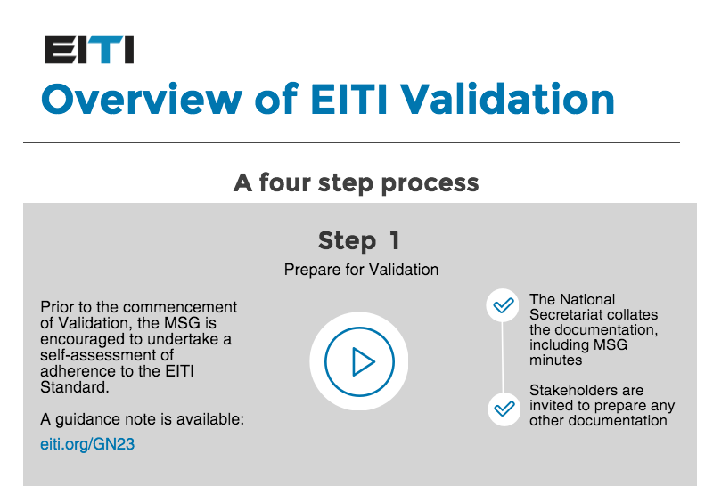
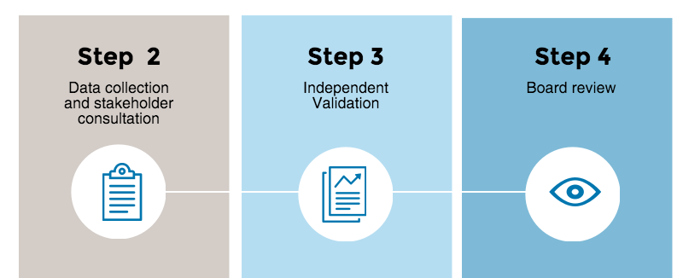

Slide 9
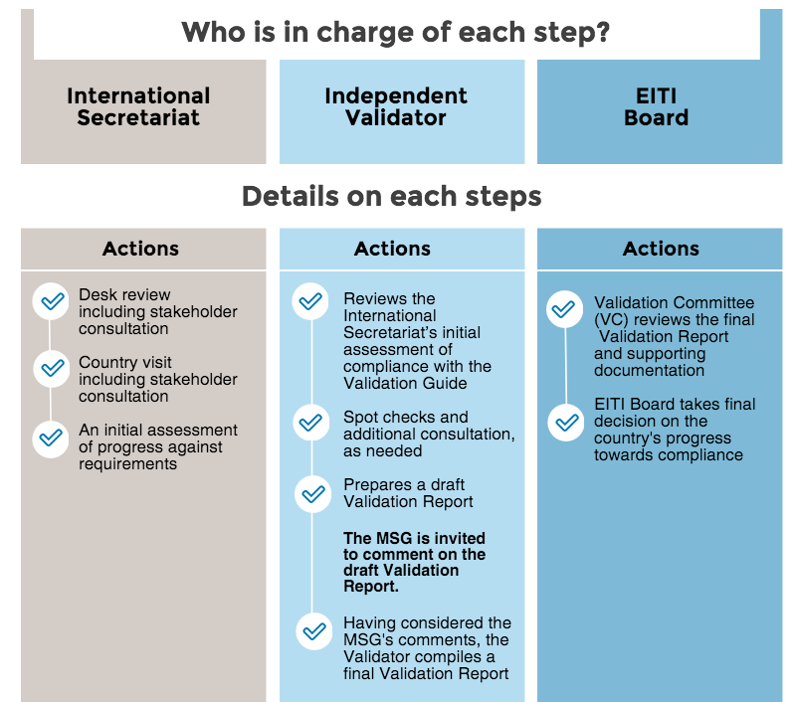

Slide 10
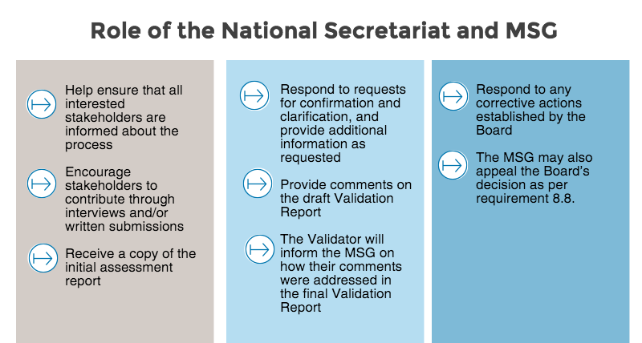

Slide 11
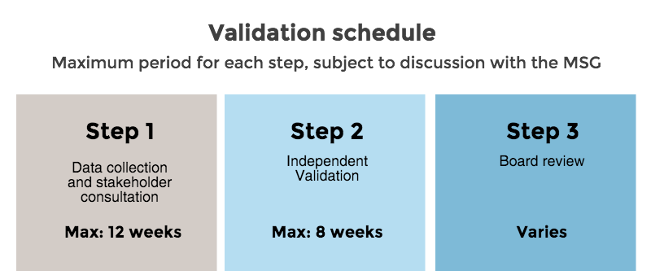
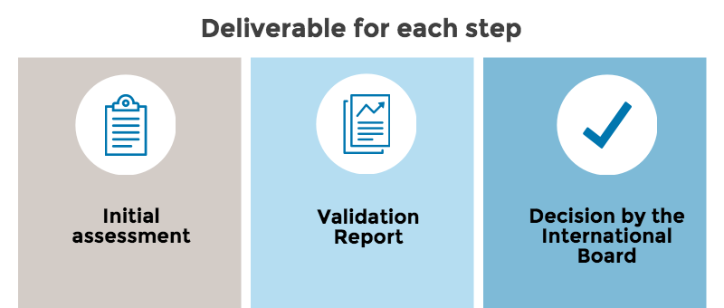

Slide 12

PREPARING STAKEHOLDER CONSULTATIONS
Useful for Validation, but also useful for:
MSG’s links with key institutions
Capacity building
Identifying opportunities to streamline EITI reporting and mainstream key EITI information.

Slide 13
The MSG should prepare a comprehensive list of stakeholders to consult, canvassing broadly
Government
MSG members
Industry
MSG members
Civil Society
MSG members and the NGOs they represent
Others
Development partners with extractives and public finance reform assistance
Reporting entities
Other relevant actors (e.g.
auditor general
statistics agency
central bank)
Reporting companies
Other relevant actors (e.g.
Mining, oil and gas consultancies
Industry-funded researchers
Journalists, bloggers, broadcast reporters
NGOs covering extractives, public finances or governance not directly represented on EITI
Academics, analysts covering extractives
Independent Administrators of all EITI Reports (esp. most recent)
Parliamentarians
Local government officials
National secretariat staff (current and former)
Religious, landowner groups

Slide 14
Canvass broadly & strategically
Stakeholders relevant for Validation, but mainly to the national EITI (roundtable or bilaterals):
  Government
    Relevant government agencies both on and off the MSG, local officials, auditor general, statistics agency, etc.
  Industry
    Companies on and off the MSG; if possible companies that didn’t report; industry association(s); industry analysts; etc.
  Civil society
    Civil society MSG members; their direct constituent NGOs; the media; NGOs (not necessarily part of) national coalitions focusing on extractives, public finance, grassroots, religious and landowner organisations; etc.
  Other
    The IA, development partners, parliamentarians, Sec. staff.

Slide 15
Case study: Philippines EITI
Atty Maria Karla L. Espinosa, National Coordinator, PH-EITI

Slide 16

…which underlines the importance of proper preparation of Validation:

Slide 17
Key preparations include:
  A thorough pre-Validation self-assessment by the MSG;
  Compilation of additional documentation not available on the EITI website (minutes of meetings and dissemination events, internal memos, ToR…);
  Comprehensive list of stakeholders (if possible with a proposed schedule to maximise timeframe);
  Public announcement on the commencement of Validation (with contact details)
  Logistical support in liaising with stakeholders to ensure maximum stakeholder input to Validation process.

Slide 18
Case study: Solomon Islands EITI
Vincent Obimae, National Coordinator, SI-EITI

Slide 19
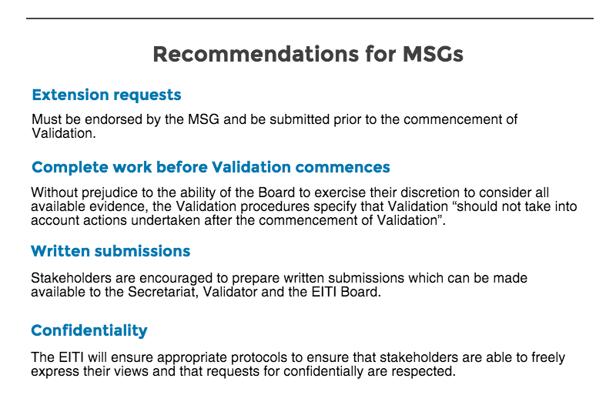

Slide 20
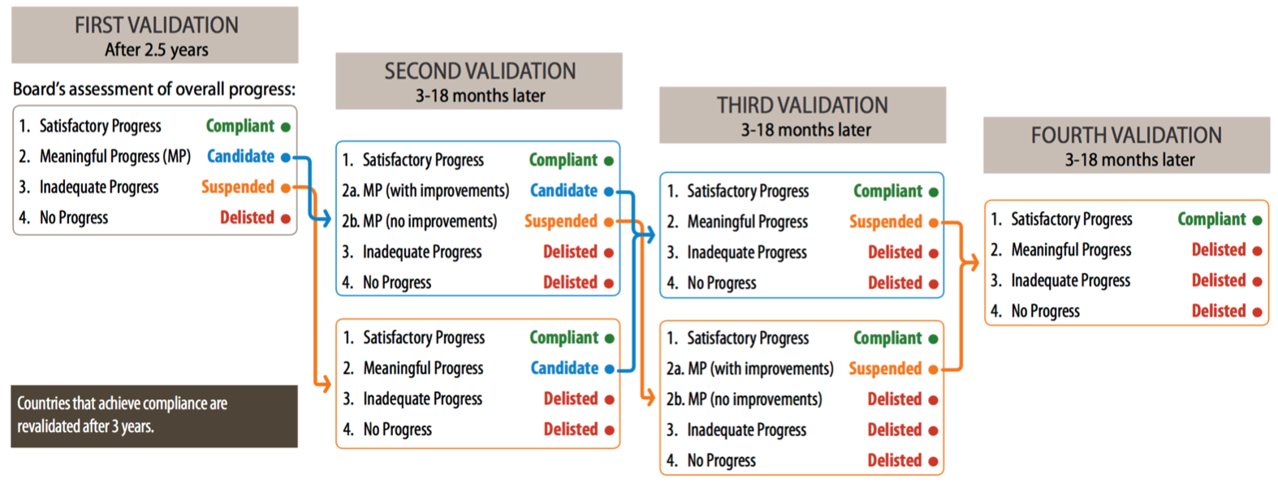

Validation procedure
12 weeks
+ 3 weeks
+ 3 weeks
+ 2 weeks
+ … weeks
Initial
Assessment
Draft
Validation
Report
MSG
Comments
Final Validation Report
Board
Decision
+ response to MSG comments

Slide 21
Author: Alex Gordy
Date: 26 October 2017
Occasion: Session 6: 2016 EITI Standard – Validation procedures
Regional EITI training, Manila, the Philippines
Email: secretariat@eiti.org - Telephone: +47 22 20 08 00
Address: EITI International Secretariat, Skippergate 22, 0154 Oslo, Norway

