Slide 1
THE EITI’S VALIDATION
Validation corrective actions to drive reforms
Regional training session 6: Validation procedures
Manila, the Philippines
27 October 2017

Slide 2

Addressing recommendations from Validation should involve linking to other ongoing reforms…
There are two types of recommendations from Validation: those involving publishing specific data to address any oversights, and those linked to broader reforms…
The first can be addressed by embedding EITI reporting in government and corporate systems (mainstreaming);
The second should involve broader reform efforts from government.

Slide 3

OUTLINE
Types of EITI corrective actions
Approaches to follow up
Linking to reforms

Slide 4
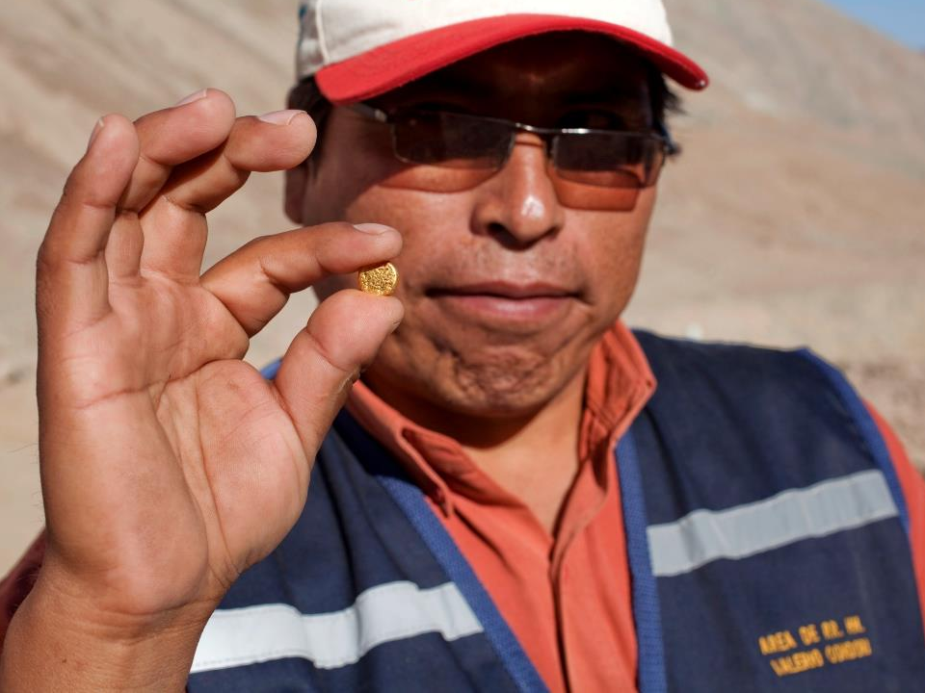

Validation provides an independent diagnostic of EITI implementation, providing solid foundations for integrating the EITI into government and company systems.
Meeting name, location & date if needed
(edit on this slide)

Slide 5
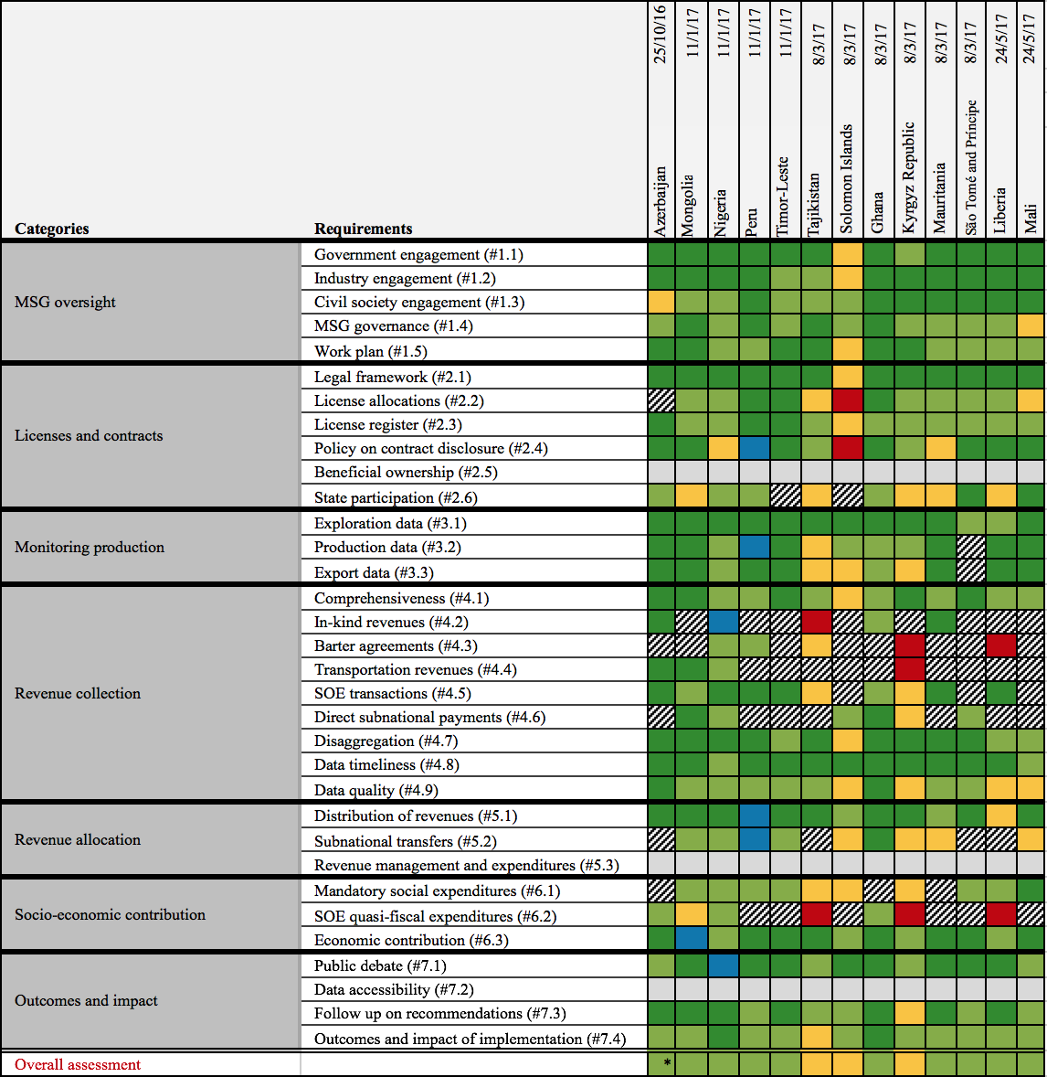
The EITI Board has agreed the results of 16 countries’ Validations to date (15 below)

Slide 6
The EITI Standard applies unevenly

Slide 7
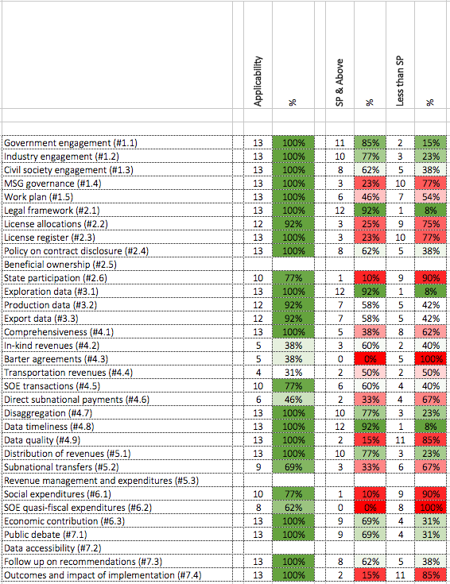
Early Validation results reveal some common challenges…
Notes:
Some “highlights”
38% <SP on CSO (#1.3)
77% <SP on MSG Governance (#1.4)
90% <SP on State Participation (#2.6)
62% <SP on Comprehensiveness (#4.1)
85% <SP on Data Quality (#4.9)
100% <SP on QFE (#6.2)
85% <SP on Outcomes & Impact (7.4)
Key issues
MSG governance
Effective work plans
Delays (re funding and procurement)
Inadequate scoping
Weak adherence to the standard ToRs
Inattention to data quality issues

Slide 8
Case study: Timor-Leste EITI
Elda Guterres da Silva, National Coordinator, TL-EITI

Slide 9
Types of EITI corrective actions
From the simple to the longer term

Slide 10

FOLLOWING up on Validation’s corrective actions
If countries haven’t achieved satisfactory progress across all requirements, they are given 3-18 months to undertake corrective actions, of which there are two types:
Missing data points and codification of practice (easy to correct)
Longer term reforms that require at least one more EITI Report to correct

Slide 11
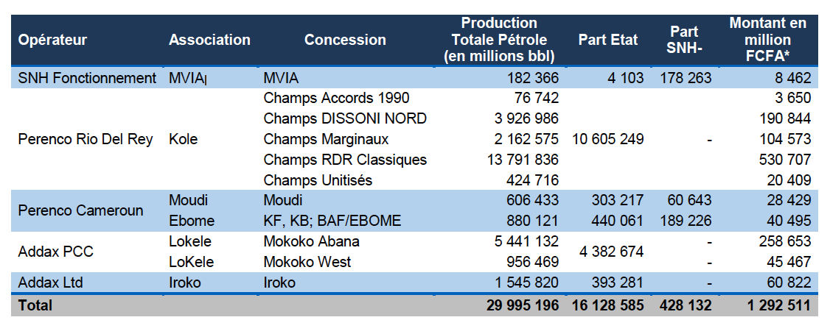
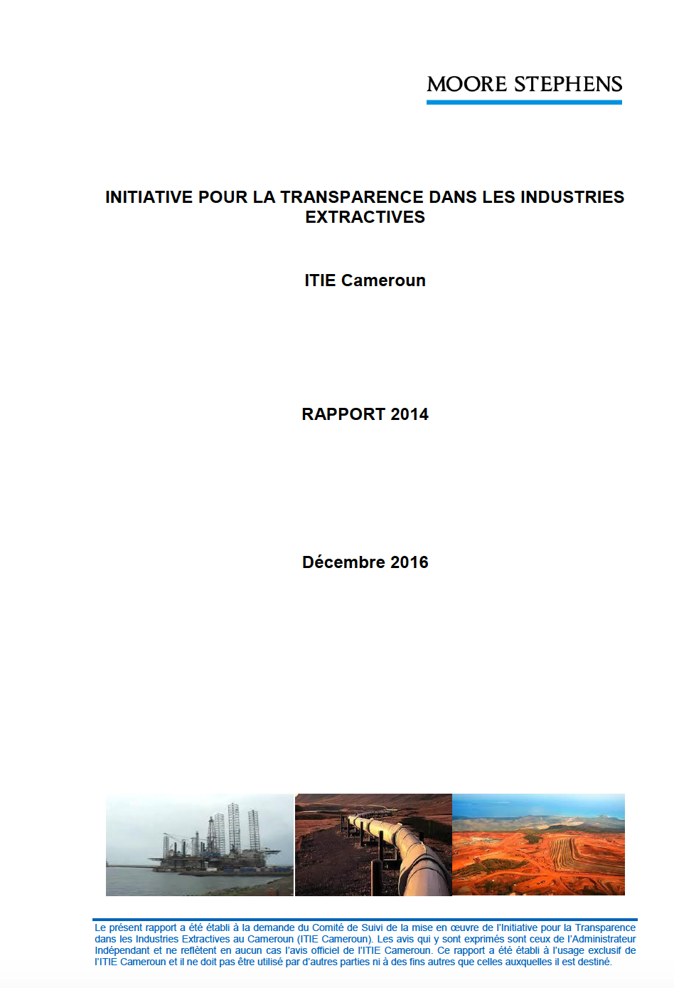
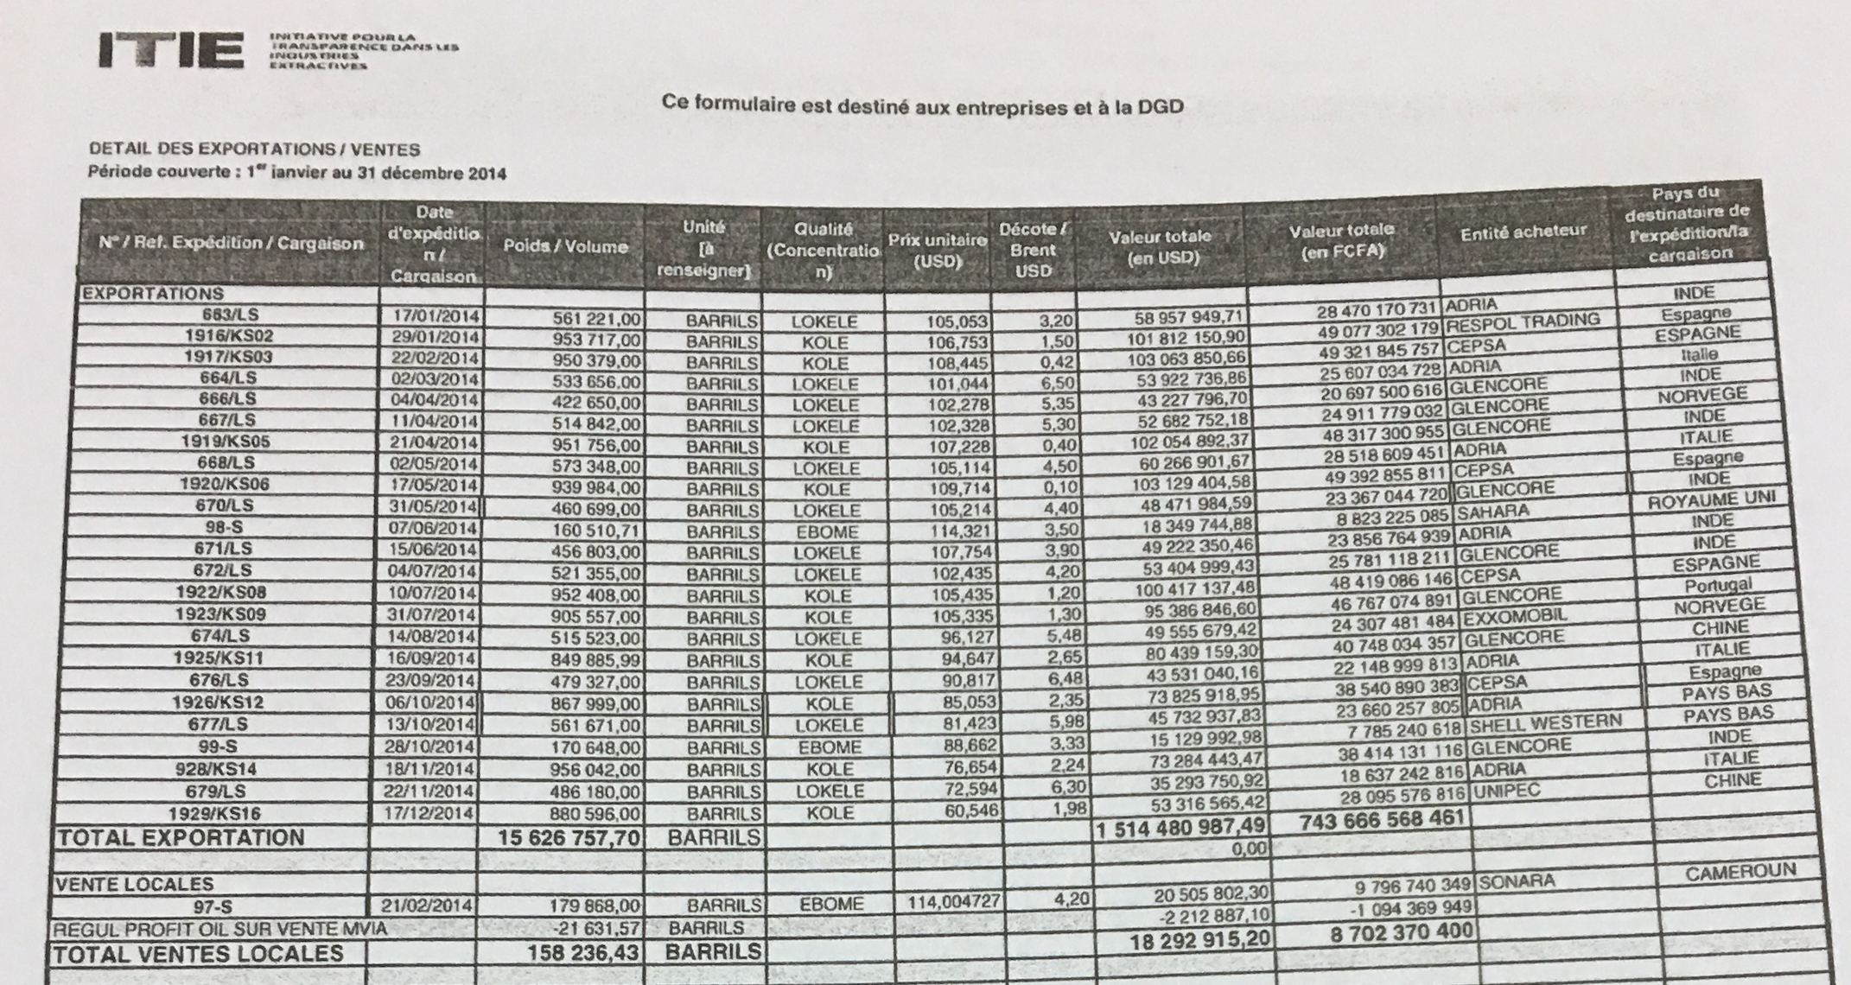
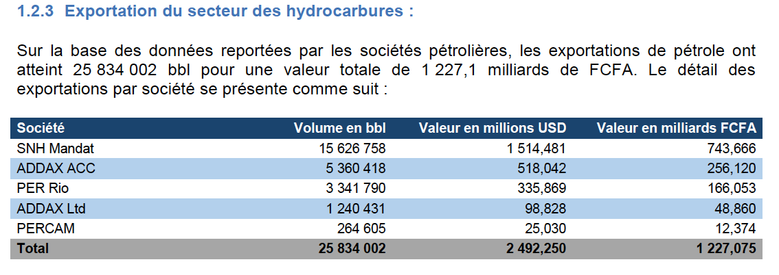
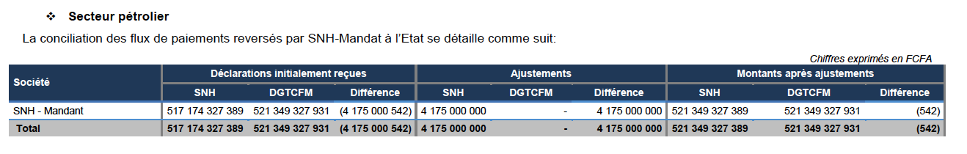
Crude oil sales in Cameroon: a simple oversight
The MSG realised and is preparing to publish the data before the EITI Board’s Validation Committee considers the case. SNH intends to join the EITI’s commodity trading pilot.
Cameroon’s 2014 EITI Report provided SNH’s oil sales in volumes collected and revenues received, but not disaggregated by buyer.

Slide 12




Improvements in the licensing regime in Nigeria linking to NNPC reforms
Validation highlighted the lack of public availability of official basic license data (for mining, oil and gas), despite its availability on 3rd party websites. It also encouraged the MSG to pilot BO reporting.
The MSG is considering ways of mainstreaming license data through existing government (DPR and Ministry of Mines) systems. The MSG has also started implementing its beneficial ownership roadmap (to 2020).

Slide 13
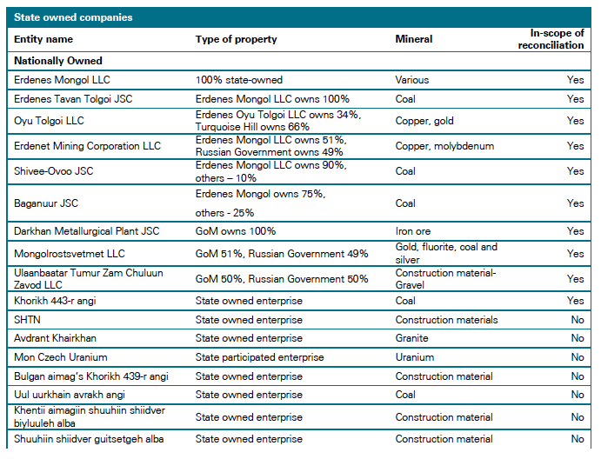
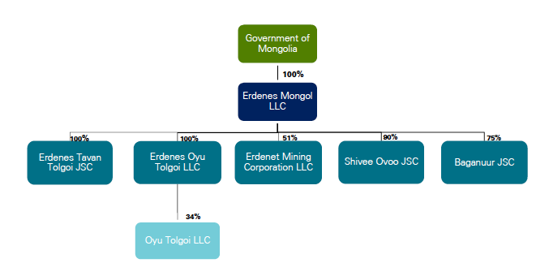

Clarifying SOEs’ financial relations with the government in Mongolia with support from the IMF
Validation highlighted the lack of clarity in the financial relations (in practice) between the 21 mining SOEs and the government (and any QFEs).
The MSG is working with the IA on its 2016 EITI Report (due in December 2017), liaising with relevant partners.

Slide 14


Reforms to public-sector audit standards in Albania, linked to possible European Union accession talks
Albania’s Validation (initial assessment) recommends the strengthening of data reliability standards for government EITI reporting, in line with reforms planned as part of Albania’s planned EU accession talks. It is recommended that Alb-EITI tracks the auditor general’s reforms as part of annual EITI reporting.

Slide 15
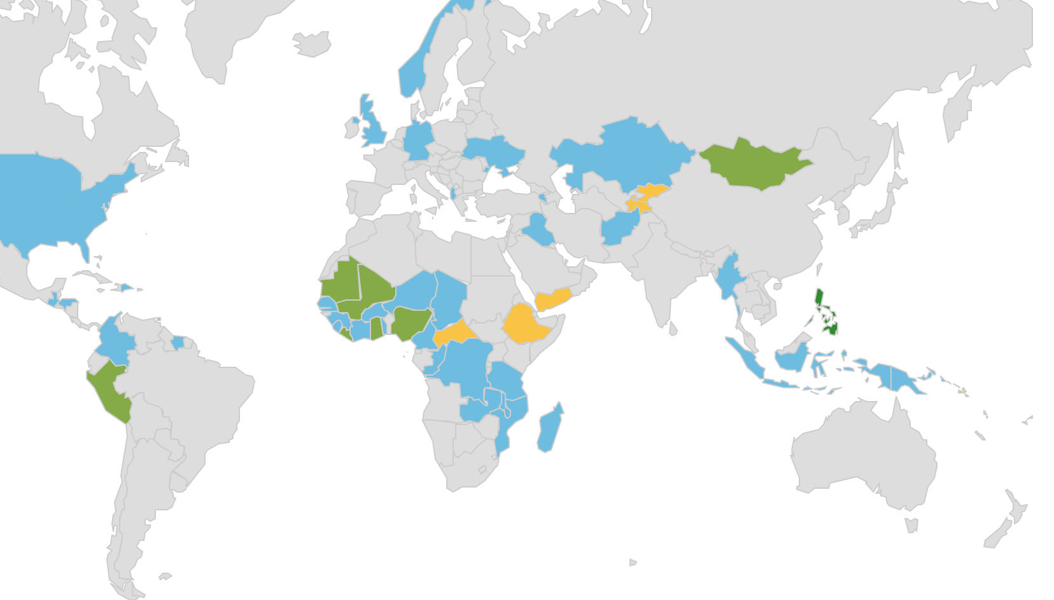
Several countries faced challenges in MSG governance at their first EITI Standard Validation
Many legacy MSGs
Often just a matter of codifying current selection practice.
Linking to industry priorities.
Opening up selection to all interested parties.
Clarifying MSG internal governance.

Slide 16
Case study: Mongolia EITI
Shar Tsolmon, National Coordinator, EITI Mongolia

Slide 17

Break-out groups
Group one
Group two
Group four
Group three
Design 4 concrete activities that could be used to follow up and address corrective actions from any of the Validations so far.
List 4 people each driving specific extractives or public finance reforms in your country.
List 4 priority areas you would like Validation to focus on, providing an independent diagnostic.
Make a list of 4 concrete MSG activities to follow up on what 14 of the 16 Validations so far have struggled to make satisfactory progress on: assessing impact.

Slide 18
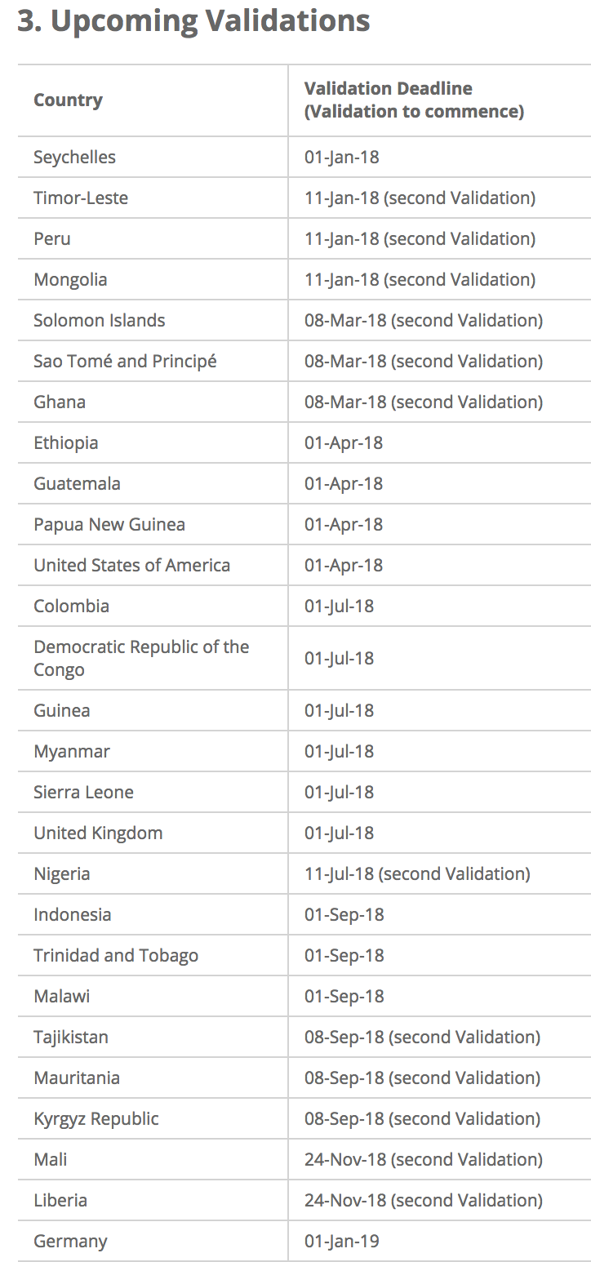
WRAP-UP
Validation is a process:
lessons learned on all sides.

Slide 19
Author: Alex Gordy
Date: 27 October 2017
Occasion: Session 6: 2016 EITI Standard – Validation procedures
Regional EITI training, Manila, the Philippines
Email: secretariat@eiti.org - Telephone: +47 22 20 08 00
Address: EITI International Secretariat, Skippergate 22, 0154 Oslo, Norway

