Slide 1
Modelling: a natural outgrowth of contract transparency
June 2018
johnny.west@openoil.net

Slide 2
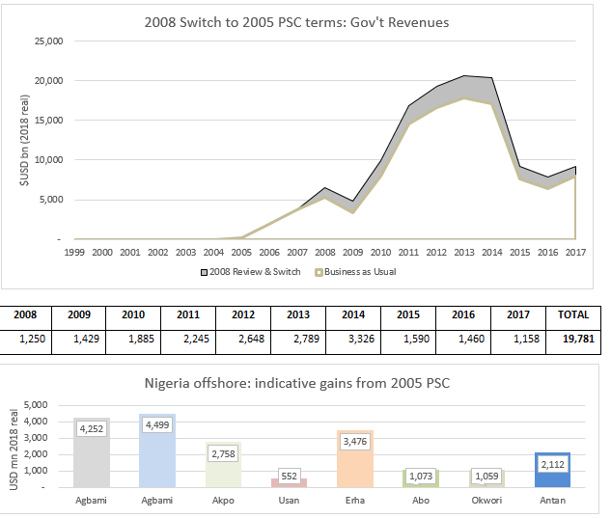
NEITI: 1993 PSC contract review

Slide 3
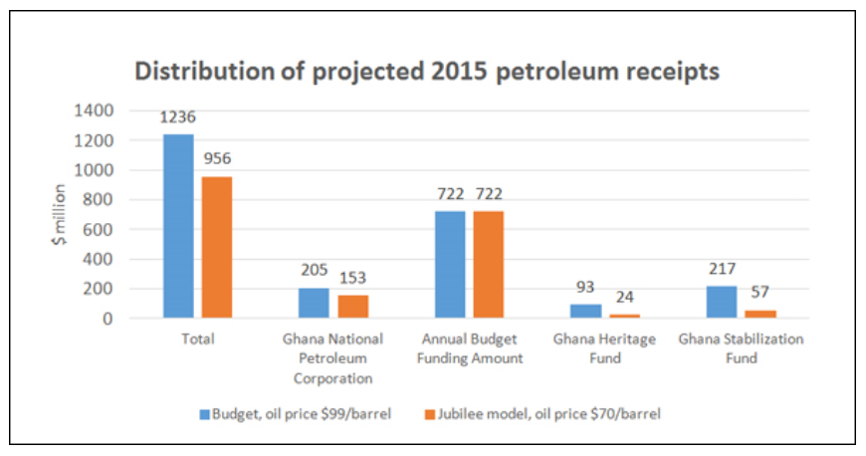
Ghana: Managing expectations

Slide 4
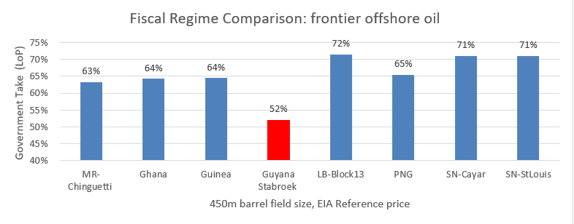
Guyana: Fiscal Regime Comparison

Slide 5
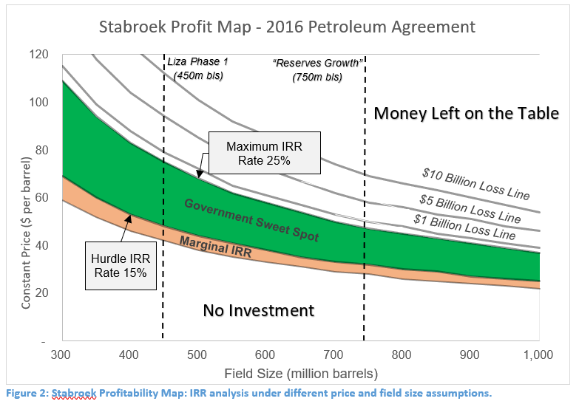
Guyana: the “profit map”
5
Notes:
5

Slide 6
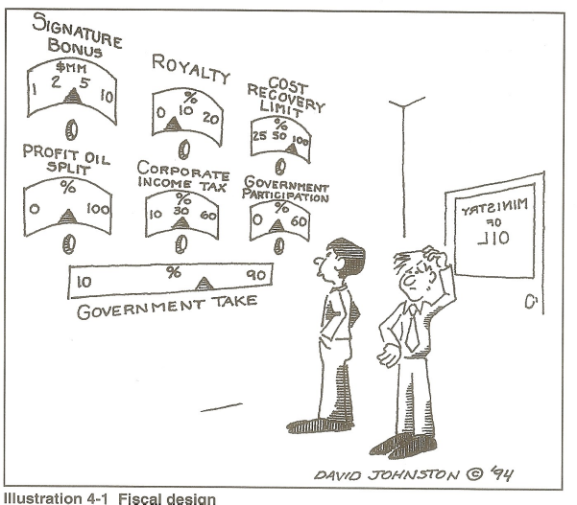
The usual health warnings…
6
Notes:
6

Slide 7
In EITI: next-level reconciliation
Move from: what has been paid to what should have been paid
The litmus of public interest financial modelling: is the model itself published?
EITI countries with projects modelled:
Afghanistan, Ghana, Tanzania, (Guyana), Kyrgyzstan, Colombia, Mongolia, Cote d’Ivoire, Indonesia, Malawi, (Nigeria), (Philippines)
Other EITI MSGs engaged:
Zambia, Senegal, Albania, Trinidad & Tobago
Other countries with financial models published or coming:
Lebanon, Kenya, Argentina, Brazil, Ireland
EITI convening power: standardisation can massively accelerate institutional capacity
7
Notes:
7

