Slide 1
Contract transparency in LAC
Where are we?
Ecuador and Guyana: reminders of the importance of contract transparency

Slide 2
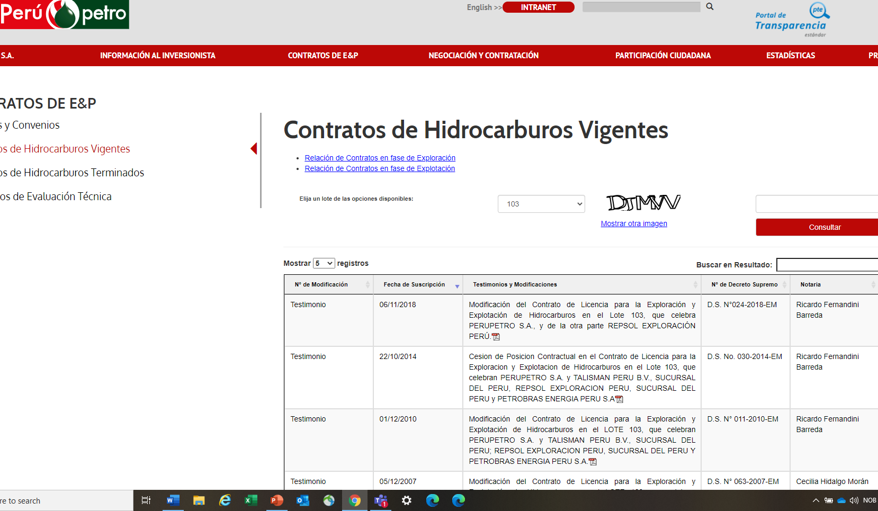
Where are we?
Oil and gas Good practices (Mexico’s CNH pre-contract –licensing- Contracts Monitoring) Regulator’s website (ANH, Perupetro) publishes contracts Model contracts (Suriname) Still…. Redacted clauses or un-published (confidential) contracts | Mining Generally, standardized But important parts regulating the operations and taxation are in operational plans or other amendments not always public. Old contracts: some are public some are not Licensing (pre-contract) could be made more transparent /user friendly in some countries
Law of access to information/Freedom of information: useful tool

Slide 3
Ecuador-China (loan/oil agreements)
2009 Ecuador’s dire financial situation -> loans with China Dev. Banks to be paid with oil exports.
Confidentiality of contracts.
Significant part (60-80%?) of oil exports were tied under these agreements.
Opacity -> questioned (2013’s Comptroller General concluded that there were important lost revenues).
Going forward…
EITI-Ecuador is an opportunity to have a one-stop shop to publish relevant information -> clear understanding.
Build trust: not to repeat past mistakes.
https://financialpost.com/investing/how-china-took-control-of-ecuadors-oil-2
https://periodismodeinvestigacion.com/wp-content/uploads/2020/07/PresentacionProyectoFinaciamiento.pdf

Slide 4
Guyana: Liza and Payara blocks
Discoveries in 2015 anticipated promising oil production and fiscal boom.
Guyana-Exxon M (Liza field) contract published following public opinion demand in 2018.
Scrutiny has been intense with contrasting views.
New contracts (Payara field ) signed recently and made public.
Going forward…
GYEITI could build further trust by using its platform for serving as resource center, host debates and informed analysis.
GYEITI and EITI International Secretariat collaborating on commodity trading transparency

Slide 5
In 2021
Full disclosure of new contracts
Educate/capacitation
Accessible/user friendly publication
Better understanding -> Informed analysis

