Slide 1
Implementation Deep Dive:
Achievements and Challenges of EITI Implementation in the DRC
EITI 40th Board meeting
Berlin, June 2018
Notes:
Explain objective and methodology of the stocktake:
At the end of 2017, the IS undertook a stocktake of commodity trading reporting
The objective of this commodity trading stocktake was to map the progress of CT disclosures in EITI countries and opportunities for improving transparency.
We included two types of countries in the scope: 1. the countries that are part of the targeted efforts and that have produced reports with commodity trading data (Albania, Ghana, Nigeria, Indonesia, Chad); and 2. countries that have undertaken validations and where the validations have found issues related to commodity trading (Cote D’Ivoire, Cameroon, Republic of Congo, Norway, Kazakhstan, Mongolia, Mozambique, Iraq, Tajiksitan). Altogether, the stocktake covered 14 countries.
2. Explain presentation - the presentation will highlight the key findings from the stocktake – three areas where we have seen progress and three areas where there is still room for improvement.

Slide 2
In summary
EITI has contributed in increasing transparency, improving government systems, which in turn may have contributed in increasing government revenues
EITI has contributed in creating a robust and lively public debate, which in turn may have contributed in changing expectations, social norms and sometimes behaviours.
Notes:
but major challenges remains to build resilient institutions and government revenues are still well below its poten
Creating a culture of transparency and accountability will require more work.

Slide 3
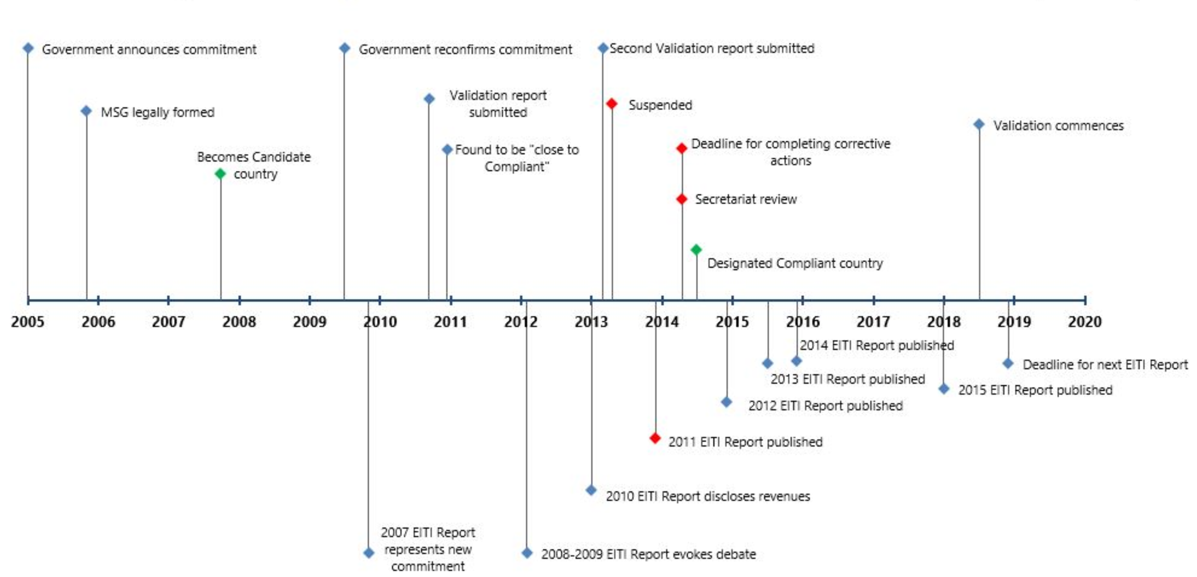
Implementation Timeline
Notes:
A decade of implementation has established the EITI as a space for dialogue between key stakeholders. High-level government representation in the MSG makes the EITI an effective participative governance mechanism, whereby resolutions agreed by state and non-state actors become effectively government policy. The following Ministers participate regularly in MSG meetings: Mr Modeste Bahati Lukwebo, Minister of Planning and Chair of the MSG, Mr Martin Kabwelulu Minister of Mine, Vice Chair of the MSG, Mr Aimé Ngoy Mukena, Minister of Hydrocarbon, Mr Henri Yav Mulang, Minister of Finance, and Mr Amy Ambatobe Nyongolo, Minister of Environment. High-level officials from the President office, the office of the Prime Minister and members of parliament also take part in MSG deliberations. Companies representatives include the world’s largest producer of cobalt, Tenke Funkurume, and the leading oil producer in the country PERENCO. Civil society on the MSG are supported by various coalitions (PWYP) and international civil society (Carter Center, Cordaid, Global Witness, NRGI, Oxfam, etc).
Validation is due to commence in July 2018, in a difficult context
the political environment has become increasingly volatile. Demonstrations both in the capital and in resource-rich regions have been increasing since President Kabila refused to step down at the end of his mandate in December 2016. According to the electoral commission, the presidential elections are scheduled for 23 December 2018. The Government of Belgium suspended its cooperation with the Government of the DRC in January 2018, and the Government of the DRC retaliated by closing the “Schengen house”, which is the consular office of 18 EU member countries and Norway.
All EITI Requirements are relevant in the DRC

Slide 4
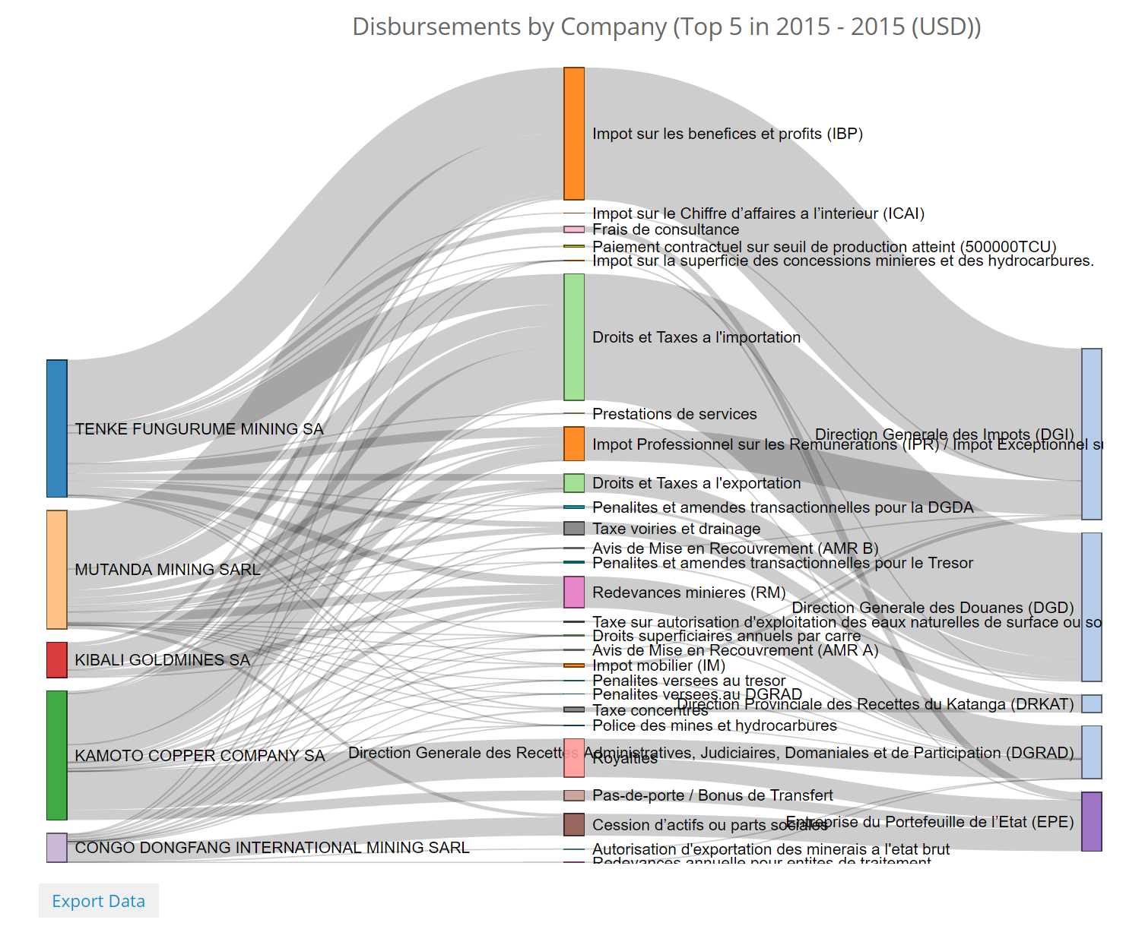
2.1 Clarifying a fragmented fiscal regime
Notes:
This interactive graphic summarises the problem that we want to address in the DRC.
There are 53 different revenue streams being collected by more than 15 different government agencies.
Each revenue streams requires a bureaucracy and enforcement mechanism
A highly complex and inefficient fiscal regime requires significant technical capacities to monitor and enforce.
This also shows the magnitude of the challenge and the work being done by EITI DRC to help address this.

Slide 5
2.1 Ongoing reforms
Government reforms in recent years have focused on updating the mining and hydrocarbon codes to increase government revenues.
The new mining code, increases taxes on profits from 30% to 35%; doubles the government's stake in new mining projects from 5% to 10% and; increases royalties from 2% to 3.5% for copper and cobalt, which could be designated strategic minerals.
Notes:
The new mining code introduces significant reforms, but it also add increase uncertainties
It is unclear whether “stabilisation clauses” are cancelled or not.

Slide 6
2.1 Ongoing reforms
The new hydrocarbon code introduces a minimum capital gains tax of 35% and a minimum stake for the Congolese state of 20% in all projects.
Both legislations introduce important reforms, including transparency provisions.
Notes:
The new hydrocarbon code introduces significant reforms, but it also add increase uncertainties
by providing discretion to government officials negotiating contracts.

Slide 7
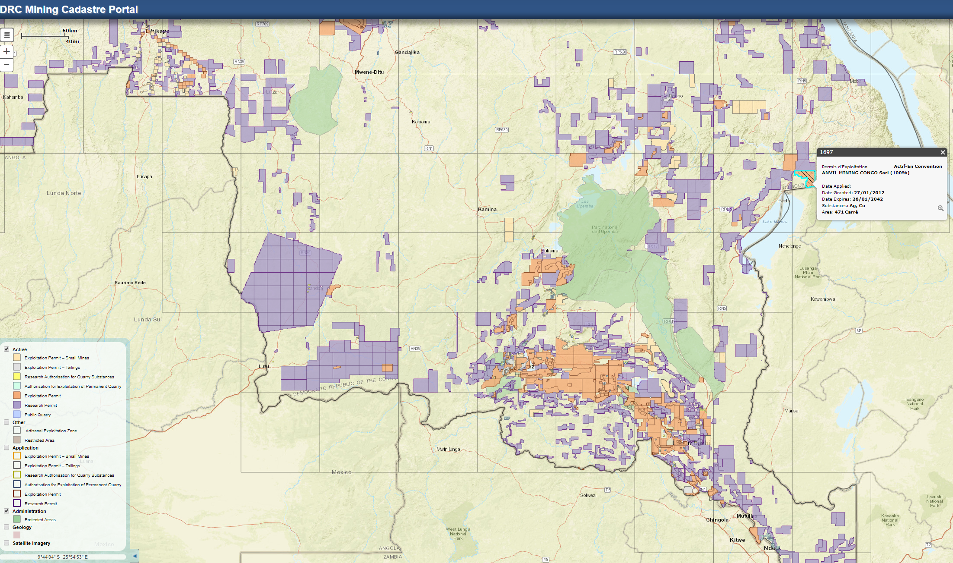
2.3 a functioning licence register is accessible online
Source: http://portals.flexicadastre.com/drc/en/
https://app.mapx.org/
Notes:
In June 2013, DRC did not have a complete list of companies operating in the country.
This interactive map of valid licences was last updated in March 2018
The EITI has played a key role in improving the license register,
There is now a relatively update online cadastre for the mining sector, but not for the hydrocarbon sector.

Slide 8
An annual review of the cadastre points out inconsistencies
Notes:
A robust system is a system that has routine check to identify weaknesses.

Slide 9
2.4 A clear government policy for contract transparency
All contracts must be published within 60 days following signature.
Notes:
This policy predates the EITI Requirement on contract transparency and the IMF deserves credit for these reforms.

Slide 10
Publication of 142 documents for over 100 contractual agreements
http://mines-rdc.cd/resourcecontracts/search
Notes:
Implementation of the government policy took time and EITI played a key role along with GIZ, DFID, Carter Center and NRGI.

Slide 11
Example of contracts: the Sicomine agreement
DRC
COLLABORATIVE PROJECT
Group/consortium of Chinese enterprises
(CREC group + SYNOHYDRO group + Zhejiang)
Gécamines Group
JOINT VENTURE
32%
68%
Sicomines JV
REPAYMENTS
~ USD 3.2 BILLION
~ USD 3 BILLION MAX.
Mining project
Infrastructure projects
Operating profits
Shares
Mining loans
Contracts
Source: Carter Center 2013
Infrastructure loans

Slide 12
EITI Reporting on infrastructure projects

Slide 13
BCPSC
Oversees the overall agreement, including financial circuits
DRC
Exim bank
COLLABORATIVE PROJECT
Gécamines Group
JOINT VENTURE
Group/consortium of Chinese enterprises
(CREC group + SYNOHYDRO group + Zhejiang)
32%
68%
Reporting Template F2
Reporting Templates F1
Sicomines JV
F3 when production begins (2015 -)
Mining project
Infrastructure projects
Operating profits
Shares
Mining loans
Contracts
Infrastructure loans

Slide 14
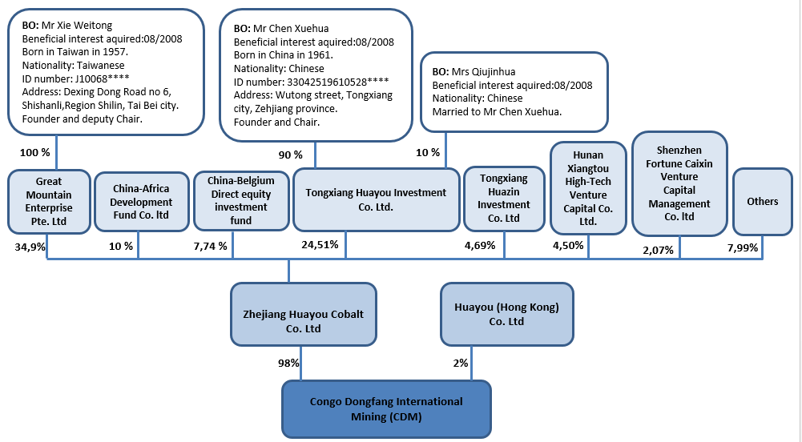
Progress on beneficial ownership disclosures has stalled

Slide 15
Significant challenges in SOE disclosures
Notes:
The Secretariat is supporting the EITI DRC in the preparation of thematic report specifically on SOE.

Slide 16
Significant achievements in production data disclosures

Slide 17
Significant progress in disclosure of export data

Slide 18
Government revenues increased five folds from 2009 to 2014
Notes:
A detailed and fastidious reconciliation process that varify all significant payments. We cannot claim causality but we can clearly identify correlation between EITI reporting and increase in government revenues.

Slide 19
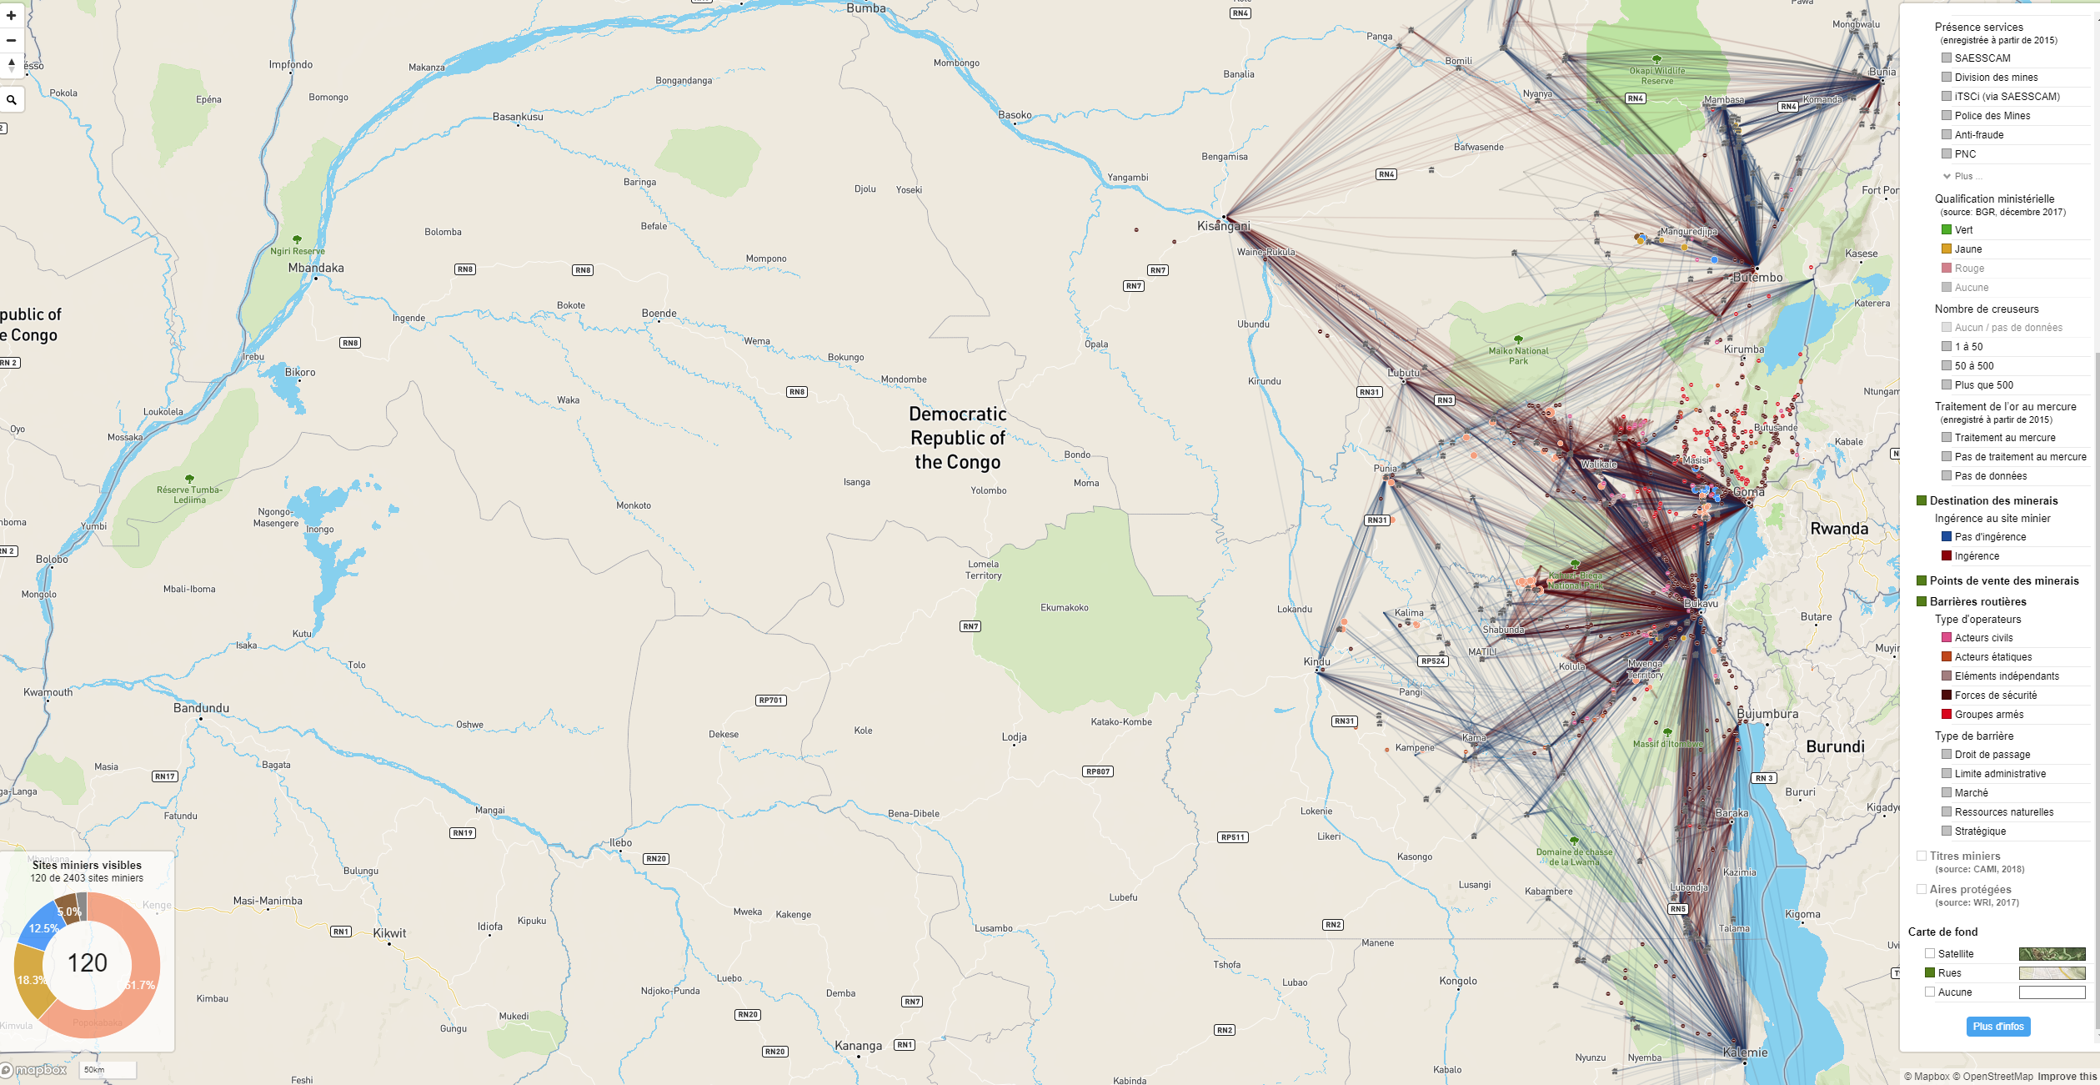
Small-scale and artisanal mining directly contribute to the livelihoods of more than two million people
Source: IPIS 2017 http://www.ipisresearch.be/mapping/webmapping/drcongo/v5/#-1.9537251704184229/23.935316496157384/6.783750245802602/2/1,6,2,3/1.14.17,5.e4,6.s,7.n
Notes:
Small-scale and artisanal mining directly contribute to the livelihoods of more than two million artisanal miners, but presents formidable challenges in mineral traceability and increases the reputational risk for sourcing minerals from the DRC.

Slide 20
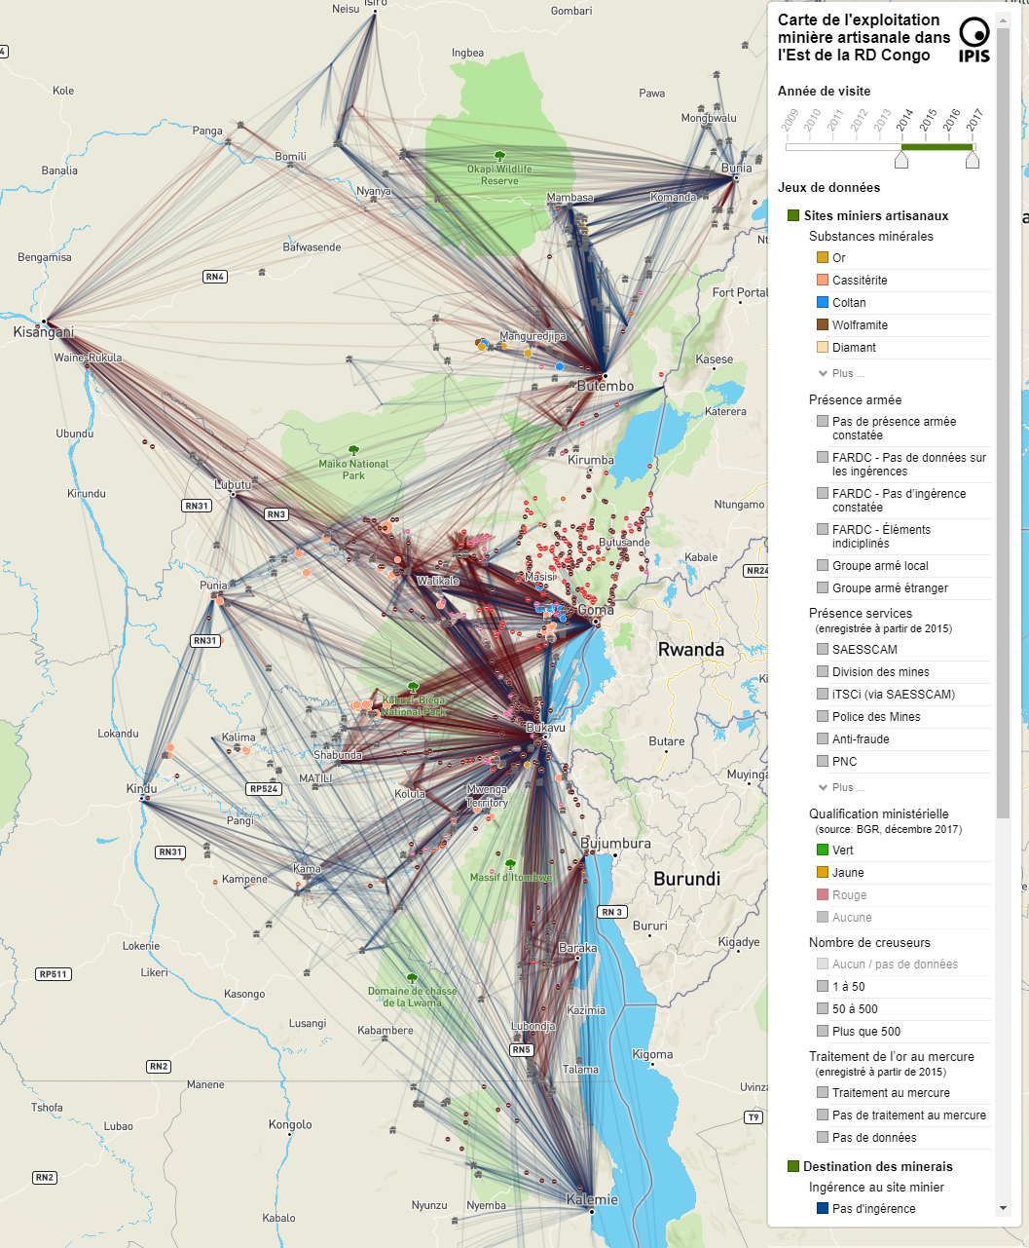
Interactive network mapping of ASM supply Chain
Source: IPIS 2017
Notes:
Could this be template for mineral traceability for cobalt?

Slide 21
Notes:
Examples of use of EITI data

Slide 22
EITI Contributes in creating a robust and lively public debate
Notes:
GIZ has done extensive work in using the data to promote public debate.

Slide 23
GIZ has supported extensive dissemination campaigns targeting students and journalists in particular
Source: GIZ 2017

Slide 24
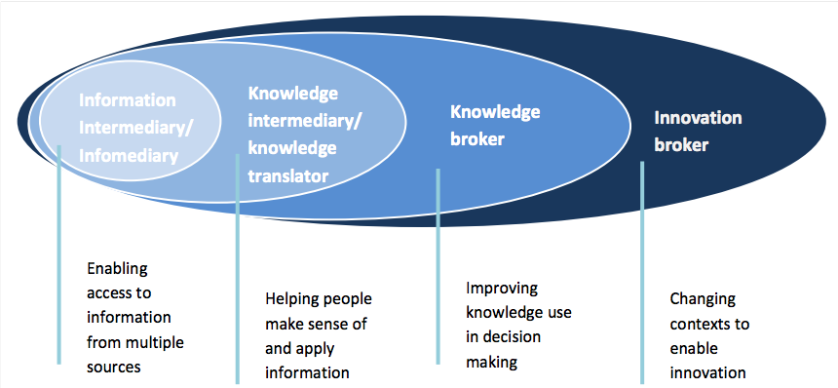
A targeted approach to the dissemination campaign
Source: Dr Don Hubert - Resources for Development.

Slide 25
In summary
Major challenges remains to build resilient institutions and government revenues are still well below its potential.
Creating a culture of transparency and accountability will require much more work.
There are significant internal governance challenges within the EITI process itself.
We need to provide extensive support to build their capacities for routine disclosure and use of data.

