Slide 1
EITI in Lebanon – An introduction
EITI Webinar 20 February 2017

Slide 2
The EITI is a global standard for transparency and good governance of the extractive sector.

Slide 3
One Standard
51 member countries
51 reasons to implement the EITI

Slide 4
Five core aspects
Effective oversight by the multi-stakeholder group.
Publish information within the EITI’s deadlines.
Country must have a credible process, to ensure that EITI data is reliable.
EITI disclosures have to be easy to understand, available to the public, and contribute to public debate.
Multi-stakeholder group must act on lessons learned and regularly review the impact of EITI implementation.

Slide 5
Effective oversight by MSG - why?
Government
Improving tax collection
Preventing corruption
Attracting quality investments
Gaining citizens’ trust
Citizens
Information enables demanding accountability
Ensuring citizens see benefits from natural resources
Companies
Showing they pay taxes
Creating a level playing field
Gaining citizens’ and communities’ trust

Slide 6
Effective oversight by MSG - how?
The government is required to commit to work with civil society and companies, and establish a multi-stakeholder group to oversee the implementation of the EITI (Requirement 1.4.a). Among other things…
Open and transparent invitation
Adequate representation. Note: this does not mean that they need to be equally represented numerically!
Consider establishing the legal basis of the group.

Slide 7
Credible and timely information
Revenue collection and reconciliation – only part of the story.

Slide 8
Credible and timely information

Slide 9
Credible and timely information

Slide 10
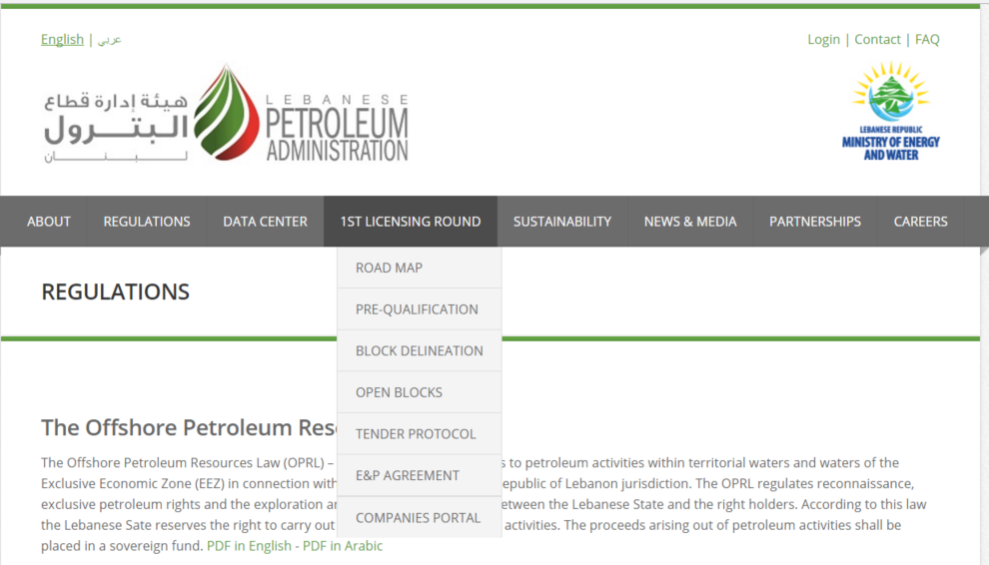
Credible and timely information

Slide 11
Credible and timely information

Slide 12
Easy to understand – contribute to public debate

Slide 13
Recommendations and acting on lessons learned

Slide 14
Ok, So now what?
The government is required to issue an unequivocal public statement of its intention to implement the EITI. The statement must be made by the head of state or government, or an appropriately delegated government representative (Requirement 1.1.a).
The government is required to appoint a senior individual to lead the implementation of the EITI (Requirement 1.1.b).
The government is required to commit to work with civil society and companies, and establish a multi-stakeholder group to oversee the implementation of the EITI (Requirement 1.4.a).
The multi-stakeholder group is required to maintain a current work plan, fully costed and aligned with the reporting and Validation deadlines established by the EITI Board (Requirement 1.5).

Slide 15
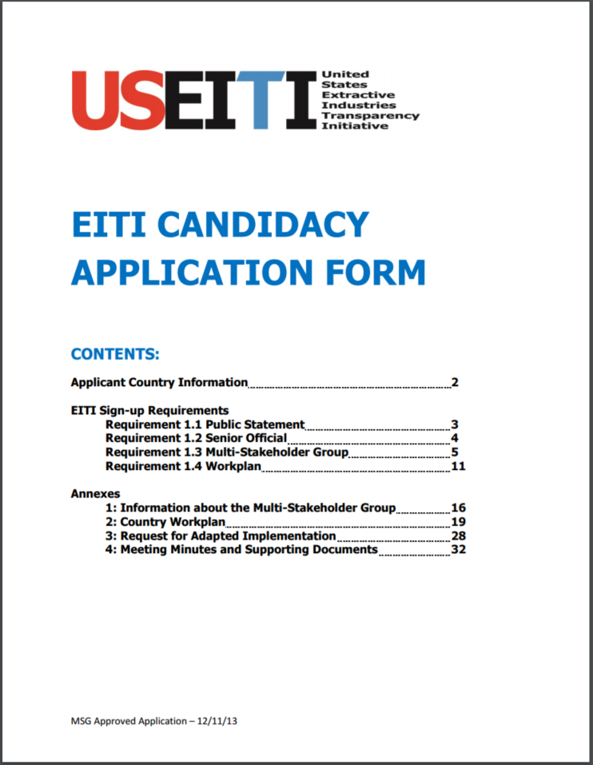
Candidature – keep in mind
Lebanese situation is special
Very early in the process
High potential for “mainstreaming”
=> Opportunities!

Slide 16
Author: Pablo Valverde
Date: 20 February 2017
Occasion: EITI webinar
Email: secretariat@eiti.org - Telephone: +47 22 20 08 00
Address: EITI International Secretariat, Ruseløkkveien 26, 0251 Oslo, Norway

