Slide 1
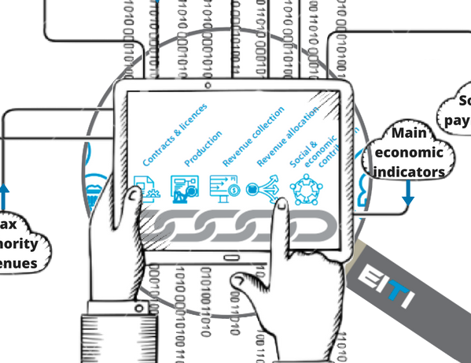
Mainstreaming Embedding EITI disclosures into government systems Pre-feasibility tool
Website video
8 November 2017

Slide 2
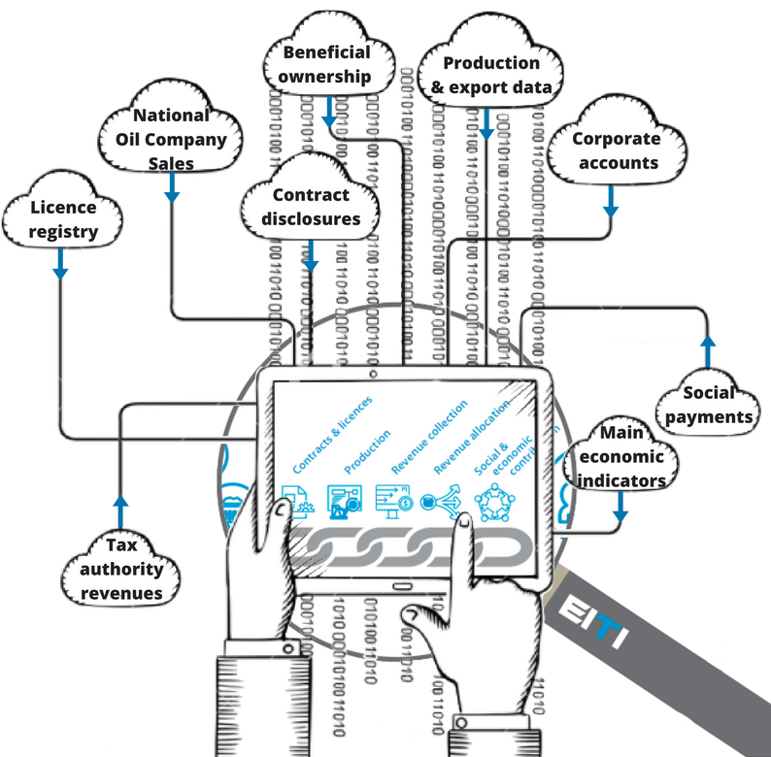
Mainstreaming
Notes:
Mainstreaming is …
1. Regular publication of EITI data by government and corporate entities
2. With transparent quality assurance of the information
3. Adhering to EITI Requirements

Slide 3
EITI Standard and Mainstreaming
Under EITI Requirement 4.9c, the multi-stakeholder group can avoid reconciliation by an independent administrator if…
there is routine disclosure of the data … and
the financial data is subject to credible, independent audit, applying international standards
Then he MSG may seek Board approval to mainstream EITI implementation

Slide 4
EITI Standard and Mainstreaming
Under EITI Requirement 4.9c, the multi-stakeholder group can avoid reconciliation by an independent administrator if…
there is routine disclosure of the data … and
the financial data is subject to credible, independent audit, applying international standards
Then he MSG may seek Board approval to mainstream EITI implementation

Slide 5
EITI Standard and Mainstreaming
• Broad definition of “EITI Report”:
“The data [required by the EITI] can be disclosed in the form of an EITI Report,
or constitute publicly available information and data gathered or cross-referenced as part of the EITI process”);

Slide 6
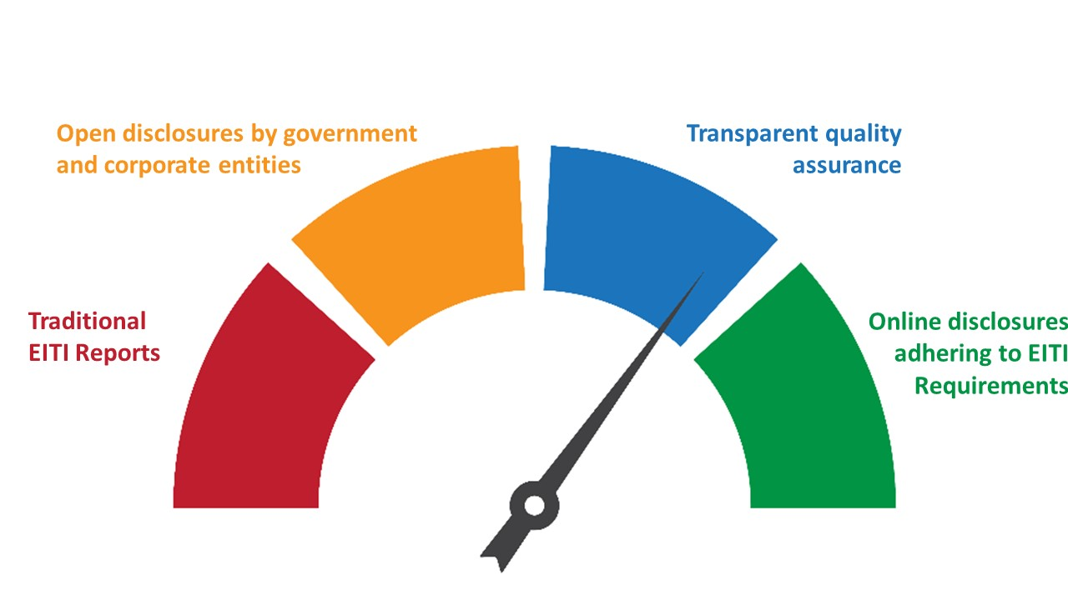
What is mainstreaming?
Notes:
Mainstreaming is …
1. Regular publication of EITI data by government and corporate entities in open formats
2. With transparent quality assurance of the information
3. Adhering to EITI Requirements

Slide 7
Mainstreaming mapping
Objective: Explore opportunities for mainstreaming
Instructions:
Based on EITI Requirements, assess whether disclosures are already made public, outside the EITI process.
Are the disclosures compliant to the EITI Standard?
What is missing to comply with the EITI Standard?

Slide 8
Mainstreaming mapping exercise

Slide 9
Mainstreaming mapping exercise
For each EITI Requirement:

Slide 10
Mainstreaming mapping exercise
For each EITI Requirement:
List what is required to be disclosed

Slide 11
Mainstreaming mapping exercise
For each EITI Requirement:
List what is required to be disclosed (comments in cells list the requirement)

Slide 12
Mainstreaming mapping exercise
For each EITI Requirement:
List what is required to be disclosed
+ What is disclosed and by whom

Slide 13
Mainstreaming mapping exercise
For each EITI Requirement:
List what is required to be disclosed
+ What is disclosed and by whom
+ Distinguish between government and companies

Slide 14
Mainstreaming mapping exercise
For each EITI Requirement:
List what is required to be disclosed
+ What is disclosed and by whom
+ Distinguish between government and companies
+ Is it comprehensive and detailed enough?

Slide 15
Mainstreaming mapping exercise
For each EITI Requirement:
List what is required to be disclosed
+ What is disclosed and by whom
+ Distinguish between government and companies
+ Is it comprehensive and detailed enough?
+ Is the information reliable? Is it quality assured?

Slide 16
Mainstreaming mapping exercise
For each EITI Requirement:
List what is required to be disclosed
+ What is disclosed and by whom
+ Distinguish between government and companies
+ Is it comprehensive and detailed enough?
+ Is the information reliable? Is it quality assured?
+ How quickly and often is it disclosed / updated

Slide 17
Mainstreaming mapping exercise
For each EITI Requirement:
List what is required to be disclosed
+ What is disclosed and by whom
+ Distinguish between government and companies
+ Is it comprehensive and detailed enough?
+ Is the information reliable? Is it quality assured?
+ How quickly and often is it disclosed / updated
+ Provide direct links to sources

Slide 18
Mainstreaming mapping exercise
For each EITI Requirement:
List what is required to be disclosed
+ What is disclosed and by whom
+ Distinguish between government and companies
+ Is it comprehensive and detailed enough?
+ Is the information reliable? Is it quality assured?
+ How quickly and often is it disclosed / updated
+ Provide direct links to sources
= Assessment: what deviates from EITI Standard?

Slide 19
Mainstreaming mapping exercise
For each EITI Requirement:
List what is required to be disclosed
+ What is disclosed and by whom
+ Distinguish between government and companies
+ Is it comprehensive and detailed enough?
+ Is the information reliable? Is it quality assured?
+ How quickly and often is it disclosed / updated
+ Provide direct links to sources
= Assessment: what deviates from EITI Standard?
Ask the International Secretariat if you have questions and/or need examples

Slide 20
Thank you!
www.eiti.org
@EITIorg
Author: EITI International Secretariat
Date: 8 November 2017
Occasion: Website video
Email: secretariat@eiti.org - Telephone: +47 22 20 08 00
Address: EITI International Secretariat, Skippergata 22, 0154 Oslo, Norway

