Slide 1
Beneficial ownership: Data collection and publication, timeliness

Slide 2
Consider data collection procedures
The requirement to disclose beneficial ownership is applicable to companies beyond those typically covered in the EITI Report.
It extends to all license holders (regardless of type of license), all companies that bid for a license, and all companies that invest in extractive projects.
EITI Report is only one tool to collect information.
Consider embedding BO disclosure requirements in license allocation procedures, and in company incorporation requirements.
Make use of EITI model BO declaration form: http://eiti.org/files/Template%20beneficial%20ownership%20declaration%20form.doc.
Need for cross-ministerial consultation to identify companies and most appropriate methods of collecting BO data from companies.

Slide 3
Beneficial ownership data collection: short term
“As of 1 January 2020, it is required that implementing countries request, and companies disclose, beneficial ownership information for inclusion in the EITI report…” (#2.5.c).
→ In the short term, BO data can be collected through the EITI reporting mechanism, e.g. by the Independent Administrator or online EITI reporting tools, using the EITI BO declaration form: http://eiti.org/files/Template%20beneficial%20ownership%20declaration%20form.doc
→MSGs are strongly encouraged to start piloting BO disclosures in their next EITI Report.

Slide 4
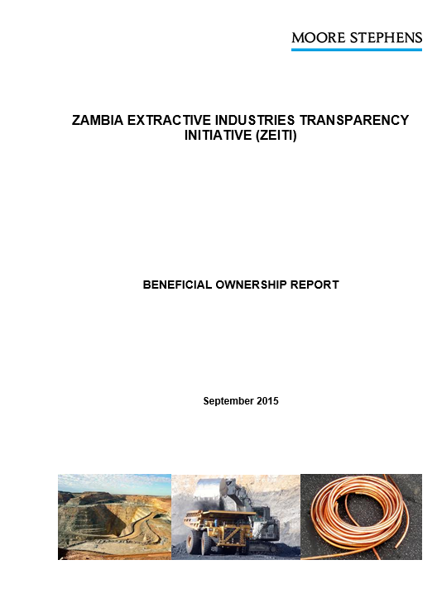
Beneficial ownership data collection: short term

Slide 5
Beneficial ownership data collection: medium term
“Where possible, beneficial ownership information should be incorporated in existing filings by companies to corporate regulators, stock exchanges or agencies regulating extractive industry licensing…” (#2.5.c).
“It is recommended that implementing countries maintain a publicly available register of the beneficial owners…”(#2.5.a).
→ MSGs are strongly encouraged to consider opportunities for mainstreaming BO disclosures and build a national beneficial ownership register.

Slide 6
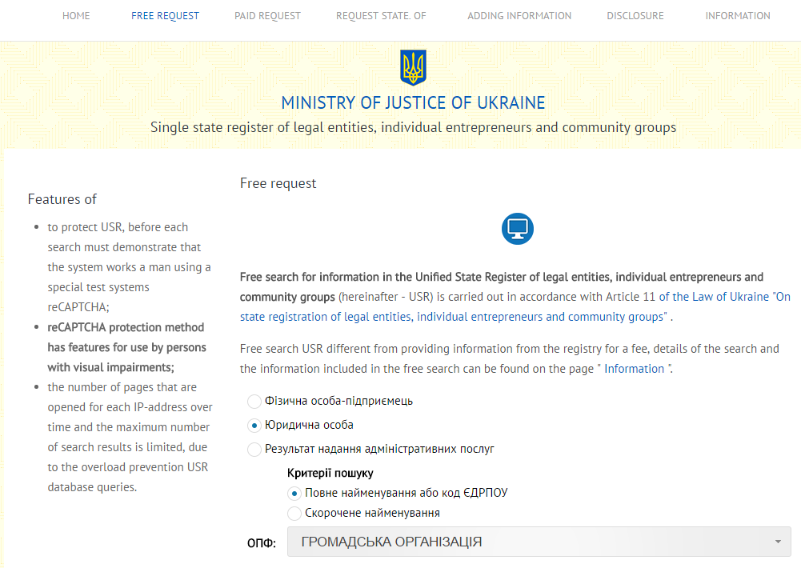
Beneficial ownership data collection: medium term

Slide 7
Elements of a roadmap and Examples
Elements | Examples of Activities | Suggested improvements on MEITI’s draft
Data collection and data accessibility | Determination of reporting companies Agreement on how to collect data (e.g.drafting a BO declaration form) Agreement on how to publish information (e.g.EITI Report, existing registers, creation of BO register, ensuring open data format) | Include activities to identify companies that will participate, Include activities to determine efficient and sustainable data collection approach, Include activity to develop a BO declaration form, Include activities to identify how to publish information to make it more accessible, e.g. BO register, use of open data formats

Slide 8
Examples from other countries
Philippines:
● Coordinate with Securities and Exchange Commission to make information on BO publicly available and free of charge
● Develop reporting templates for BO disclosure
● Pilot test BO templates (2 – 3 companies and relevant government agencies)
● Finalize the templates
● Develop online reporting system for BO (based on the approved templates, streamlined with existing EITI online reporting systems)
● Pilot test and roll-out the online system

Slide 9
Examples from other countries
Nigeria:
Activities:
• Consult stakeholders on the information to be included in the beneficial owner declaration
• Have an automated service by 1st January 2020 for the collection of data.
• Mainstreaming of BO data
• Collect beneficial ownership information through physical visits by the IA to the stakeholders (companies and relevant government agencies)
• Consult relevant stakeholders on the most efficient and sustainable data collection approach
• Adopt baseline reporting format for beneficial ownership data

Slide 10
Data timeliness
The EITI Standard states that (#4.8) “Implementing countries must disclose data no older than the second to last complete accounting period”.
Issues for consideration:
Ownership may change several times during a financial year.
When should beneficial ownership data be collected?
Should beneficial ownership data be collected at a specific point in time, e.g. at the time of data collection for the EITI Report? As of 31 March each year? As part of other reporting obligations?
Should data collection happen annually ?
Should companies be obliged to continuously disclose any changes in beneficial ownership ?
Notes:
Important to undertake consultation on the most appropriate time to collect BO data, especially as ownership may change frequently
Particularly important if collecting BO data through the EITI Report, as the report is not necessarily produced annually, nor does data collection happen at the same time every year, nor does it cover all companies affected by the scope of the BO requirement.
One approach may be to ensure that companies file their BO as of a certain date annually, and that they then provide updates on a continuous basis.

Slide 11
Roadmap recommendation 8: Consider data timeliness
Mutanda Mining (MUMI) ownership as of 31 Dec 2012
Mutanda Mining (MUMI) ownership as of 31 Dec 2013

Slide 12
Elements of a roadmap and Examples
Elements | Examples of Activities | Suggested improvements on MEITI’s draft
Data timeliness | Agreement on when to collect data and how to reflect changes over time | Should include activities aimed at agreeing on when to collect data and how to reflect changes in ownership over time

Slide 13
Example from other countries
PNG:
MSG to agree the frequency in which beneficial ownership information is collected i.e. fixed internal or trigger events or a combination of either. The PNGEITI will consider how pragmatic it is to frequently collect data noting the fluidity of ownership change with listed organisations
The MSG will consider existing laws on regularity of reporting procedures for companies

