Slide 1
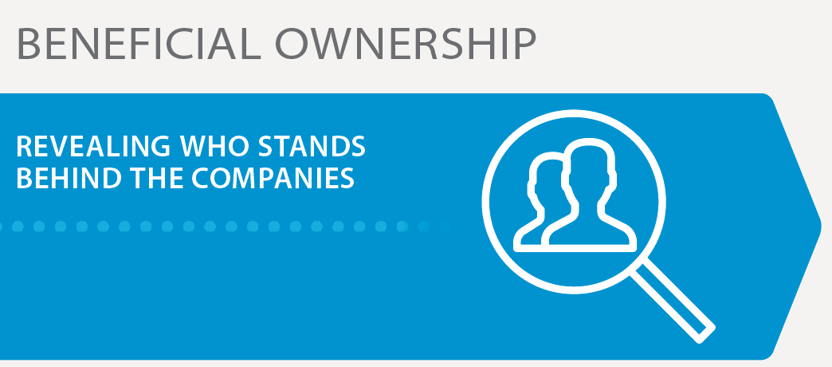
Beneficial ownership

Slide 2
Who is a beneficial owner?
“A beneficial owner in respect of a company means the natural person(s) who directly or indirectly ultimately owns or controls the corporate entity”
Notes:
A beneficial owner is always the living, breathing human being who ultimately profits from the company’s activities, or controls the company's activities. It is never a company, other legal entity, or a nominee/proxy.

Slide 3
Why is beneficial ownership transparency important?
Source: International Consortium of Investigative Journalists https://panamapapers.investigativecenters.org/#stories

Slide 4
Source: International Consortium of Investigative Journalists https://panamapapers.investigativecenters.org/#stories
Notes:
The story:
In November 2006, Touré was granted the power of attorney to Matinda Partners and Co. Ltd, a British Virgin Islands company. That same year, she began a relationship with a mining company that U.S. authorities alleged had paid her $5.3 million to help it win a disputed mining concession from her husband, then-President Lansana Conté, shortly before he died in late 2008. Investigators said Matinda was a conduit for much of the money paid to Touré. Touré has admitted to receiving bribes in order to influence her husband. She used a stand-in shareholder, Beneficence Foundation, and a Swiss company as the foundation’s manager, which reduced public connections between Matinda and Touré.

Slide 5
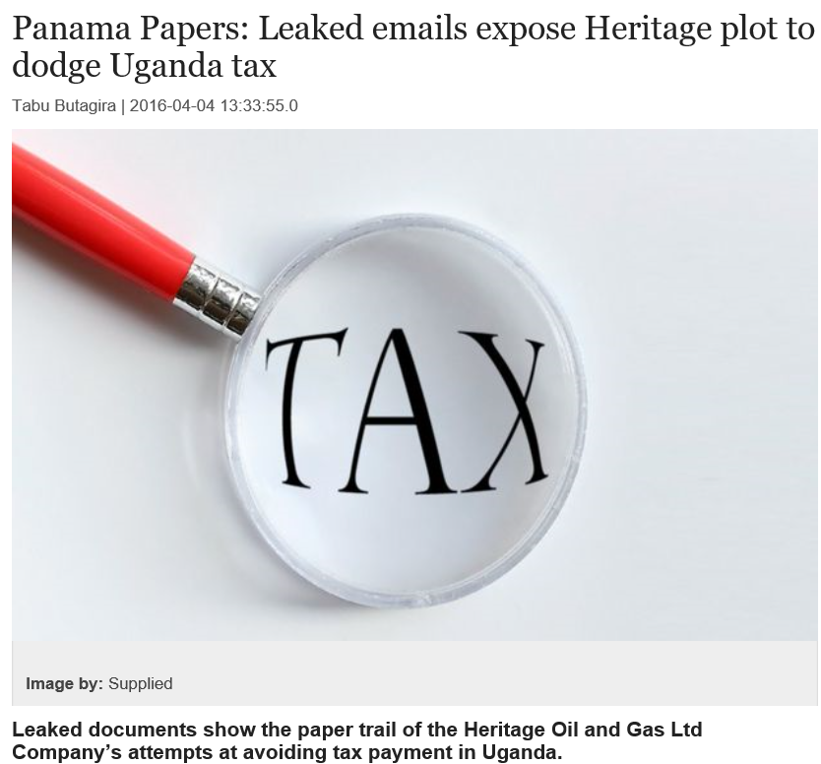
Source: International Consortium of Investigative Journalists https://panamapapers.investigativecenters.org/uganda/
Notes:
The story:
In 2010, Heritage Oil and Gas sold its 50% stake in its Uganda oil fields to Tullow. The Uganda Revenue Authority demanded a US$404 million capital gains tax on the transaction.
Heritage learnt about the imminent tax liability weeks before it was officially imposed, and decided to move the business and assets to a tax haven to avoid paying the tax. Heritage chose Mauritius because Mauritius has a double-taxation agreement, which enables only of the two countries where a company earns an income to collect tax. Mauritius’ tax regime was much more beneficial to Heritage.
Uganda eventually managed to get the dues from Tullow, who had yet to pay Heritage for the asset and who deducted the capital gains tax payment from its payment to Heritage.

Slide 6
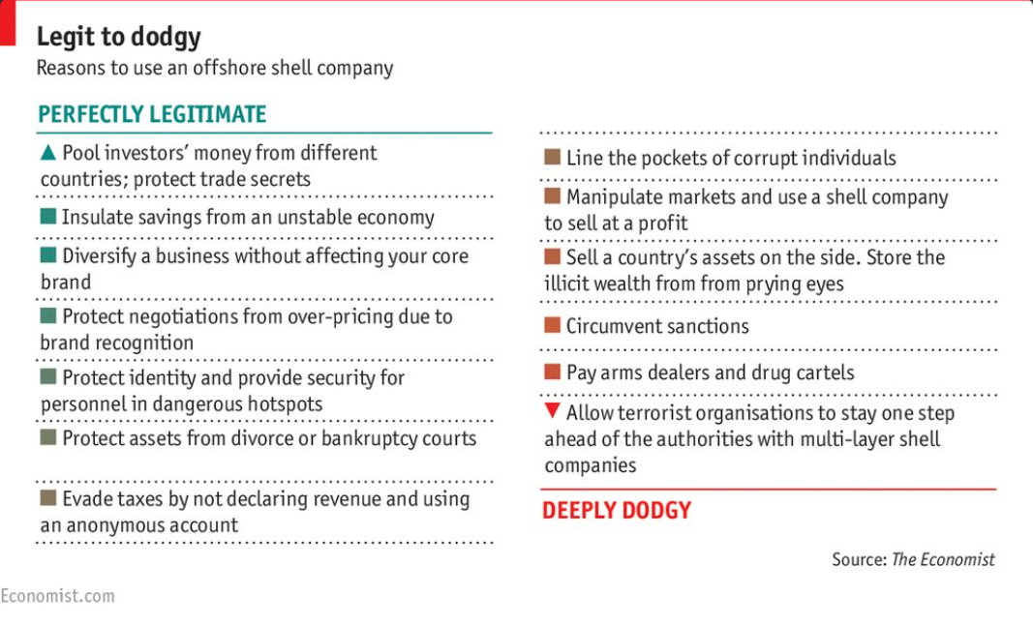
Notes:
Key messages:
There are legitimate reasons for a company to be registered offshore or to have a complex ownership structure. Disclosure of beneficial ownership is NOT necessarily about disclosing wrongdoing.
BUT in many cases secret ownership is used to hide corruption, i.e. extractive deals that have come about due to influence of and relationships to politicians or senior officials. It is also used to dodge taxes, i.e. by enabling extractive companies to declare profits in jurisdictions with less taxes than where the profit was made.
3. Disclosure of beneficial ownership can help identify and prevent such practices.

Slide 7
Benefits of beneficial ownership transparency
“Beneficial ownership information enables Nigerians to expose corruption and nepotism in the acquisition process. Besides asking companies to voluntarily disclose information on their ownership structure, including any politically exposed persons, going forward NEITI has also put into effect a mechanism that would enable it to capture ownership of divested wells, license holders, lease holders and companies bidding for extractive industry contracts. In short, beneficial ownership in the extractives sector in Nigeria begins to scratch where it itches. ”
Nigeria EITI Secretariat
Improve investment climate
Reduce reputational and other risks
Prevent corruption and illicit financial flows
Improve rule of law
Increase trust and accountability
Enhance revenue collection
Notes:
Key messages:
All stakeholders can benefit from openness in beneficial ownership.
Companies: improved investment climate (know who they are doing business with), investors have confidence in who they are investing in. Reduces reputational, financial and legal risks associated with dealing with dodgy assets, or PEPs.
Government: Attract more and better investment, reduce reputation of corruption, help ensure that companies pay the taxes they ought to pay by contributing to prevent tax evasion and tax avoidance, and ensuring that the country gets the money it ought to get for its extractive assets. Can enable tax authorities and other government bodies to crack down on illegal practices.
Civil society: Fight corruption and illicit financial flows, improved accountability of government and companies, less suspicion.

Slide 8
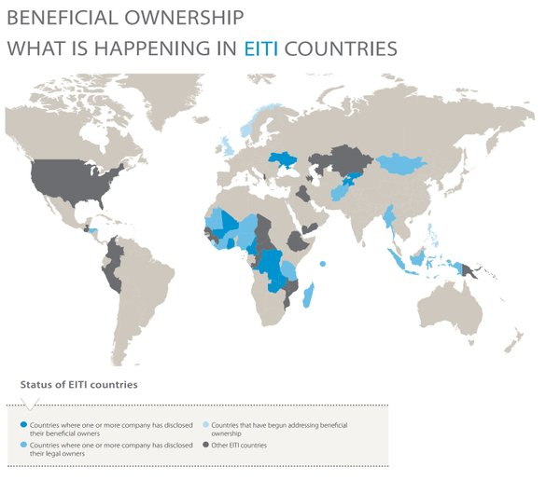
EITI and beneficial ownership
May 2013: EITI Standard recommends establishment of beneficial ownership register.
October 2013: 11 EITI countries sign up to EITI’s beneficial ownership pilot.
January 2016: 29 EITI countries are working on beneficial ownership; 9 countries have EITI Reports that disclose the beneficial owners of one or more companies.
February 2016: EITI requires that countries must disclose their beneficial owners no later than 1 January 2020.
Notes:
Explain the evolution of BO discussions within the EITI:
2013 Standard recommended BO disclosure. The Board considered that further experience and learning was needed before BO disclosure could become a requirement.
Oct 2013: 11 countries volunteered to take part in a two year BO pilot, attempting to disclose BO.
Oct 2015: Pilot ended, concluding that BO was now firmly on national agenda in numerous EITI countries. Obtaining reliable and comprehensive BO data had proved challenging, due to lack of capacity and understanding, and confusion around the concept of BO. Still, the pilot resulted in a number of valuable lessons learnt and experiences that should hopefully ensure more successful BO disclosures in the future.
February 2016: EITI Global Conference in Lima introducing new beneficial ownership requirements.

Slide 9
What the EITI Standard says
Summary of EITI Requirement 2.5:
EITI Reports must document the government’s policy and MSG’s discussion on disclosure of beneficial ownership (#2.5.b.i).
By 1 January 2017, the multi-stakeholder group must publish a roadmap for disclosing beneficial ownership information (#2.5.b.ii).
By 1 January 2020, it is required that implementing countries request, and companies disclose, beneficial ownership information for inclusion in the EITI report or a public register (#2.5.c-f).
The EITI Report should also disclose the legal owners and share of ownership (#2.5.g).
Notes:
Key messages:
The new provisions give countries some time to prepare and gain experience with beneficial ownership disclosure.
Countries are encouraged to start including such disclosures in their EITI Reports immediately, to build awareness and experience prior to that it becomes a requirement in 2020.
(Roadmap requirements in detail:
Plans and activities for how the government will ensure that the “corporate entity(ies) that bid for, operate or invest in extractive assets” disclose the “identity(ies) of their beneficial owner(s), the level of ownership and details about how ownership or control is exerted”. (Requirement 2.5.c).
Actions needed to ensure that the “information about the identity of the beneficial owner includes the name of the beneficial owner, the nationality, and the country of residence, as well as identifying any politically exposed persons”. (Requirement 2.5.d).
The steps that the multi-stakeholder group will take to consider and “agree an approach for participating companies assuring the accuracy of the beneficial ownership information they provide”. (Requirement 2.5.e).
Any actions needed to inform the multi-stakeholder group’s discussion and decisions on a beneficial ownership definition, thresholds, joint venture disclosures, and reporting obligations for politically exposed persons. (Requirement 2.5.f).
Milestones and deadlines for implementing the roadmap activities, as well as plans for evaluation implementation of the roadmap as part of the annual activity report. (Requirement 2.5.b.ii).)

Slide 10
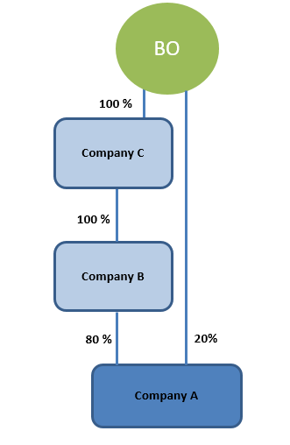
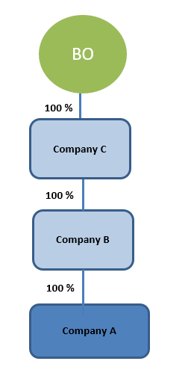
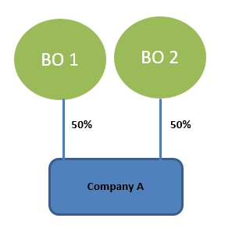
Ownership can be direct or indirect:
Example 1: Direct
Example 2: Indirect
Example 3: Direct and indirect
Notes:
1: 50% direct ownership.
2: 100% indirect ownership.
3: 20% direct ownership, 80% indirect ownership.
Also applies to ownership and control through other means than shares/voting rights.

Slide 11
Other ways of identifying beneficial ownership
Who exercises control by making decisions for the company?
Who ultimately profits from the companies’ operations?
Who has voting rights?

Slide 12
What should you disclose?
The EITI Standard (# 2.5.c) states that the beneficial ownership disclosures “…should include the identity(ies) of their beneficial owner(s)…”.
And “the level of ownership, and details about how ownership or control is exerted”.
Notes:
BO data is most useful when it has sufficient detail enabling to ascertain who the BO is. Simply disclosing a name might not be that helpful.
Privacy concerns have often been cited. Such concerns should be discussed and evaluated alongside potential benefits. There may be practical solutions, e.g. example of UK regarding residential address and full DOB.

Slide 13
What should you disclose?
“Information about the identity of the beneficial owner should include the name of the beneficial owner, the nationality, and the country of residence…” (# 2.5.d).
“It is also recommended that the national identity number, date of birth, residential or service address, and means of contact are disclosed” (# 2.5.d).
Example: Zambia’s beneficial ownership report
Name
Nationality
Country of residence ?
Notes:
At a minimum, BO’s should disclose their name, nationality and country of residence. Zambia example discloses name and nationality. Although the ‘means of contacts’ field lists a Zambian address, this does not necessarily mean that the BO’s country of residence is Zambia.

Slide 14
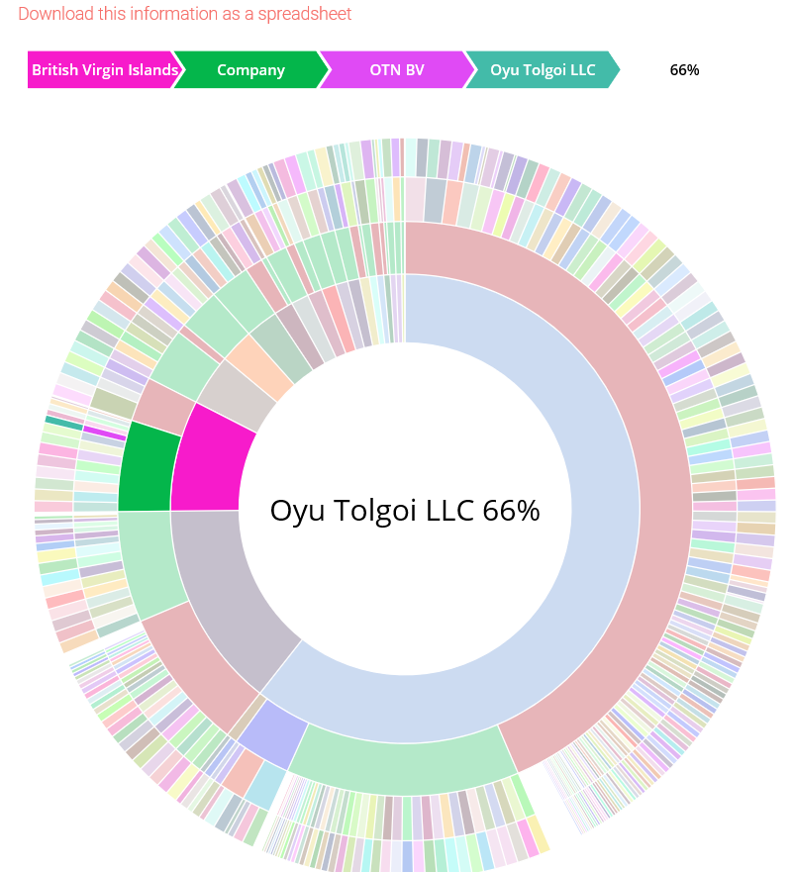
How should you disclose?
The EITI Standard states that “It is recommended that implementing countries maintain a publicly available register of the beneficial owners…”(#2.5.a).
It also requires the multi-stakeholder group to “make the EITI Report available in an open data format (xlsx or csv) online and publicise its availability” (# 7.1.c).
Notes:
http://www.eitimongolia.mn/en/beneficial-owners

Slide 15
How should you disclose?
MSGs should consider which government agency could potentially be the appropriate agency to maintain a beneficial ownership register.
MSGs should consider whether there are possibilities for integrating beneficial ownership data in existing corporate registers or license registers.
Establishing a register may take time. Other disclosure mechanisms, e.g. EITI Report, can be used in the meantime.

Slide 16
When should you disclose?
The EITI Standard requires full disclosure of beneficial owners by 2020
The MEITI agreed during its meeting on 15 March that it will incrementally disclose beneficial owners starting from its next EITI Report (March 2018)

