Slide 1
Vista general de la Validación EITI
Secretariado Internacional
Oslo, Norvegia
Februario 2017

Slide 3
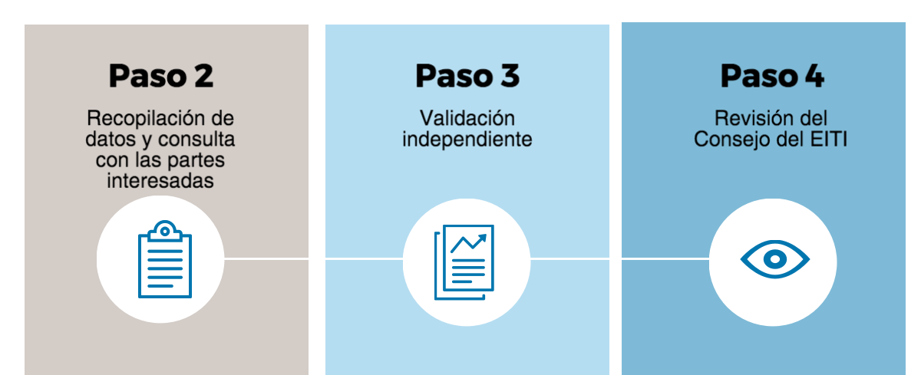

Slide 4
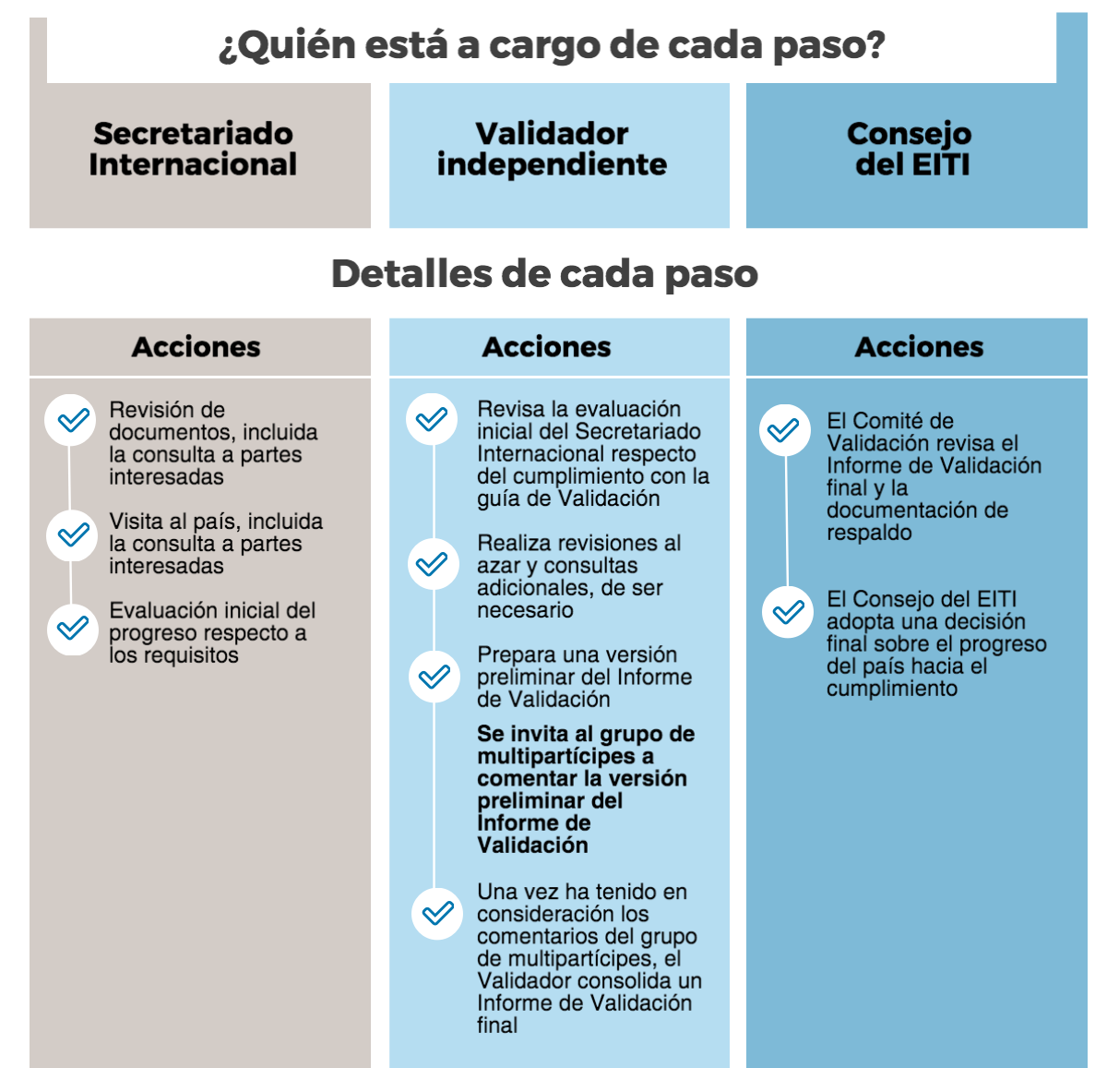

Slide 5
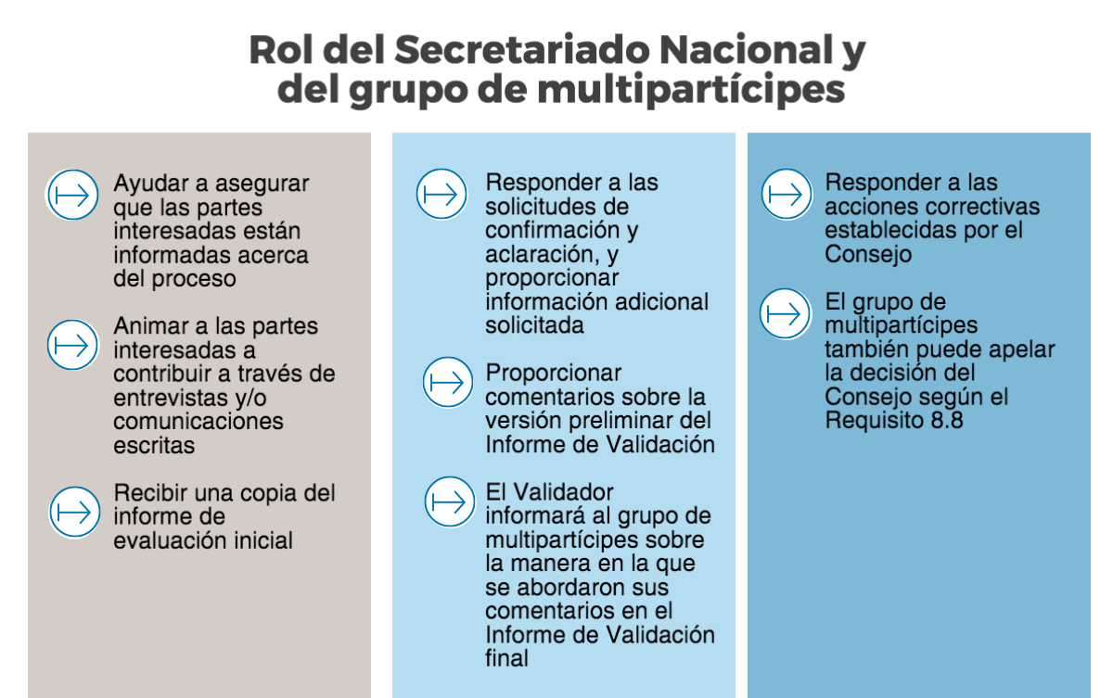

Slide 6
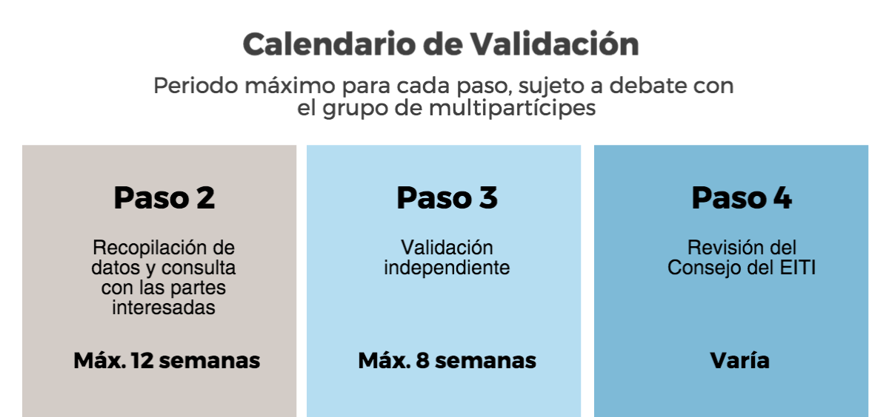

Slide 7
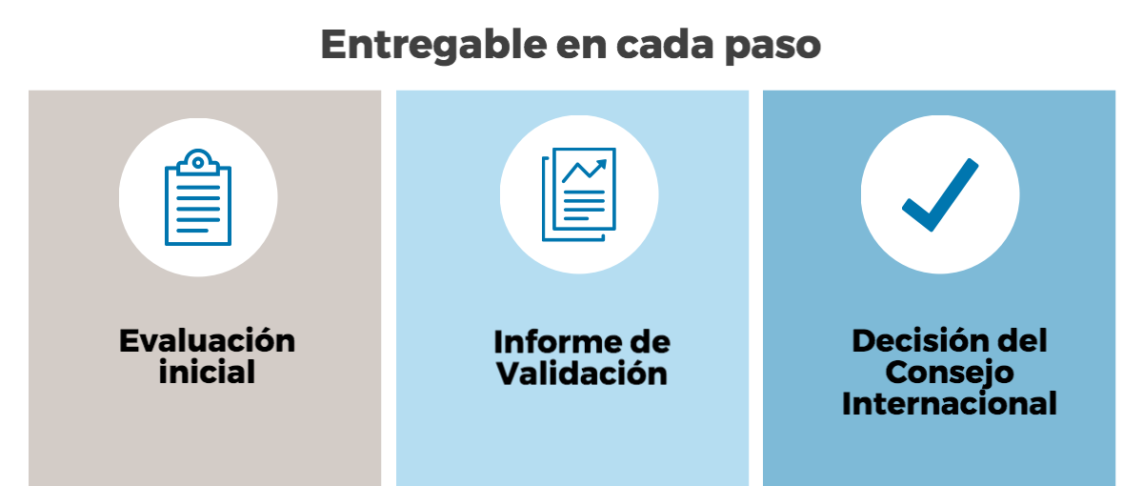

Slide 9
Link to infographic:
https://magic.piktochart.com/output/14849048-vista-general-de-la-validacion-eiti
View full infographic here:
https://magic.piktochart.com/output/20134172-eiti-validation-process-es-2017

Slide 10
Author: EITI Secretariat
Date: February 2017
Occasion: Validation process
Email: secretariat@eiti.org - Telephone: +47 22 20 08 00
Address: EITI International Secretariat, Ruseløkkveien 26, 0251 Oslo, Norway

