Slide 1
2019 Standard– changes and explanations Tuesday, 10 Sept. 2019 Webinar

Slide 2
Evolution of the EITI Standard
2003 EITI Principles
2005 EITI Criteria and Sourcebook (non-binding)
2008 EITI Validation Guide (binding requirements)
2011 EITI Rules and Validation Guide
2013 EITI Standard (global standard)
2016 EITI Standard (revisions)
2019 EITI Standard (revisions)

Slide 3
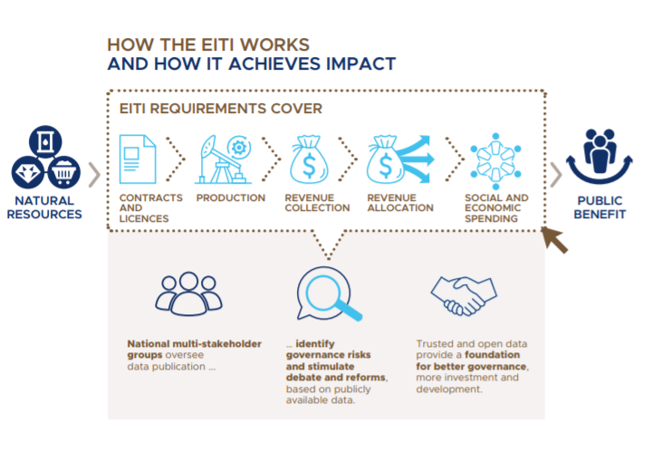
2019 EITI Standard

Slide 4
Why the changes?
Address feedback from stakeholders and clarify language
Reflect previous decisions by the Board
Reflect good practices in implementing countries
Reduce burden and introduce flexibility
Encourage disclosures where it counts and reflect national priorities

Slide 5
Process
2018-October :
Board decision to clarify EITI requirements
2018-January 2019:
Multi-stakeholder working group formation and work on drafts. (Four meetings).
2019-February:
Implementation Committee consideres the drafts and porposes consultations.
2019-February:
Consultations with implementing countires (seven regional meetings).
2019-March:
Implementation Committee proposes final draft to the Board.
2019-May:
Board approves the 2019 Standard.
2019-June:
Launch of the 2019 Standard at the Global Conference in Paris.

Slide 6
Overview of 2019 EITI Standard:
Type | Requirement | Total
Requirements | Gender (#1.4, #6.3), Contracts (#2.4), Commodity sales (# 4.2) and Environmental reporting (#6.1) | 4
Expectations | Company and SOE disclosures (#4.9, #2.6) and Contracts (#2.4) | 3
Encouragements | Licensing (#2.2), SOEs (#2.6), Production and exports (#3.2, #3.3), Commodity sales (# 4.2), Subnational transfers (#5.2), Environmental reporting (#6.4), Gender (#7.1, #7.4) and Recommendations (#7.3) | 10
Introduced flexibility | Reconciliation (#4.9) and Annual progress reporting (#7.4) | 2
Clarifications | Contracts (#2.4), Beneficial ownership (#2.5), SOEs (#2.6, #6.2), Project-level reporting (#4.7), Public debate and open data (#7.1, 7.2) | 7

Slide 7
Where to find the 2019 Standard and guides?
Guidance notes Will be updated
These Will be available progresively on our web page in the upcoming months.
Dates will be announced accordingly.

Slide 8
Terminology (1 of 3) - overview
Level of obligation | Terms used | Consequence (Validation)
Required | Must, should, required | Will be taken into account in the assesment of progress
Expected | Expected | The MSG should consider and document discussions on the issue (including barriers to disclosures). Will be verified during Validation.
Encouraged | Recommended, encouraged, may wish, could | MSG efforts in Validation Will be documented, but will not be taken into account in the assessment of progress.

Slide 9
Terminology (2 of 3) – text from the Standard
The use of the terms ‘must’, ‘should’ and ‘required’ in the EITI Standard indicates that something is mandatory and will be taken into account in the assessment of compliance with the EITI Standard.
The use of the term ‘expected’ in the EITI Standard indicates that the multi-stakeholder group should consider the issue and document their discussions, rationale for disclosure/non-disclosure and any barriers to disclosure. Validation will consider and document the discussions by the multi-stakeholder group.
The use of the terms ‘recommended’, ‘encouraged’, ‘may wish’ and ‘could’ in the EITI Standard indicates that something is optional. Efforts by the multi-stakeholder group will be documented in Validation but will not be taken into account in the overall assessment of compliance with the EITI Standard

Slide 10
Terminology (3 of 3) – “Mainstreaming”
The terms ‘systematic disclosure’ and ‘mainstreaming’ are used interchangeably. They refer to the desired end-state, where the EITI’s disclosure requirements are met through routine and publicly available company and government reporting. This could include public financial reporting, annual reports, information portals and other open data initiatives. Systematic disclosure is the expectation, with EITI Reports used to provide additional context, collate the sources where systematic disclosures can be found, and address any gaps and concerns about data quality. EITI disclosure requirements can be met by referencing publicly available information and/or data collected as part of EITI implementation.

Slide 11
How does it affect Validation?
The 2019 Standard came into effect on 17 June.
Countries that are currently working on EITI Reports and corrective actions from Validation can continue their work in the framework of the 2016 Standard.
"No disadvantage test“ on Validationts that cover reports published before 31 Decemeber 2019 (and any fiscal year previous to 2018).
Until 31 December 2019 implementing countries can adhere to the 2016 EITI Standard or if they prefer the 2019 EITI Standard.

Slide 12
Today we wont cover chapter 4: EITI Board oversight of EITI implementation
Article 1 – Adapted implementation
Article 2 – Disclosure deadlines
Article 3 – Initial Validation deadline
Article 4 – EITI Validation process
Article 5 – Safeguards
Article 6 – Outcome of Validations.
Article 7 – Extensions
Article 8 – Suspension
Article 9 – Delisting
Article 10 – Appeals

Slide 13
“Mainstreaming” ( “sistematic disclosure”)
Is NOT mainstreaming
= data disclosure
Mainstreaming is partial…
Mainstreaming 100%
ENLACES
Administrador
independiente
Administrador
independiente

Slide 14
Systematic disclosures: What has changed?
Requirements emphasise comprehensive and reliable disclosures by reporting entities rather than only focusing on EITI Reports (#4.1).
Companies expected to disclose annual financial statements (#4.1.e).
Opens up for MSGs to consider other data assurance procedures than reconciliation, pending Board approval (#4.9).
Further details: requirement 4.1 on comprehensive disclosures and 4.9 on data quality and assurance. Blog: https://eiti.org/es/node/9448

Slide 15
Project-level reporting: What has changed?
Includes the definition of project, in line with new practices:
A project is defined as operational activities that are governed by a single contract, license, lease, concession or similar legal agreement, and form the basis for payment liabilities with a government (#4.7).
Where a payment covered by the scope of EITI disclosures is levied at entity level rather than at project level, the company may disclose the payment at the entity level.
Further details: see requirement 4.7 about level of disaggregation.

Slide 16
Contract transparency: What has changed?
Implementing countries are required to disclose any contracts and licenses that are granted, entered into or amended from 1 January 2021 (#2.4.a).
The multi-stakeholder group is expected to agree and publish a plan for disclosing contracts with a clear time frame for implementation and addressing any barriers to comprehensive disclosure. This plan will be integrated into work plans covering 2020 onwards. (#2.4.b).
The EITI Reports should describe existing contracts (#2.1), as well as the government’s policy and real practices(#2.4.c).
Further details: see requirement 2.4 about contracts and 2.1 about legal framework and fiscal regime.

Slide 17
State-owned enterprise: What has changed?
The description of the relationship between the government and SOEs should also include joint ventures and subsidiaries. (#2.6.a.i)
The information on loans must disclose repayment schedule and interest rate (#2.6.a.ii).
SOEs are expected to publicly disclose their audited financial statements(#2.6.b)
Multi-stakeholder groups maay wish to take the IMF’s definition on quasi-fiscal expenditures(#6.2).
Further detailes: see requirements 2.6, 4.5 and 6.2.

Slide 18
Sale of the state’s share of production or other revenues collected in kind: What has changed?
Implementing countries, state-owned enterprises and third parties that sale on behalf of the state are covered (#4.2.a).
Volumes and values sold should be disaggregated by contract (instead of by buyer)
It is encouraged to disclose the process for selecting the buying companies and of the sales agreements(#4.2.b).
Companies buying are encouraged to disclose payments made for the purchase if oil, gas and/or mineral resources. (#4.2.c).
Further details: see requirement 4.2 about sales of the state’s share of production.

Slide 19
Gender: What has changed?
The multi-stakeholder groups are required to consider gender balance. (#1.4).
EITI Reports must include employment figures by project, role and gender when available (# 6.3).
MSGs should consider information access challenges by gender and sub-groups (# 7.1).
MSGs are encouraged to document efforts to improve gender equality and social inclusion (# 7.4).

Slide 20
Environmental reporting: What has changed?
Material environmental payments to governments should be disclosed (#6.1)
Disclosure of information related to environmental impact and monitoring in encouraged (#6.4)
Further details: see requierement 6.1 on social and environment expenditures and 6.4 envionment impact.

Slide 21
Annual progress reporting: What has changed?
MSGs can choose how to undertake their annual review the outcomes and impact of EITI implementation (#7.4).
Countries are no longer required to publish such reviews by 1 July.
Further details: see requirement 7.4 on reviewing impact and outcomes of EITI implementation.

Slide 22
Other encouraged provisions
Licensing (#2.2) - Selection of license procedures and requirements for revoking or cancelling licenses.
Production and exports (#3.2, #3.3) - Disclosure by company or project.
Data timeliness (#4.8) - More timely disclosures.
Subnational transfers (#5.2) - Allocation and expenditure.
Follow-up on EITI findings (#7.3) - Recommendations for reform.
For further detail see each requirement.

Slide 23
Minor refinements and clarifications
Clearer distinction between public debate and data accessibility/open data (#7.1 and #7.2).
Section on ‘Terminology’ also explains systematic disclosures
Countries are not suspended for achieving less than satisfactory progress on Requirements 1.1-1.3.
Separate section on EITI Board oversight of implementation (previous Requirement 8 on ‘Compliance and deadlines’).
For further detail see each requirement.

Slide 24
Thank you!
Questions?

